Slide 1

Show me the data…
About careers in statistics!
Jessica Utts
Professor, Department of Statistics
University of California, Irvine
2016 President, American Statistical Association
Notes:
1

Slide 3
Statistics offers tremendous
opportunity for graduates.
Most in-demand skill in 2014, according
to LinkedIn.
Among the fastest-growing jobs.
The McKinsey Global Institute predicts a shortage of up to 190,000 people with the data analysis skills to work with Big Data.

Slide 4
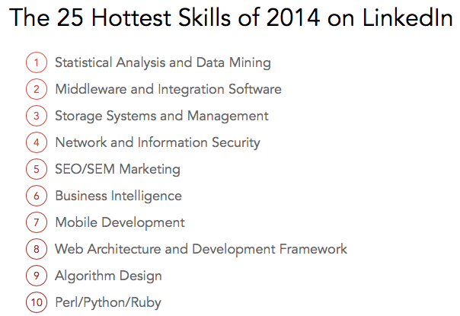

Slide 5
Most in-demand skill in 2014 according to LinkedIn,
2nd in 2016, but 1st in many countries
“Data isn’t [sic] going anywhere. Our top skill category last year, statistical analysis and data mining, is still sitting comfortably at #2. It is the only skill category that is consistently ranked in the top 4 across all of the countries we analyzed. We still live in an increasingly data-driven world, and businesses are still aggressively hiring experts in data storage, retrieval and analysis.”

Slide 6

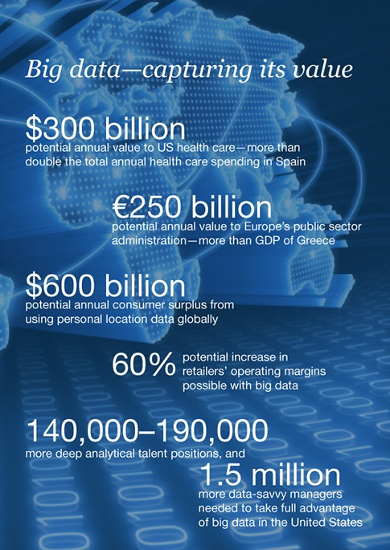
By 2018, the United States alone could face a shortage of 140,000 to 190,000 people with deep analytical skills as well as 1.5 million managers and analysts with the know-how to use the analysis of big data to make effective decisions.

Slide 7

“The Fastest-Growing STEM Major in the U.S.”
Move over, computer science. Bachelor’s Degrees in
Statistics have soared 95% since 2010…the number
of U.S. colleges granting degrees in the field has already
gone up, from 74 in 2003 to 110 within 10 years,
and 20 more schools have recently added new programs.
Source: Fortune, February 10, 2015.

Slide 8
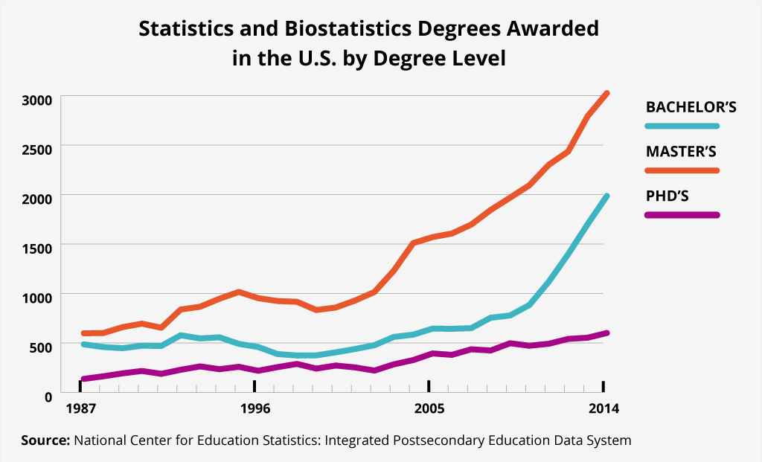

Slide 9
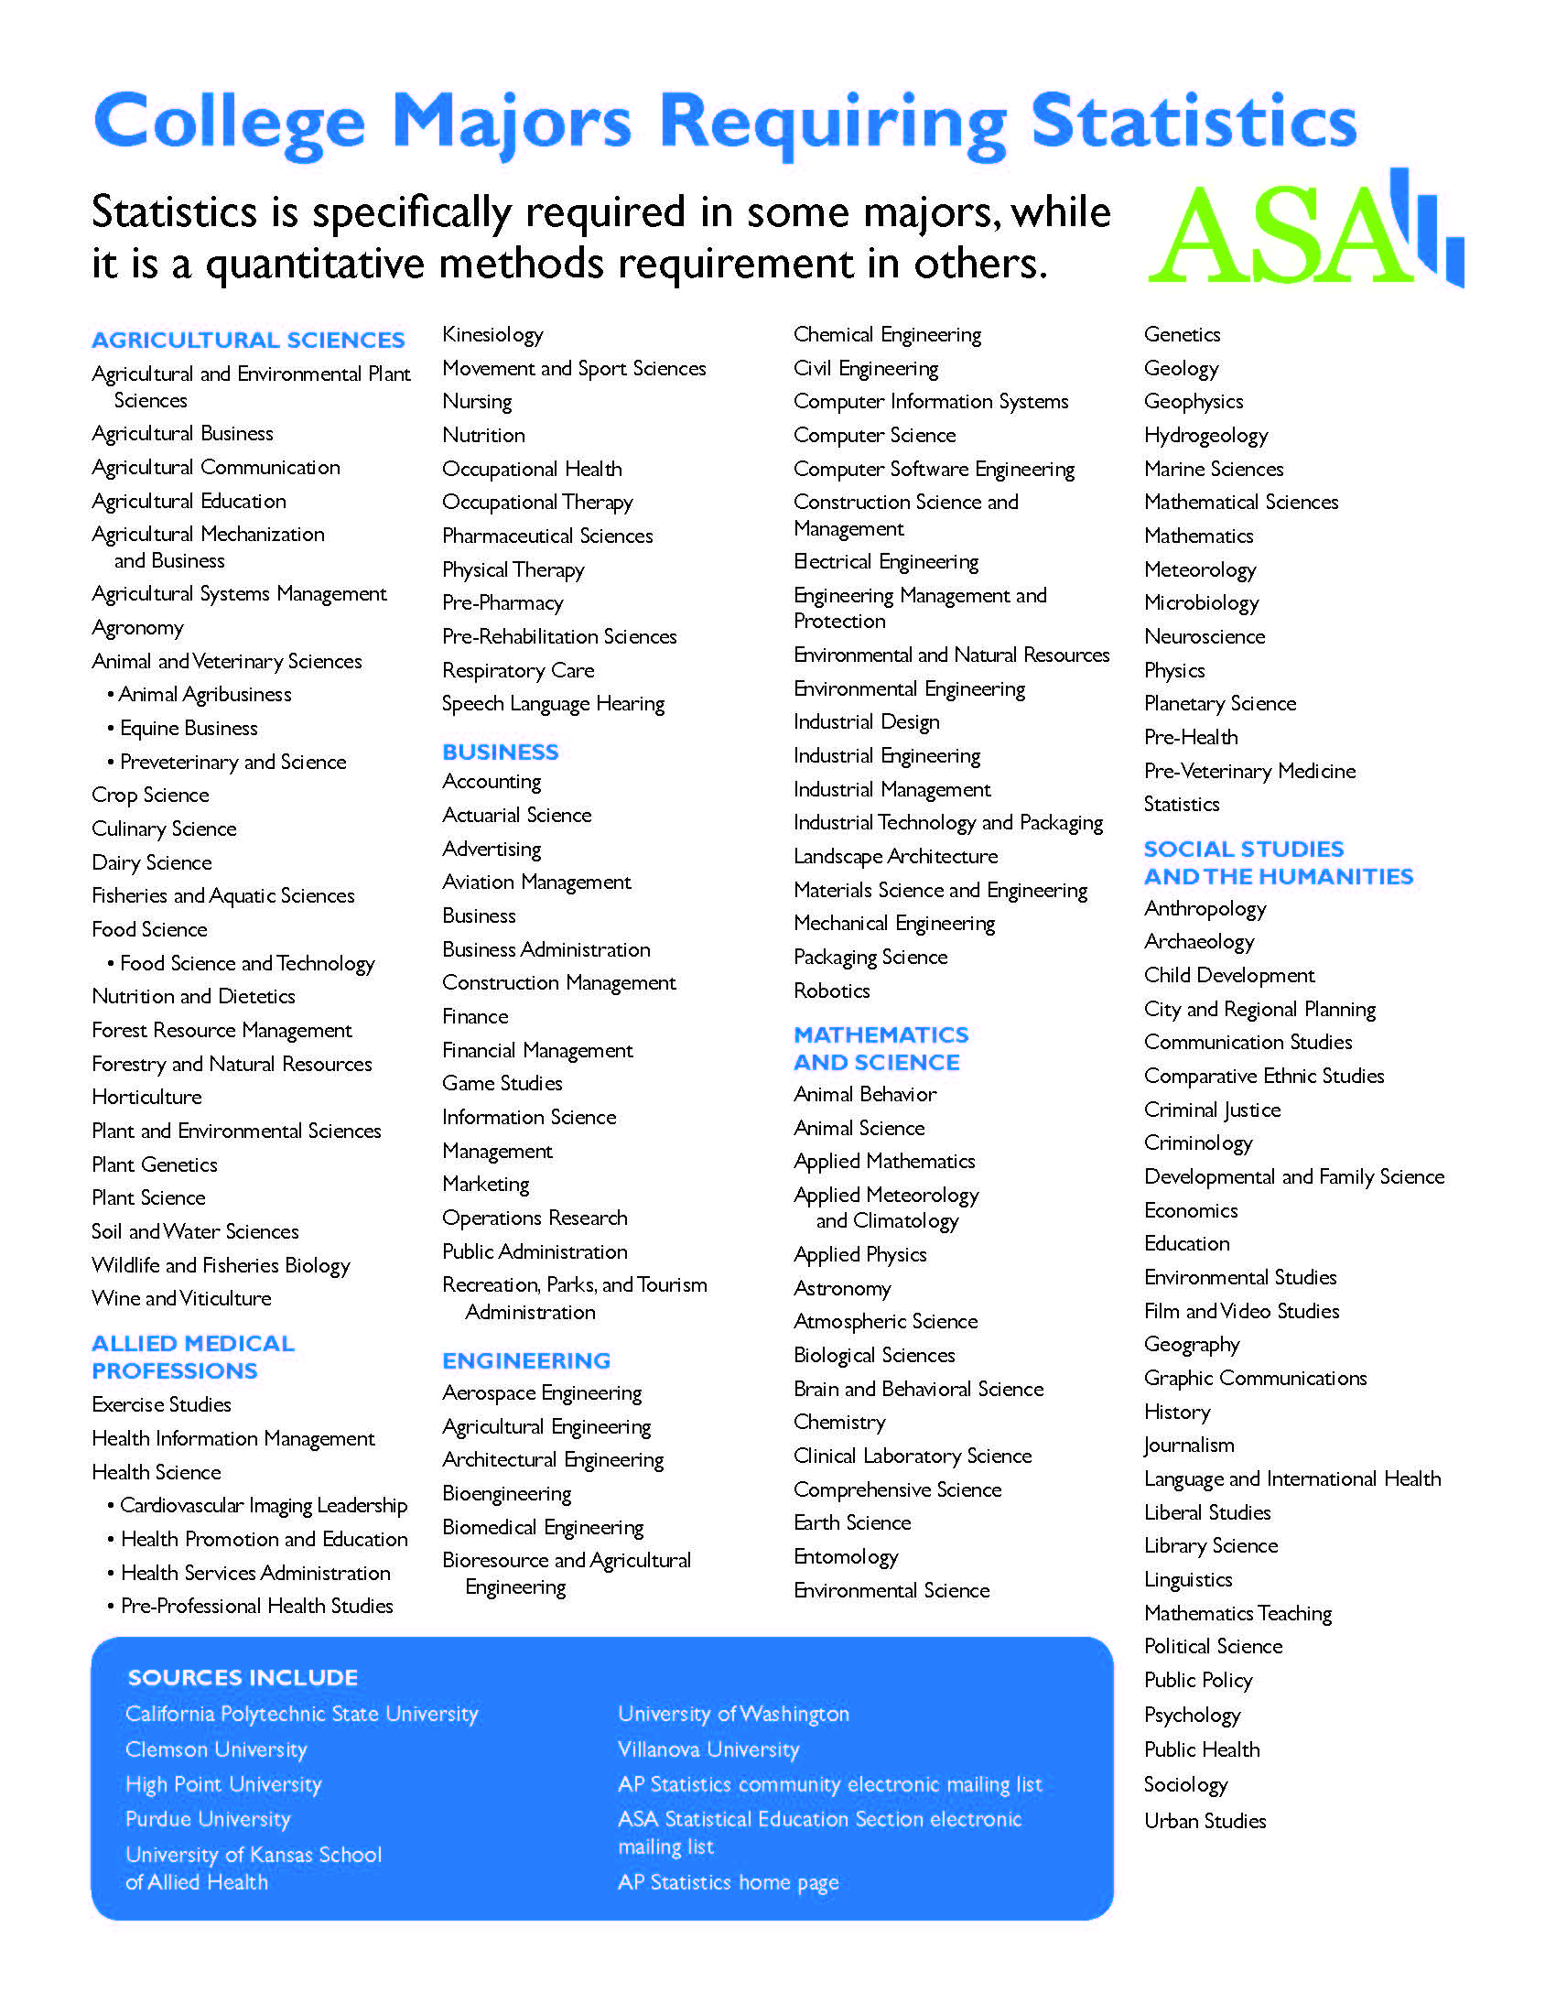
Construction
Management
Microbiology
History
Journalism
Entomology
Criminal Justice
City and Regional Planning
Respiratory Care
Wine and Viticulture
Film and video studies
Aviation Management
Robotics
Electrical Engineering
Landscape Architecture

Slide 10
Thanks to the AP Statistics Career Information Work Group Members
Rachel Braun*
Paul Buckley*
Ann Cannon**
Jesse Chittams
Will Eagan
Chris Franklin**
Sharon Hessney*
John Holcomb
Donna LaLonde
Devan Mehrotra
Jason Molesky*
Anna Nevius (Chair)
Rebecca Nichols
Allan Rossman**
Jill Talley
*Current or former AP Statistics Teacher; **AP Statistics Leadership

Slide 11
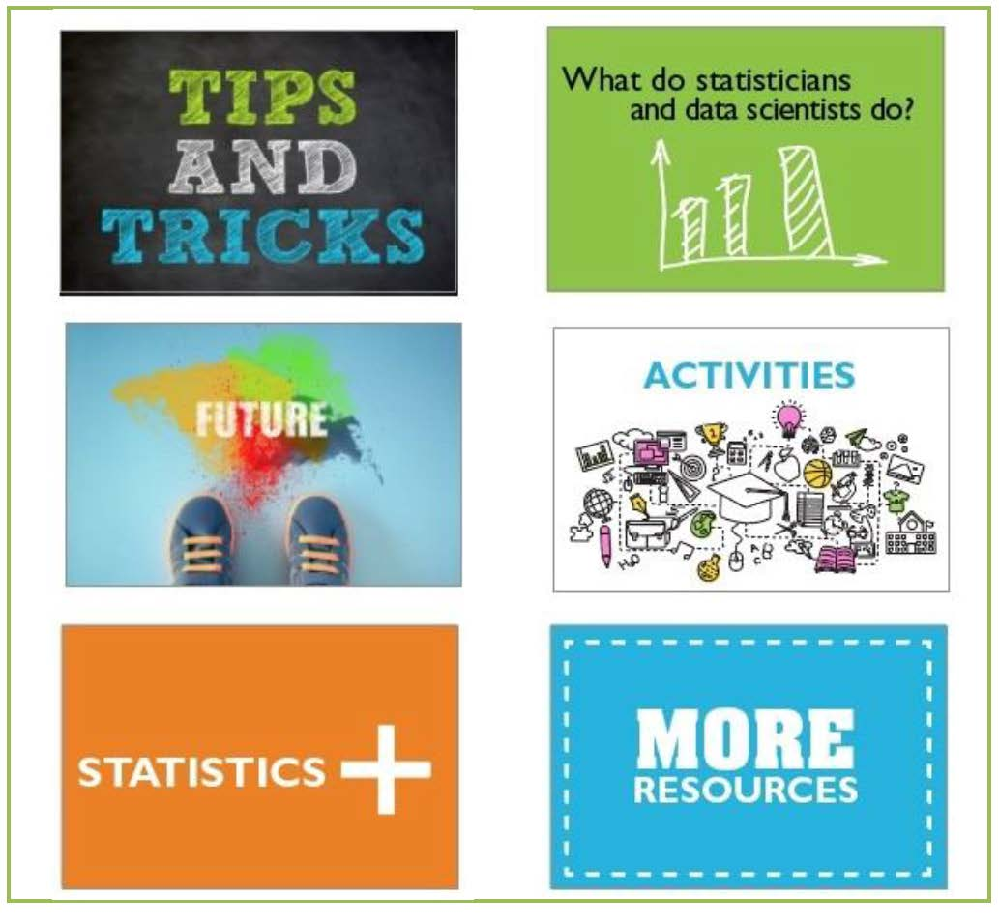
http://www.amstat.org/ASA/Education/K-12-Student-Outreach.aspx

Slide 13
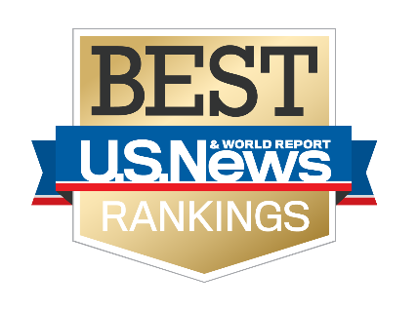

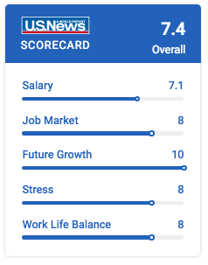
“#1 in Best Business Jobs”
Statistics is one of the oldest professions in the world, it dates back to the 1700s. There’s a tremendous history
...and now more exciting opportunities. It has never
been a better time to be a statistician.
Source: U.S. News & World, February 12, 2016

Slide 14
US News and world report…
Has ranked Statistician as the best business job, based on a combination of:
Salary
Job Market
Future Growth
Stress (or lack of!)
Work Life Balance
http://money.usnews.com/careers/best-jobs/statistician

Slide 15

“Women Flocking to Statistics”
  As the demand explodes for workers in high-tech
  professions who can analyze the staggering amounts of raw digital data produced every year, women barely register.
  Except In One Field: Statistics.
Source: The Washington Post, “Women Flocking to Statistics, the Newly Hot,
High-Tech Field of Data Science,” December 2014.

Slide 16
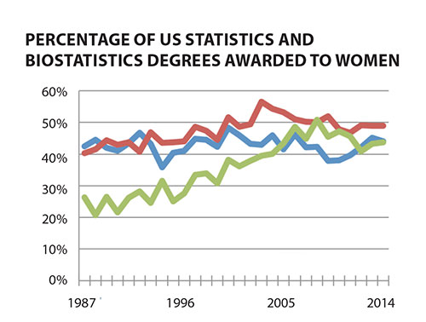

Source: http://magazine.amstat.org/blog/2015/10/01/statistics-degrees-continue-strong-growth/

Slide 17
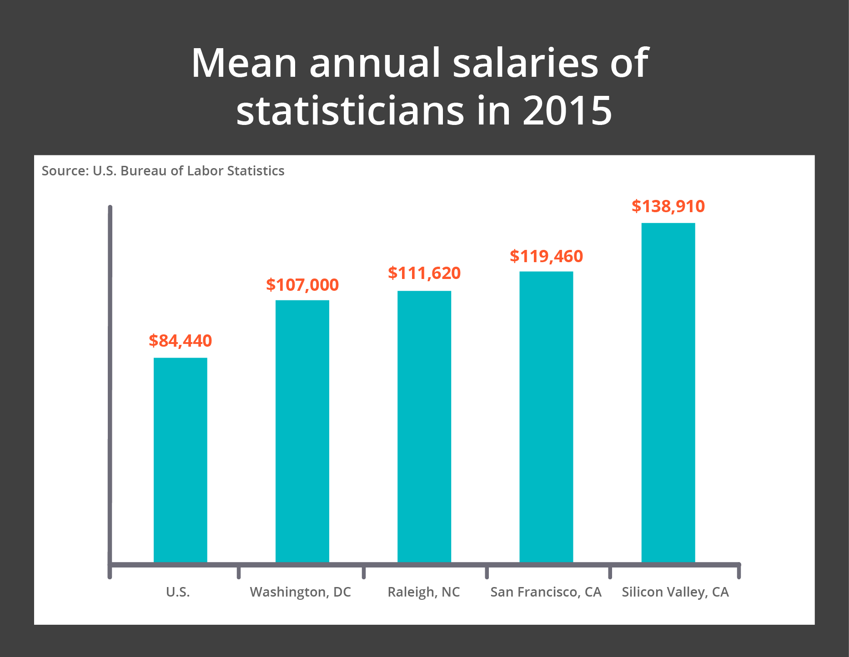
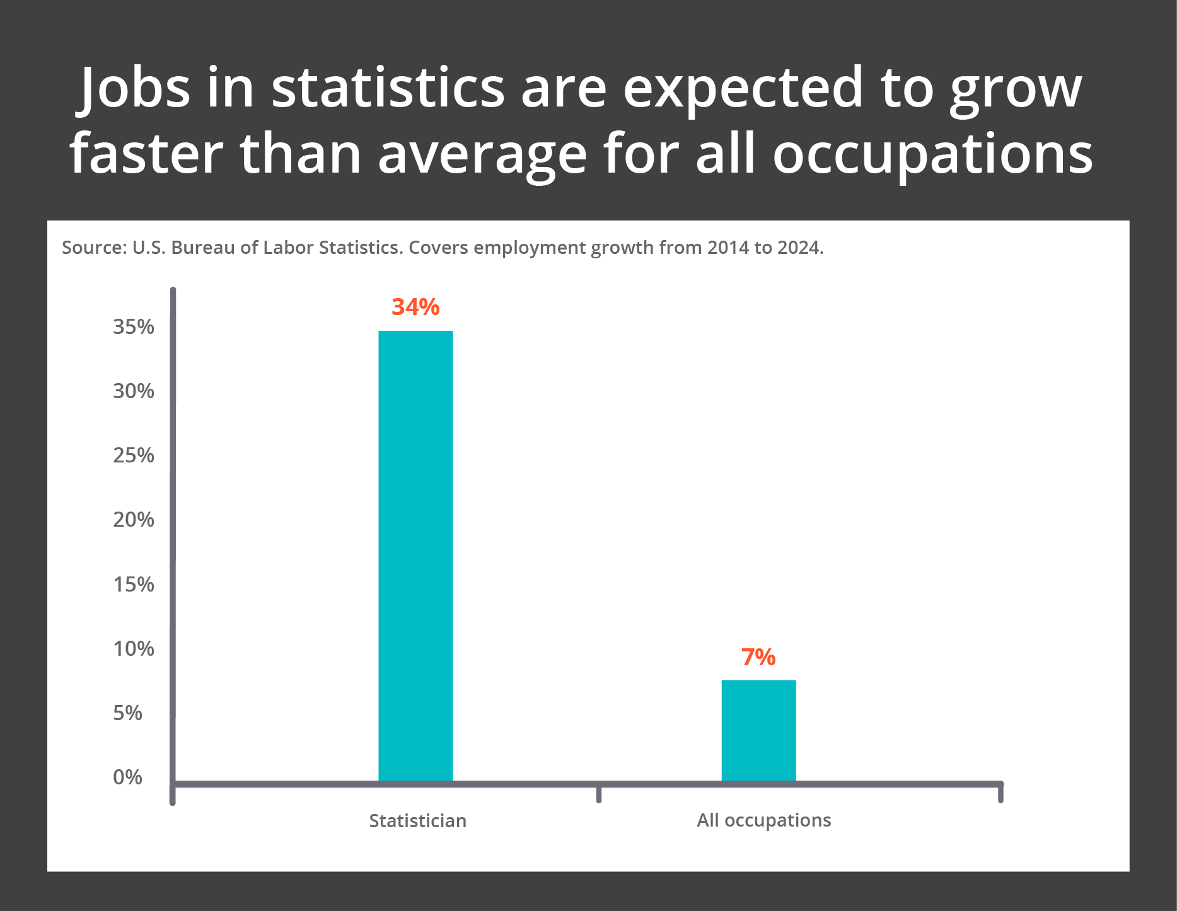
Statistics education also offers a strong
return on investment.

Slide 18
Share this information with your students!
…and your kids, nieces, nephews, neighbors…
Notes:
18

Slide 19
Learn more at ThisisStatistics.org

