Slide 1
Finding the m best solution using search

Slide 2
Optimization algorithms for Bayesian networks developed in our group
Bucket Elimination [Dechter 1996]
  Bucket Elimination with external memory [Kask, Dechter, Gelfand 2010]
AND/OR Branch and Bound [Marinescu, Dechter 2005]
  Parallel AND/OR Branch and Bound [Otten, Dechter, 2010]
Best First AND/OR search [Marinescu, Dechter 2007]
9

Slide 3
Exact optimization algorithms for graphical models
3 main types:
  Variable Elimination (dynamic programming)
  Best First Search
  Branch and Bound Search
State of the art:
  Bucket Elimination [Dechter 1996]
    Bucket Elimination with external memory [Kask, Dechter, Gelfand 2010]
  AND/OR Branch and Bound [Marinescu, Dechter 2005]
    Parallel AND/OR Branch and Bound [Otten, Dechter, 2010]
  Best First AND/OR search [Marinescu, Dechter 2007]
10

Slide 4
Overview
Motivation: haplotyping in pedigrees
  Formulation of the problem of finding of the most likely haplotype as an optimization on a Bayes Net
Previous work on the m best solutions
Dynamic programming for finding the m best solutions
  MPE bucket elimination algorithm overview
  Algorithm elim-m-opt
Search for finding the m best solutions
  Best First search
  Branch and Bound search
  Extension to the AND/OR search space
Complexity comparison of the algorithms
11

Slide 5
Overview
Motivation: haplotyping in pedigrees
Previous work on the m best solutions
Dynamic programming for finding the m best solutions
Search for finding the m best solutions
  Best First search
  Branch and Bound search
  Extension to the AND/OR search space
Complexity comparison of the algorithms
13

Slide 6
M best solutions for graphical models
Lawler [1972]
Seroussi and Golmard [1994]
Nilsson [1998]
Elliot [2007]
12

Slide 7
Overview
Motivation: haplotyping in pedigrees
Previous work on the m best solutions
Dynamic programming for finding the m best solutions
Search for finding the m best solutions
  Best First search
  Branch and Bound search
  Extension to the AND/OR search space
Complexity comparison of the algorithms
13

Slide 8
Complexity of elim-m-opt
Complexity of processing a bucket:
  O(k^{|S|} · m· j log(m· j))
Complexity of elim-m-opt
  time complexity: O(n·k^{w*}·m·log(m · deg))
  space complexity is O(m·n·k^{w*})

Slide 9
Overview
Motivation: haplotyping in pedigrees
Previous work on the m best solutions
Dynamic programming for finding the m best solutions
Search for finding the m best solutions
  Best First search
  Branch and Bound search
  Extension to the AND/OR search space
Complexity comparison of the algorithms
33

Slide 10
Search algorithms for optimization
Optimization task on a graphical model → search for a path in a graph
Primary search strategies:
  Best First Search (e.g. A*)
  Depth-Based Branch and Bound Search
A
A
f₁(A,B)
f₂(A,C)
B
B
B
C
f₃(B,C)
C
C
C
C
0
1
0
1
0
1
0
1

Slide 11
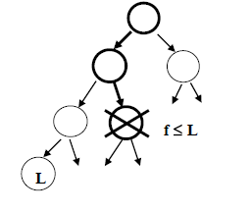
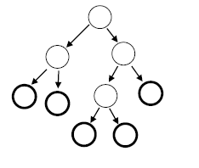
Basic heuristic search schemes
Heuristic function f(x) computes a lower bound on the best extension of x and can be used to guide a heuristic search algorithm.
We focus on
1.Best-First Search
Always expand the node with the highest heuristic value f(x^{p}).
Needs lots of memory
2.Branch and Bound
Use heuristic function f(x^{p}) to prune the depth-first search tree.
Linear space

Slide 12
Search algorithms for optimization
BFS (A*)
  Optimally efficient
  The first solution found is optimal
  Space exponential in the depth of the optimal solution
DF Branch and Bound
  Explores at least as many nodes
  Anytime: quickly find lower bound on the optimal solution and then improves it
  Can be done in linear space
Both use additional information (in form of heuristic)
to guide the search

Slide 13
Relative time complexity of m-best algorithms
(worst-case)
BF done after BE
O(n k^{w*})+n m deg log(n m b))
Nilsson
O(n m k^{w*})
m-AOBF
O(n m k^{w*})
elim-m-opt
O(n m k^{w*} log(m deg))
Elliot
O(n m k^{w*} log(m deg))
m-AOBB
O(n m k^{w*} deg log(m))
Seroussi and Golmard
O(n m² k^{w*} deg)
Lawler
O(n² m k^{w*})

Slide 14
Relative space complexity of algorithms
(worst-case)
Nilsson
O(m + n k^{w*})
Lawler
O( m + n k^{w*})
BF done after BE
O(n k^{w*})+n m)
m-AOBF
O(n m k^{w*})
elim-m-opt
O(n m k^{w*} )
m-AOBB
O(n m k^{w*} )
Elliot
O(n m k^{w*} )
Seroussi,
Golmard
O(n m k^{w*})

Slide 15
Relative search space prunning
m-AOBF
f(n)<C_{m}*
m-AOBB
C_{m}*<f(n)<C_{m+1}*
elim-m-opt
Lawler
Elliot
Nilsson
Seroussi,
Golmard

Slide 16
Future work
Empirical evaluation of the algorithms
Parallel implementation and evaluation of m-AOBB
Efficient compilation of m best results
Incorporating diversity measure as part of utility function

Slide 17
Best-First search for m-best
On general search spaces
Evaluation function f(n) - estimates the best cost solution path that passes through n.
OPEN list – contains nodes - candidates for expansions (often called ”OPEN”, or ”frontier”).
CLOSED list – contains already expanded nodes
At each iteration the best node from OPEN is chosen, put on CLOSED, and expanded: its children are generated and put on OPEN
When a goal node is selected for expansion the algorithm can terminate with the solution found.
when f(n) is a lower bound on the optimal solution the algorithm terminates with an optimal solution

Slide 18
m-A*
For m solutions: don’t terminate with the first solution, continue searching until all m solutions are generated.
Focus: A∗, where f(n) = g(n) + h(n) in which g underestimate g∗, the minimal cost from n_0 to n and h(n) underestimates h∗(n), the optimal cost from n to a goal.
m-A* expands nodes in increasing value of f in the usual A∗ manner. Nodes can be expanded multiple times and the algorithm maintains separate paths to each copy of a node in the explored search tree, denoted by Tr.
C∗_{i} denotes the i^{th} best solution cost of the problem, f∗_{i} (n) the i^{th} best solution going through node n, f_{i}(n) the evaluation function estimating f∗_{i} (n), g_{i}(n) – cost of the i^{th} best path from start to node n .

Slide 19
m-A*
The extension of BFS to finding the m-best solutions seems simple: rather than terminate with the first solution, the algorithm continues searching until it generates m solutions. These solutions can be shown to be the m best ones. Specifically,
Focus: A∗, where f(n) = g(n) + h(n) in which g underestimate g∗, the minimal cost from n_0 to n and h(n) underestimates h∗(n), the optimal cost from n to a goal.
Formally, given an implicit directed search space graph G = (N;E), its root is n_0 and its set of goal nodes are Goals.
h(n) where n ∈ N, denotes an underestimate of the least cost path from n to any g ∈ Goals. g(n) denotes an estimate of a least cost path from the n_0 to n, with h∗(n) and g∗(n) the optimal costs respectively. We denote by g_{\pi} (n) the cost from the root to n along path and by c(n1; n2) the cost from n1 to n2 along pi .
m-A* expands nodes in increasing value of f in the usual A∗ manner. Nodes can be expanded multiple times and the algorithm maintains separate paths to each copy of a node in the explored search tree, denoted by Tr.
C∗i denotes the ith best solution cost of the problem, f∗i (n) the ith best solution going through node n, fi(n) the evaluation function estimating f∗i (n) and by gi(n).

Slide 20
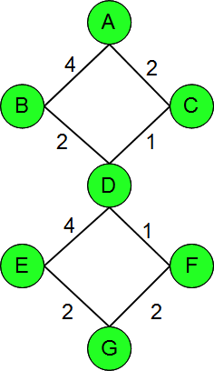
Example of m-A*
m=2

Slide 21
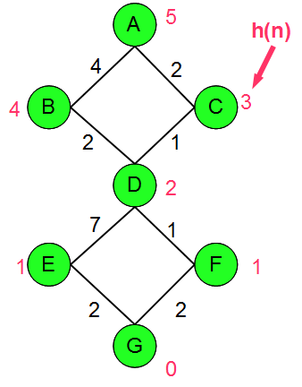
Example of m-A*
m=2

Slide 22
Example of m-A*
m=2
OPEN | CLOSED
A , f(A)=5
A

Slide 23
Example of m-A*
m=2
OPEN | CLOSED
A , f(A)=5
C, f(C)=5; B, f(B)=8 | A
A
B
C

Slide 24
Example of m-A*
m=2
OPEN | CLOSED
A , f(A)=5
C, f(C)=5; B, f(B)=8 | A
D, f(D)=5; B, f(B)=8 | C
A
B
C
D

Slide 25
Example of m-A*
m=2
OPEN | CLOSED
A , f(A)=5
C, f(C)=5; B, f(B)=8 | A
D, f(D)=5; B, f(B)=8 | C
F, f(F)=5; B, f(B)=8; E, f(E)=11 | D
A
B
C
D
E
F

Slide 26
Example of m-A*
m=2
OPEN | CLOSED
A , f(A)=5
C, f(C)=5; B, f(B)=8 | A
D, f(D)=5; B, f(B)=8 | C
F, f(F)=5; B, f(B)=8; E, f(E)=11 | D
G, f(G)=6; B, f(B)=8; E, f(E)=11 | F
A
B
C
D
E
F
G

Slide 27
Example of m-A*
m=2
OPEN | CLOSED
A , f(A)=5
C, f(C)=5; B, f(B)=8 | A
D, f(D)=5; B, f(B)=8 | C
F, f(F)=5; B, f(B)=8; E, f(E)=11 | D
G, f(G)=6; B, f(B)=8; E, f(E)=11 | F
B, f(B)=8; E, f(E)=11 | G
A
B
C
D
E
F
G

Slide 28
Example of m-A*
m=2
OPEN | CLOSED
A , f(A)=5
C, f(C)=5; B, f(B)=8 | A
D, f(D)=5; B, f(B)=8 | C
F, f(F)=5; B, f(B)=8; E, f(E)=11 | D
G, f(G)=6; B, f(B)=8; E, f(E)=11 | F
B, f(B)=8; E, f(E)=11 | G
A
B
C
D
E
F
G

Slide 29
Example of m-A*
m=2
OPEN | CLOSED
A , f(A)=5
C, f(C)=5; B, f(B)=8 | A
D, f(D)=5; B, f(B)=8 | C
F, f(F)=5; B, f(B)=8; E, f(E)=11 | D
G, f(G)=6; B, f(B)=8; E, f(E)=11 | F
B, f(B)=8; E, f(E)=11 | G
A
B
C
D
E
F
G

Slide 30

Example of m-A*
m=2
OPEN | CLOSED
A , f(A)=5
C, f(C)=5; B, f(B)=8 | A
D, f(D)=5; B, f(B)=8 | C
F, f(F)=5; B, f(B)=8; E, f(E)=11 | D
G, f(G)=6; B, f(B)=8; E, f(E)=11 | F
B, f(B)=8; E, f(E)=11 | G
A
B
C
D
E
F
G

Slide 31

Example of m-A*
m=2
OPEN | CLOSED
A , f(A)=5
C, f(C)=5; B, f(B)=8 | A
D, f(D)=5; B, f(B)=8 | C
F, f(F)=5; B, f(B)=8; E, f(E)=11 | D
G, f(G)=6; B, f(B)=8; E, f(E)=11 | F
B, f(B)=8; E, f(E)=11 | G
D₂, f(D₂)=8; E, f(E)=11 | B
A
B
C
D₂
D
E
F
G

Slide 32
Example of m-A*
m=2
OPEN | CLOSED
A , f(A)=5
C, f(C)=5; B, f(B)=8 | A
D, f(D)=5; B, f(B)=8 | C
F, f(F)=5; B, f(B)=8; E, f(E)=11 | D
G, f(G)=6; B, f(B)=8; E, f(E)=11 | F
B, f(B)=8; E, f(E)=11 | G
D₂, f(D₂)=8; E, f(E)=11 | B
F₂, f(F₂)=8; E, f(E)=11; E₂, f(E₂)=14 | D₂
A
B
C
D₂
D
E₂
F₂
E
F
G

Slide 33
Example of m-A*
m=2
OPEN | CLOSED
A , f(A)=5
C, f(C)=5; B, f(B)=8 | A
D, f(D)=5; B, f(B)=8 | C
F, f(F)=5; B, f(B)=8; E, f(E)=11 | D
G, f(G)=6; B, f(B)=8; E, f(E)=11 | F
B, f(B)=8; E, f(E)=11 | G
D₂, f(D₂)=8; E, f(E)=11 | B
F₂, f(F₂)=8; E, f(E)=11; E₂, f(E₂)=14 | D₂
G₂, f(G₂)=9; E, f(E)=11; E₂, f(E₂)=14 | F₂
A
B
C
D₂
D
E₂
F₂
E
F
G₂
G

Slide 34
Example of m-A*
m=2
OPEN | CLOSED
A , f(A)=5
C, f(C)=5; B, f(B)=8 | A
D, f(D)=5; B, f(B)=8 | C
F, f(F)=5; B, f(B)=8; E, f(E)=11 | D
G, f(G)=6; B, f(B)=8; E, f(E)=11 | F
B, f(B)=8; E, f(E)=11 | G
D₂, f(D₂)=8; E, f(E)=11 | B
F₂, f(F₂)=8; E, f(E)=11; E₂, f(E₂)=14 | D₂
G₂, f(G₂)=9; E, f(E)=11; E₂, f(E₂)=14 | F₂
 | G₂
A
B
C
D₂
D
E₂
F₂
E
F
G₂
G

Slide 35
Algorithm m-A*
Input: An implicit directed search graph G = (N;E), with a start node s and a set of goal nodes Goals. A heuristic evaluation function h(n). parameter m, OPEN=Φ. A tree Tr which is initially empty. For this version we assume that h is monotone.
Output: the m-best solutions.
1. i =1 (i counts the current solution being searched for).
2. Put the start node n0 in OPEN, f(n0) = h(n0). Put n0 the root of Tr.
3. If OPEN is empty exit and return the solutions found so far.
4. Remove a node in OPEN having a minimum f (break ties arbitrarily but in favor of goal nodes) and put it in CLOSED.
5. If n is a goal node, output the current solution obtained by tracing back pointers from n to s (pointers are assigned in the following step). Denote this solution sol_i. If i = m exit. else i ← i + 1, and go to step 3.
6. Otherwise expand n, generating all its child nodes M and include only those appearing at most m − 1 times in OPEN or CLOSED and attach from each a pointer back to n in Tr. For every n′ ∈ M successor of n: compute g(n′) = g(n) + c(n; n′) and f(n′) = g(n′) + h(n′) and place n′ with f(n′) in OPEN.
7. Go to step 3.

Slide 36
Primary properties
(A* vs m-A*)
1. A* terminates with an optimal solution.
2. A* is optimally efficient in terms of nodes expansions compared with any other search algorithm that is guaranteed to find an optimal solution. Namely, any node that is surely expanded by A*, regardless of tie breaking rule must be expanded by any other sound and complete search algorithm.
3. A* is optimally efficient in terms of number of nodes expansions when the heuristic function is monotone. In the latter case, A* expands each node just once.
4. Given two heuristic functions h1 and h2 s.t. for every n, h1(n) < h2(n) then A∗1 will expand every node surely expanded by A∗2.
We can show properties for m-A*
1. Soundness and completeness: m-A* terminates with the m-best solutions generated in order of their cost.
2. Optimal efficiency: m-A* is optimally efficient in terms of nodes expansions, compared with any other search algorithm that is guaranteed to find the m-best solutions.
3. Optimal efficiency for monotone heuristics: m-A* is optimally efficient in terms of number of nodes expansions when the heuristic function is monotone. In the latter case, m-A* expands each node at most m times.
4. Dominance: Given two heuristic functions h1 and h2 s.t. for every n, h1(n) < h2(n) then m-A*1 will expand every node surely expanded by m-A*2.

Slide 37
m-A* is sound and complete
Proposition 1. Anytime before m-A* expands the goal of the ith best solution path there is a node n′ in OPEN whose evaluation function satisfies f(n′) ≤ C∗_{i}
Proof. We assume that the search graph G accommodates at least m solutions. Lets assume that all the i − 1 best solutions were already generated. Namely, the goals of the first i − 1 solution paths were selected for expansion. At anytime after that there is a node n in OPEN that resides on an ith optimal path p_i, because the ith path is yet to be generated. Let n be the first OPEN node on p_i. Its evaluation function is by definition f(n) = g_{i}_{pi}(n) + h(n). Since pi is an ith best path, g_{i}(n) + c(n; t) = C∗_{i} , when t is the goal for path i. Since by definition h(n) ≤ c(n; t) we get that f(n) ≤ C∗_{i} .
Theorem 1. The ith solution generated by m-A* is the ith best solution.
Proof. By induction. We know that the first solution generated is the optimal one. Assuming that the first i − 1 solutions are i − 1 optimal in sequence, we will prove that the ith one is optimal. If not, the ith generated solution path, denoted by pi′ has a cost c and c > C∗_{i} . However when the algorithm selected the goal t′ along pi′, its evaluation function is f(t′) = g′(t′) = c while at the same time there is a node in OPEN whose evaluation function is C∗i or smaller that should have been selected. Contradiction.
Corollary 1. Algorithm m-A* generates the m-best solutions in order of bestness.

Slide 38
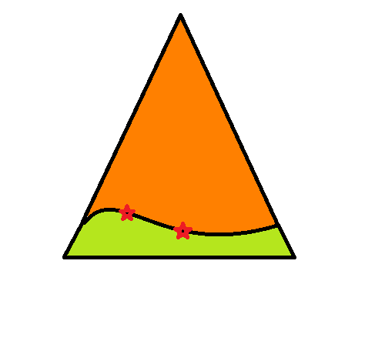
m-A* is optimally efficient
Corollary 2. The following properties hole for m-A*:
i.) If n is expanded by m-A* before the ith solution is generated, then f(n) <= C∗_{i} .
ii.) If f(n) < C∗_{i} and h is monotone, then n is expanded by m-A* before the ith solution is generated.
iii) if h is monotone, the set {n|f(n) < C∗_{m}} will surely be expanded.
Iv) m-A* will not expand any node n, s.t. f(n)> C∗_{m}
There is a subset of the nodes for which f(n) = C∗_{m} that will be expanded and this set depends on the tie breaking rule used by m-A*.
{n|f(n) < C∗_{m}}
Explored search space
{n|f(n) < C∗_{m}}
{n|f(n) = C∗_{m}}

Slide 39
{n|f(n) < C∗_{m}}
Explored search space
{n|f(n) < C∗_{m}}
{n|f(n) = C∗_{m}}

Slide 40
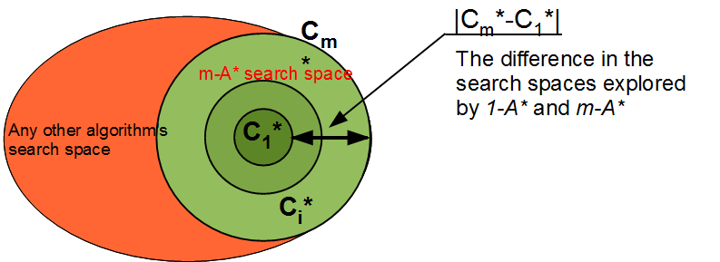
m-A* is optimally efficient
Theorem 2 (efficiently m-optimality). Any search algorithm that is guaranteed to find the m-best solutions, that explores the same search graph as A* and that has access to the same heuristic information will have to expand any node that is surely expanded by m-A*. Namely, it will have to expand every node n that lies on a path s.t., f(n′) < C∗_{m} ∀n′ ∈ .

Slide 41
m-A* is optimally efficient
Theorem. Any search algorithm, that is guaranteed to find the m-best solutions, will expand any node that is surely expanded by m-A*.
Namely, it will have to expand every node n s.t.,
f(n′) < C∗_{m} .

Slide 42
m-A* for monotone heuristics
Theorem . Given a monotone heuristic h, when m-A* selects a node n for expansion for the i^{th} time, then it has found the i^{th} best solution from start to n.
Corollary 3. Given m-A* with a monotone h, the maximum number of copies of the same node in OPEN or CLOSED is bounded by m.

Slide 43
Larger version of previous example
A
A
7
4
2
B
C
6
B
C
5
2
1
D
4
D₂
D
7
1
3
E
F
3
E₂
F₂
E
F
2
2
G
1
1
2
G₂
G
1
H
I
10
1
14
H₂
I₂
H
I
J
0
J₂
J

Slide 44
The impact of heuristic accuracy on m-A*
Performance of m-A* will improve with more accurate heuristics:
When h1 is strictly larger (and therefore more accurate) than h2, algorithm m-A* that uses h2 will expand every node that will be expanded by the algorithm m-A* that uses h1 before finding the j^{th} solution .
Theorem. If h = h* is the exact heuristic, then m-A* generates solutions only on j-optimal paths 1 ≤ j ≤ m.
Theorem. When m-A* has access to exact heuristic h = h*, then, if it uses a tie breaking rule in favor of deeper nodes, it will expand at most #N = Σ i #Ni nodes and #Ni is the length of the i-optimal solution path.

Slide 45
Increase in the state space
Proposition 2. Given a search problem having a search graph for finding optimal solutions, and given a heuristic evaluation function h, and two integers i < j. Assuming identical tie breaking rules by A*, if i < j
1. Any node expanded by i-A* is expanded by j-A*.
2. The set of nodes that are surely expanded by j-A* and not be expanded by i-A*, S(i; j), is defined by: S(i; j) = {n|C∗i < f(n) < C∗j}
Proposition 3. Let m-A* algorithm using any h, if C*i = C*j = c for i < j. The difference between their searches is bounded by the size of G(c). Where Let G(c) = {n|g(n) = c}.

Slide 46
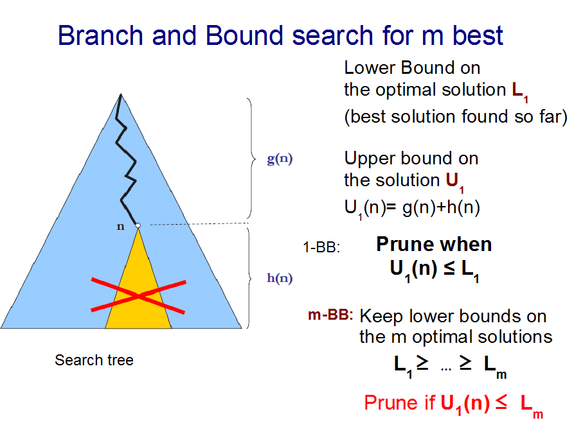
m-A* for graphical models.
When applied to a graphical model:
We can obtain exact heuristic by bucket elimination and then use m-A*. The total complexity of both algorithms is O(nk^w* + nm).
In general (with inexact heuristic) the search space explored by m-A* applied to a graphical model is O(nmk^w*).

Slide 47
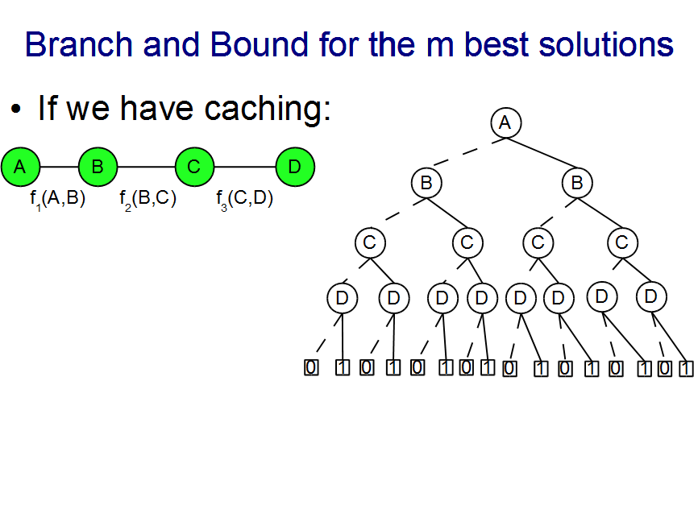

Slide 48
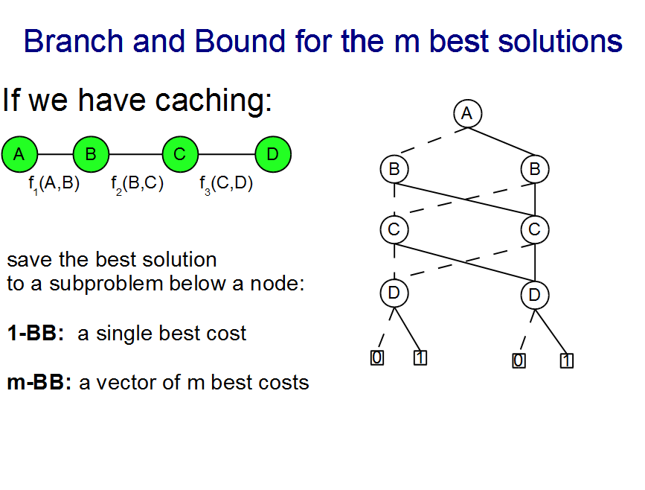

Slide 49
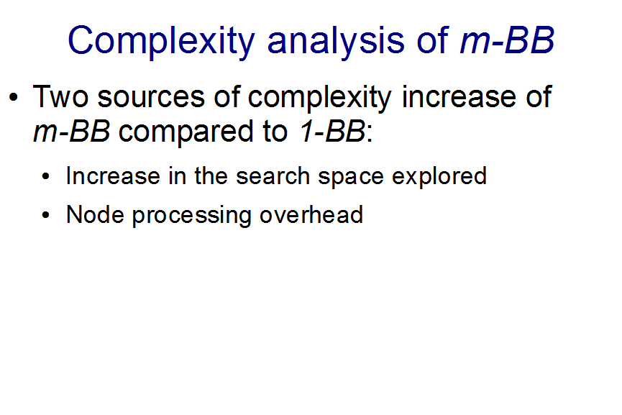

Slide 50
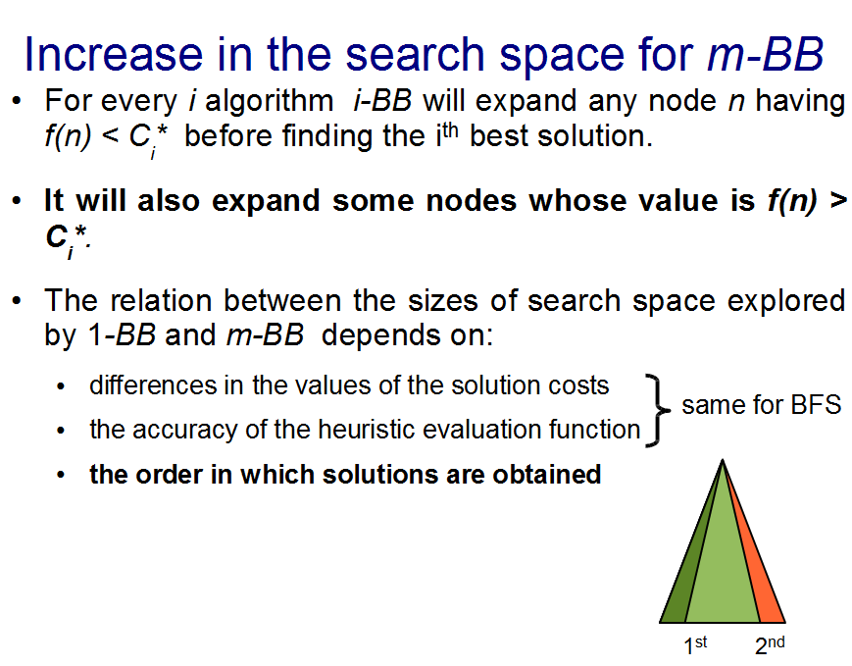

Slide 51
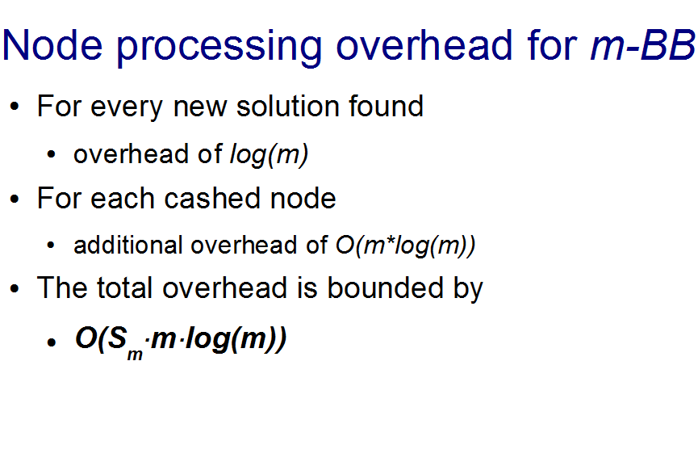

Slide 52
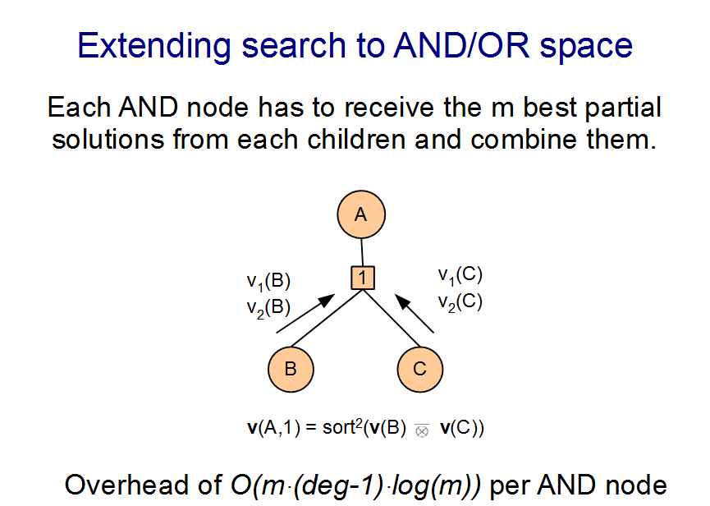

Slide 53
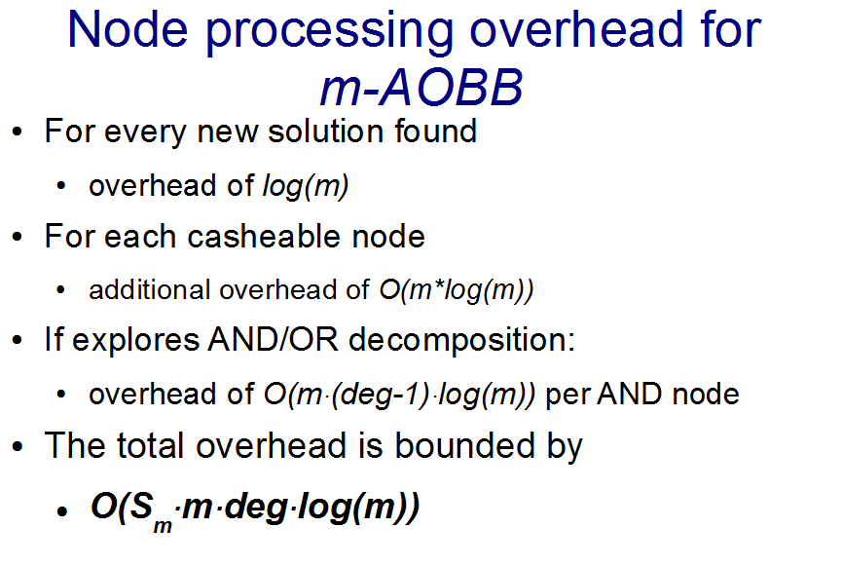

Slide 54
On the heuristic capability of m-best on relaxed models
Suppose we can find m best solutions to the relaxed problem (upper bounds on the exact solutions):
c1 c2 c3 c4 c5 c6 …

Slide 55
On the heuristic capability of m-best on relaxed models
Suppose we can find m best solutions to the relaxed problem (upper bounds on the exact solutions):
c1 c2 c3 c4 c5 c6 c7 …
C*1
C*2
C*3
These sequence of solutions to the relaxed problem contains the exact solutions

Slide 56
On the heuristic capability of m-best on relaxed models
Suppose we can find m best solutions to the relaxed problem (upper bounds on the exact solutions):
c1 c2 c3 c4 c5 c6 c7 …
C*1
C*2
C*3
These sequence of solutions to the relaxed problem contains the exact solutions
c2 is a tighter upper bound on the exact best solution, then c1
(for this example) – better heuristic for search!

Slide 57
On the heuristic capability of m-best on relaxed models
Suppose we can find m best solutions to the relaxed problem (upper bounds on the exact solutions):
c1 c2 c3 c4 c5 c6 c7 …
C*1
C*2
C*3
These sequence of solutions to the relaxed problem contains the exact solutions
However, if we use c2, we loose the guarantee of optimality of search

Slide 58
Relative time complexity of m-best algorithms
(worst-case)
BF done after BE
O(n k^{w*})+n m deg log(n m b))
Nilsson
O(n m k^{w*})
m-AOBF
O(n m k^{w*})
elim-m-opt
O(n m k^{w*} log(m deg))
Elliot
O(n m k^{w*} log(m deg))
m-AOBB
O(n m k^{w*} deg log(m))
Seroussi and Golmard
O(n m² k^{w*} deg)
Lawler
O(n² m k^{w*})

Slide 59
Relative space complexity of algorithms
(worst-case)
Nilsson
O(m + n k^{w*})
Lawler
O( m + n k^{w*})
BF done after BE
O(n k^{w*})+n m)
m-AOBF
O(n m k^{w*})
elim-m-opt
O(n m k^{w*} )
m-AOBB
O(n m k^{w*} )
Elliot
O(n m k^{w*} )
Seroussi,
Golmard
O(n m k^{w*})

Slide 60
Relative search space prunning
m-AOBF
f(n)<C_{m}*
m-AOBB
C_{m}*<f(n)<C_{m+1}*
elim-m-opt
Lawler
Elliot
Nilsson
Seroussi,
Golmard

Slide 61
Future work
Empirical evaluation of the algorithms
Parallel implementation and evaluation of m-AOBB
Efficient compilation of m best results
Incorporating diversity measure as part of utility function

