Slide 1
Constraint Networks (cont.)
Emma Rollón
Postdoctoral researcher at UCI
April 1st, 2009

Slide 2
Agenda
1
Combinatorial problems
2
Local functions
3
Global view of the problem
4
Some bits on modelling
5
Examples

Slide 3

Combinatorial Problems
Combinatorial
Problems
MO Optimization
Optimization
Decision

Slide 4
Combinatorial Problems
Combinatorial
Problems
Combinatorial Problems
Given a finite set of solutions …
… choose the best solution.
Observations:
  The set of alternatives can be exponentially large.
  The definition of best depends on each problem.
MO Optimization
Optimization
Decision

Slide 5
Combinatorial Problems
Combinatorial
Problems
Map coloring
Given a set of regions and k colors …
… color each region …
… such that no two adjacent regions have the same color
MO Optimization
Optimization
Decision
A
E
A
E
D
D
B
F
B
F
C
G
C
G
A
E
What if the problem is unfeasible?
Users may have preferences among
solutions
D
…
B
F
C
G
Experiment: if I give you the whole bunch of solutions and tell you to choose one
not all of you will choose the same one.

Slide 6
Combinatorial Problems
Combinatorial
Problems
Map coloring (optimization)
Given a set of regions and k colors …
… find the best map coloring …
… such that no two adjacent regions have the same color …
Best: using as much blue as possible.
MO Optimization
Optimization
Decision
A
E
D
B
F
C
G

Slide 7
Combinatorial Problems
Combinatorial
Problems
Combinatorial Auctions
Given a set G of goods and a set B of bids …
… find the best subset of bids …
  r(b_{i})=v_{i} revenue of bid b_{i}
… subject to bids’ compatibility.
Best = maximize benefit (sum)
MO Optimization
Optimization
Decision
bids
b₁
b₃
auctioner
b₄
b₂

Slide 8


Combinatorial Problems
Combinatorial
Problems
Portfolio Optimization
Given a set I of investments …
… find the best portfolio (subset of investments) …
Best =
MO Optimization
Optimization
Decision
maximize return
minimize risk

Slide 9
Combinatorial Problems
Combinatorial
Problems
Graphical Models
Those problems that can be expressed as:
  A set of variables
  Each variable takes its values from a finite set of domain values
  A set of local functions
Main advantage:
  They provide unifying algorithms:
    Search
    Complete Inference
    Incomplete Inference
MO Optimization
Optimization
Decision
Graphical
Models

Slide 10

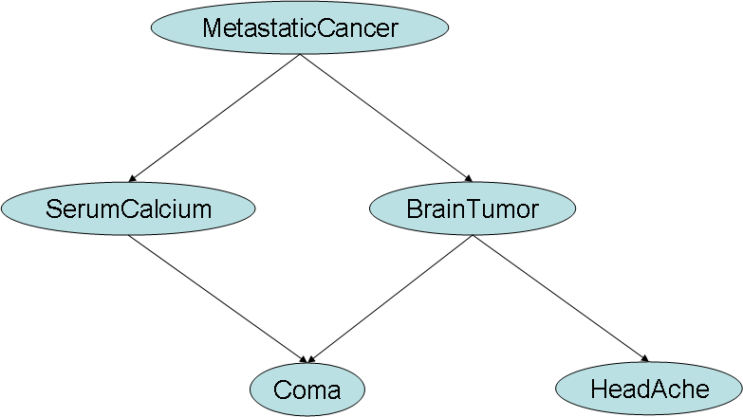

Combinatorial Problems
Combinatorial
Problems
Many Examples
MO Optimization
Optimization
Decision
Graphical
Models
EOS Scheduling
Bayesian Networks
x₁ x₂
x₃
x₄
Graph Coloring
Timetabling
… and many others.

Slide 11
Local Functions
Local function
where
var(f) = Y ⊆ X: scope of function f
A: is a set of valuations
In constraint networks: functions are boolean
x₁ | x₂ | f
a | a | true
a | b | false
b | a | false
b | b | true
x₁ | x₂
a | a
b | b
relation

Slide 12
Local Functions
Combination
Join :
Logical AND:
x₁ | x₂
a | a
b | b
x₂ | x₃
a | a
a | b
b | a
x₁ | x₂ | x₃
a | a | a
a | a | b
b | b | a
x₁ | x₂ | x₃ | h
a | a | a | true
a | a | b | true
a | b | a | false
a | b | b | false
b | a | a | false
b | a | b | false
b | b | a | true
b | b | b | false
x₁ | x₂ | f
a | a | true
a | b | false
b | a | false
b | b | true
x₂ | x₃ | g
a | a | true
a | b | true
b | a | true
b | b | false

Slide 13
Global View of the Problem
C₁
C₂
Global View
x₁ | x₂
a | a
b | b
x₂ | x₃
a | a
a | b
b | a
x₁ | x₂ | x₃
a | a | a
a | a | b
b | b | a
Does the problem a solution?
The problem has a solution if the
global view is not empty
x₁ | x₂ | x₃ | h
a | a | a | true
a | a | b | true
a | b | a | false
a | b | b | false
b | a | a | false
b | a | b | false
b | b | a | true
b | b | b | false
TASK
The problem has a solution if there is some
true tuple in the global view
≡
The logical OR over all tuples in the global view
is true

Slide 14
Global View of the Problem
C₁
C₂
Global View
x₁ | x₂
a | a
b | b
x₂ | x₃
a | a
a | b
b | a
x₁ | x₂ | x₃
a | a | a
a | a | b
b | b | a
What about counting?
x₁ | x₂ | x₃ | h
a | a | a | true
a | a | b | true
a | b | a | false
a | b | b | false
b | a | a | false
b | a | b | false
b | b | a | true
b | b | b | false
x₁ | x₂ | x₃ | h
a | a | a | 1
a | a | b | 1
a | b | a | 0
a | b | b | 0
b | a | a | 0
b | a | b | 0
b | b | a | 1
b | b | b | 0
TASK
true is 1
false is 0
logical AND?
Number of true tuples
Sum over all the tuples

Slide 15

Representing a problem
Modelling
If a CSP M = <X,D,C> represents a problem P, then every solution of M
corresponds to a solution of P and every solution of P can be derived
from at least one solution of M
The variables and values of M represent entities in P
The constraints of M ensure the correspondence between solutions
The aim is to find a model M that can be solved as quickly as possible
Good rule of thumb: choose a set of variables and values that allows
the constraints to be expressed easily and concisely

Slide 16
Representing a problem
Modelling
Example: Magic Square
Problem
Arrange the numbers 1 to 9 in a 3 x 3 square so that
each row, column and diagonal has the same sum.
Variables and Values
A variable for each cell, domain is the numbers that can go in the cell
A variable for each number, domain is the cells where that number can go
What about constraints?
It’s easy to define them: x1 + x2 + x3 = x4 + x5 + x6 = …
Definetely not easy …
4 | 3 | 8
9 | 5 | 1
2 | 7 | 6
x1 | x2 | x3
x4 | x5 | x6
x7 | x8 | x9

Slide 17
Global Constraints
Modelling
A global constraint is a constraint defined over a large set of variables
and with specific semantics
The commonest: AllDifferent constraint
Variables: one for each slot
Domains: {1, 2, 3, 4, 5, 6, 7, 8, 9}
Constraints:
- pairwise not equal constraints
- alldifferent for each row, columns, 3x3 square
Solvers provide algorithms for locally
reasoning about them
There is a trade-off time spent in local
reasoning and time saved in global reasoning

Slide 18
Symmetries
Modelling
A symmetry transforms any solution into another:
Sometimes symmetry is inherent in the problem: chessboard symmetry
Sometimes it’s introduced in modelling: golfers problem
Symmetry causes wasted solving effort: after exploring choices that don’t
lead to a solution, symmetrically equivalent choices may be explored
Problem: 32 golfers want to play in 8 groups of 4 each week, so that any two golfers play in the same group at most once. Find a schedule for n weeks.
One model has 0/1 variables x_{ijkl}:
x_{ijkl} = 1 if player i is the j^{th} player in the k^{th} group in week l, and 0 otherwise.
Symmetry: The players within each group could be permuted in any solution to give an equivalent solution

Slide 19
Examples
Propositional Satisfiability
Given a proposition theory
ϕ = {(A v B), (C v ¬B)}
does it have a model?
Can it be encoded as a constraint network?
Variables:
{A, B, C}
If this constraint network
has a solution, then the
propositional theory
has a model
Domains:
D_{A} = D_{B} = D_{C} = {0, 1}
Relations:
A | B
0 | 1
1 | 0
1 | 1
B | C
0 | 0
0 | 1
1 | 1

Slide 20
Examples
Radio Link Assignment
Given a telecommunication network (where each communication link has
various antenas) , assign a frequency to each antenna in such a way that
all antennas may operate together without noticeable interference.
Encoding?
Variables: one for each antenna
Domains: the set of available frequencies
Constraints: the ones referring to the antennas in the same communication link

Slide 21

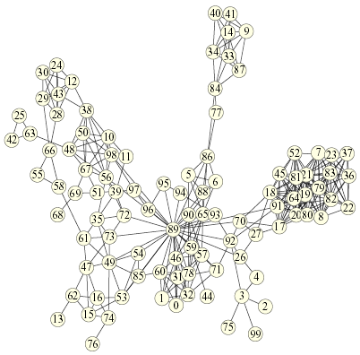
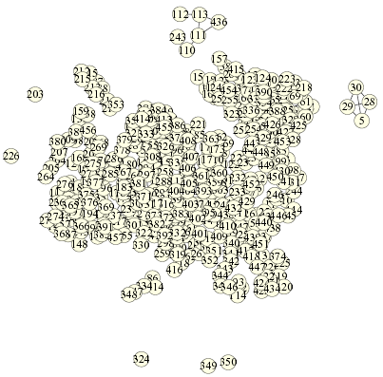
Examples
Radio Link Assignment
Given a telecommunication network (where each communication link has
various antenas) , assign a frequency to each antenna in such a way that
all antennas may operate together without noticeable interference.
Encoding?
Variables: one for each antenna
Domains: the set of available frequencies
Constraints: the ones referring to the antennas in the same communication link

Slide 22
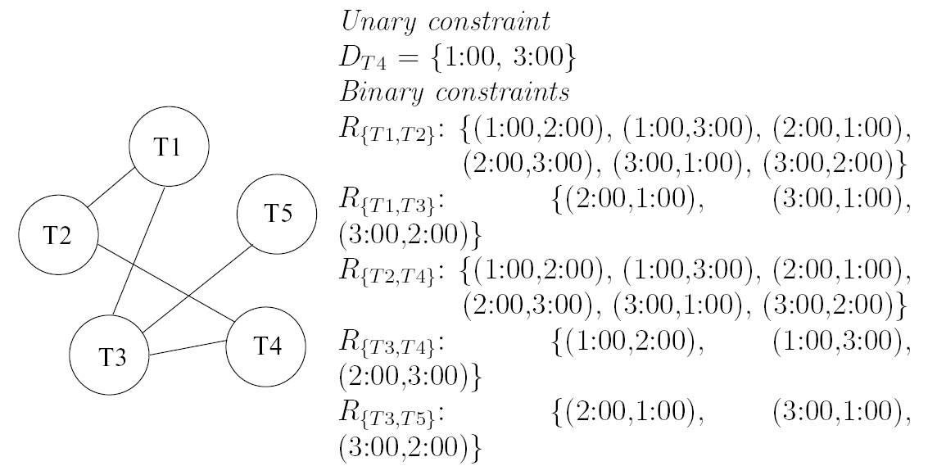
Examples
Scheduling problem
Five tasks: T1, T2, T3, T4, T5
Each one takes one hour to complete
The tasks may start at 1:00, 2:00 or 3:00
Requirements:
  T1 must start after T3
  T3 must start before T4 and after T5
  T2 cannot execute at the same time as T1 or T4
  T4 cannot start at 2:00
Encoding?
Variables: one for each task
Domains: D_{T1} = D_{T2} = D_{T3} = D_{T3} = {1:00, 2:00, 3:00}
Constraints:
T4
1:00
2:00

Slide 23
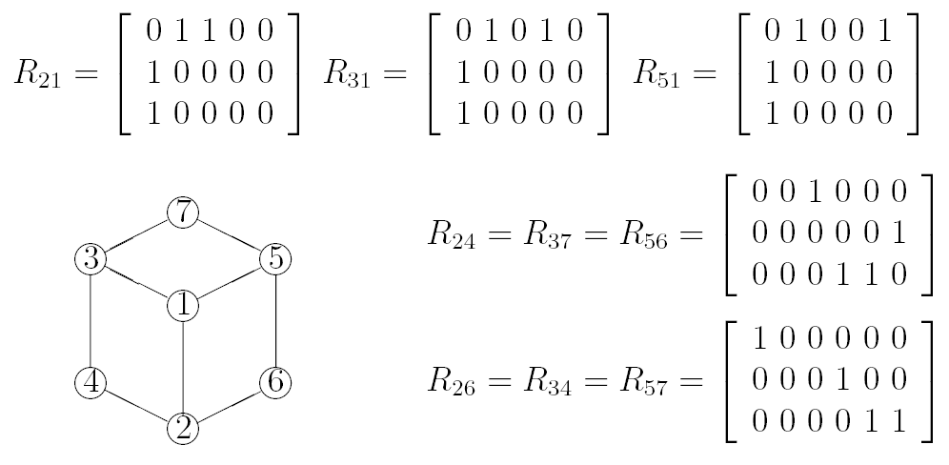
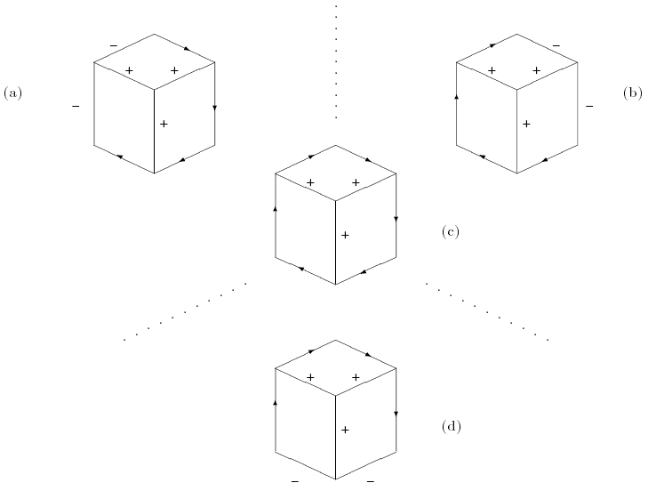
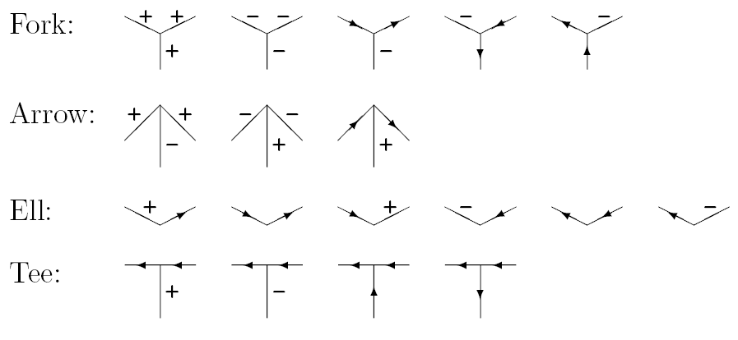
Examples
Scene-labelling problem (Huffman-Clowes labelling)

Slide 24
Examples
Numeric constraints
V1
v1 < v2
{1, 2, 3, 4}
{ 3, 6, 7 }
V2
v1+v3 < 9
v2 < v3
v2 > v4
V3
{ 3, 4, 9 }
{ 3, 5, 7 }
V4
Can we specify numeric constraints as relations?
It can be formulated as an integer linear program and apply
specific (and efficient) algorithms.

Slide 25
Examples
Temporal reasoning
Does it have a solution?

