Slide 1
Exact Inference Algorithms
Bucket-elimination and more
COMPSCI 179, Spring 2010
Set 8: Rina Dechter
(Reading: chapter 14, Russell and Norvig

Slide 2
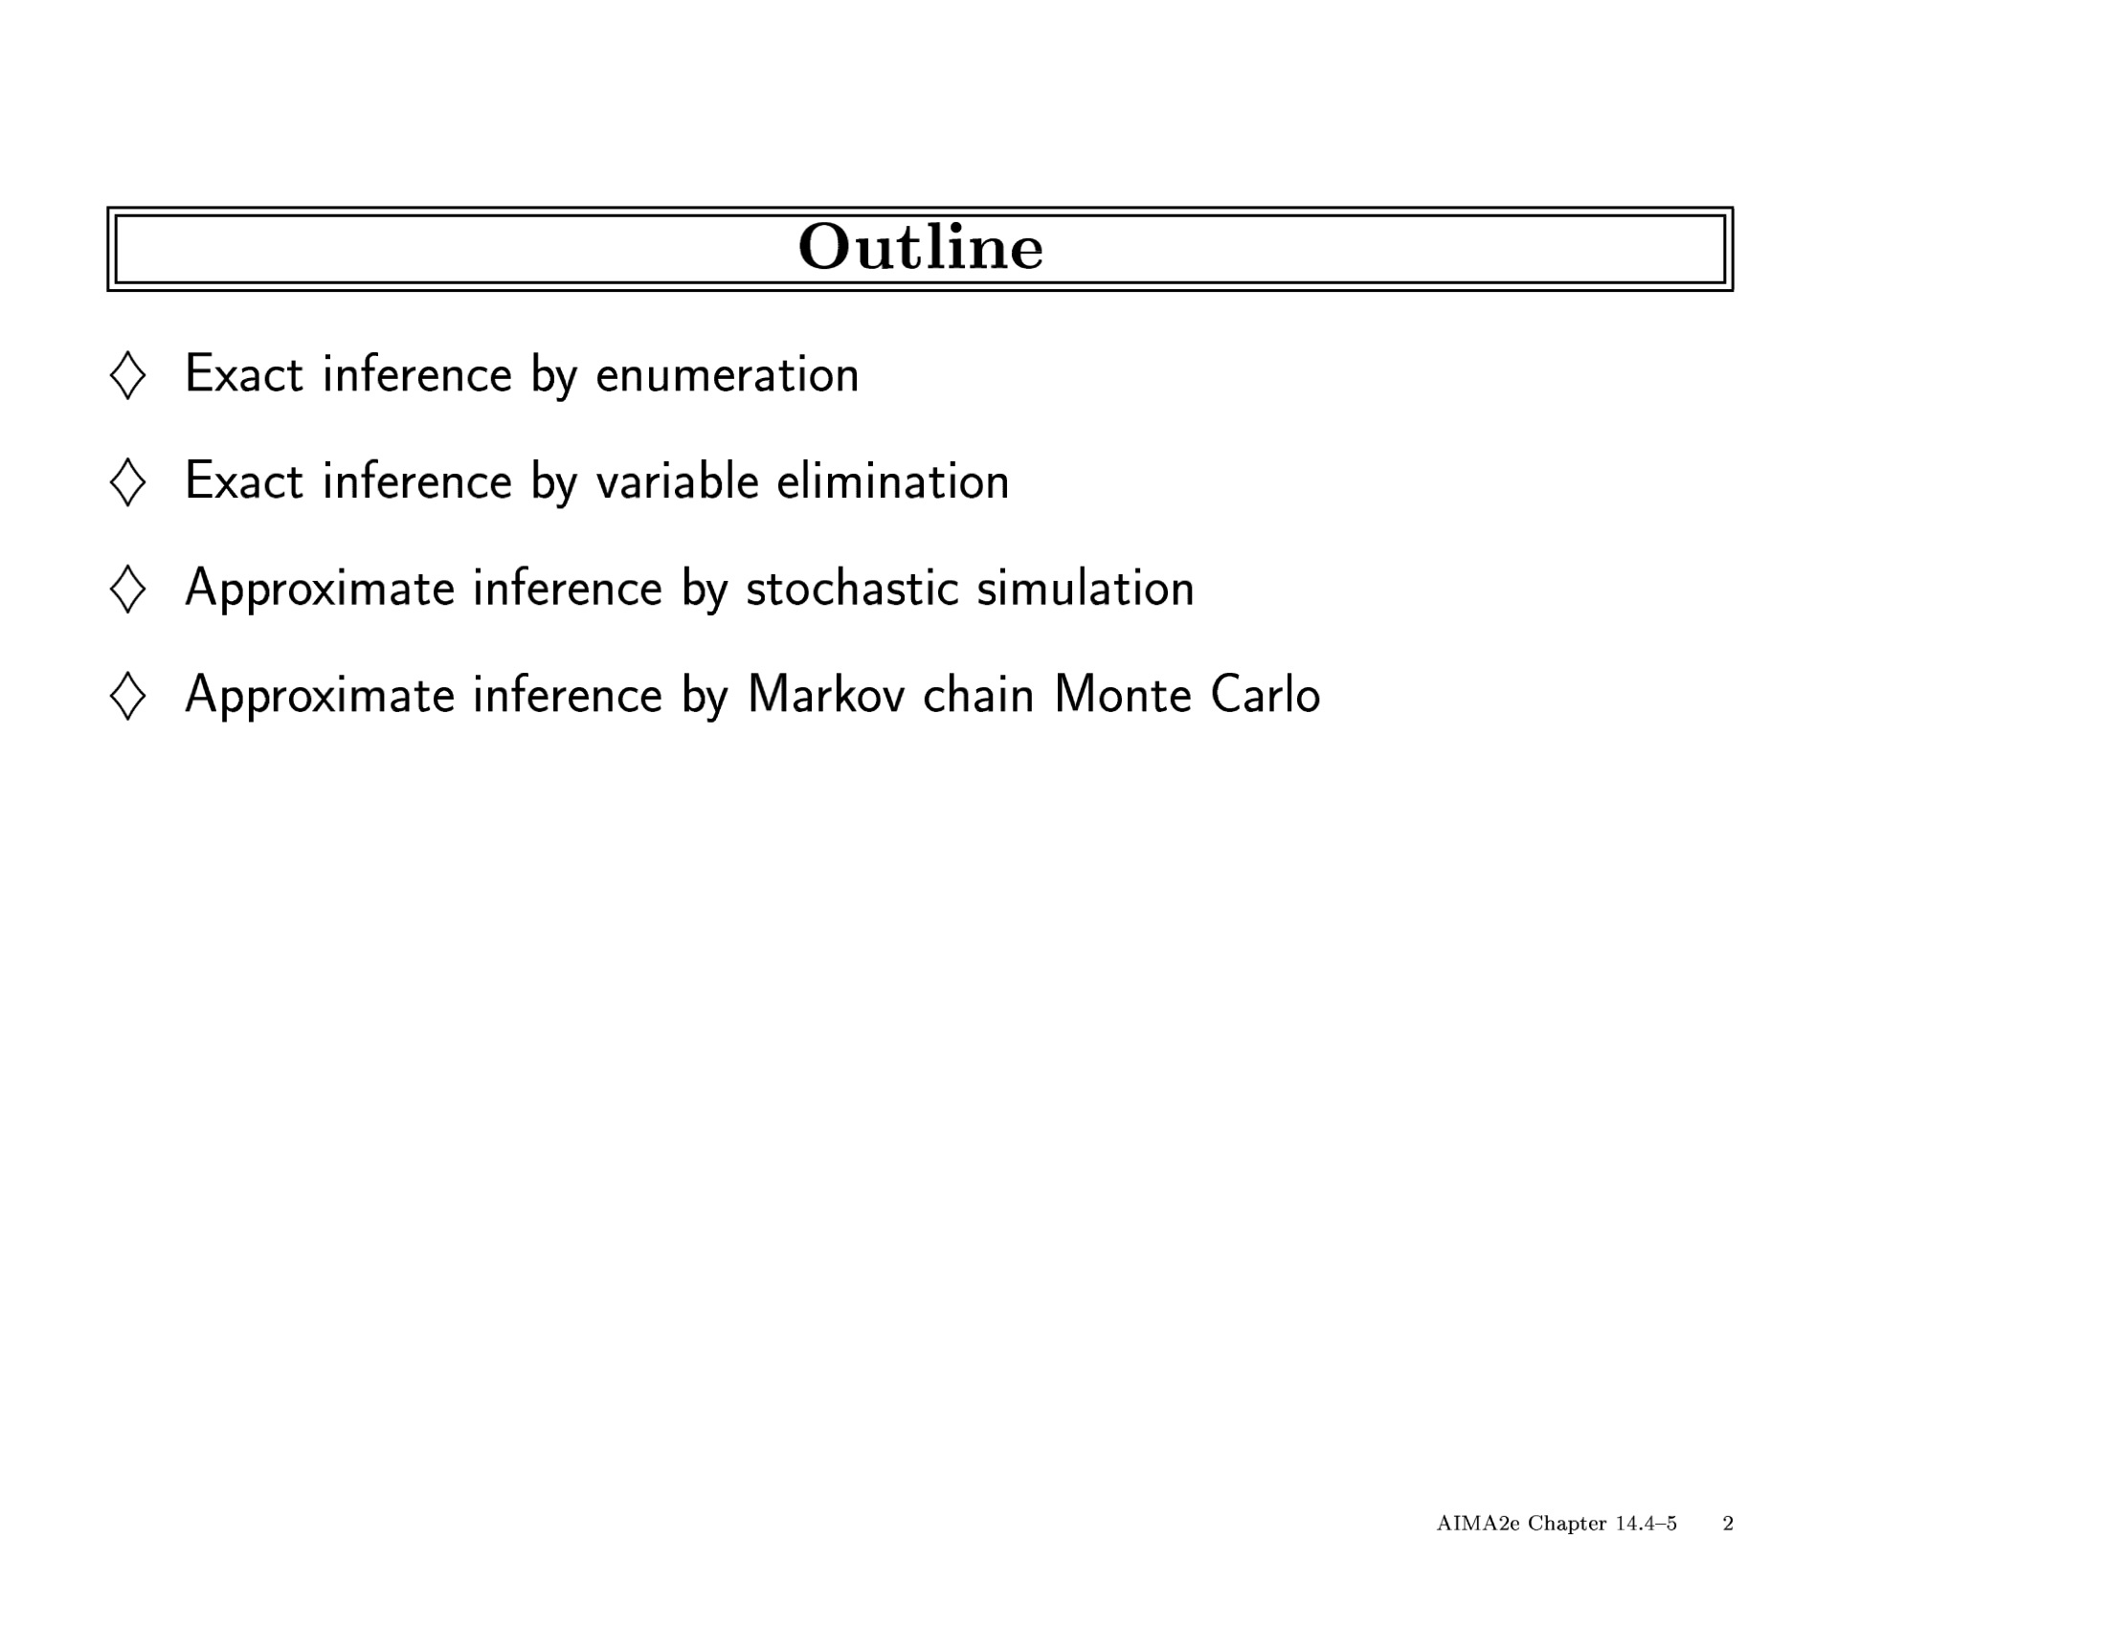

Slide 3
Counting
SUM operator
CHAIN structure
4
5
3
5
2
5
1
5
5
1
2
3
4
How many people?

Slide 4

Maximization
77
100
MAX operator
TREE structure
23
77
100
100
32
50
23
100
10
100
32
47
23
77
47
15
10
65
100
100
100
100
10
77
15
100
What is the maximum?

Slide 5
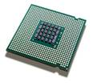
Min-Cost Assignment
12”
14”
15”
12”
14”
15”
12” | 14” | 15”
105 | 120 | 155
75
80
105
+
30
40
50
=
S
 | I | II | III
12” | 45 | ∞ | ∞
14” | 50 | 60 | 70
15” | ∞ | 65 | 80
 | I | II | III
12” | 75 | ∞ | ∞
14” | 80 | 100 | 130
15” | ∞ | 105 | 140
12”
14”
15”
75
80
 | 60G | 80G
12” | 30 | 50
14” | 40 | 45
15” | 50 | ∞
105
30
+
P
H
40
I
II
III
50
30
40
60
I
II
III
60G
80G
 | 6C | 9C
I | 30 | 50
II | 40 | 55
III | ∞ | 60
MIN-SUM operators
CHAIN structure
30
B
40
6C
9C
60
What is minimum cost configuration?

Slide 6


Belief Updating
H | P(H)
0 | .9
1 | .1
F | P(F)
0 | .99
1 | .01
F | h₃(F)
0 | .1245
1 | .73175
F | h₄(F)
0 | 1
1 | 1
F | P(F,B=1)
0 | .123255
1 | .073175
*
*
=
SUM-PROD operators
POLY-TREE structure
High
temperature
Faulty
head
H | F | M | P(M|H,F)
0 | 0 | 0 | .9
0 | 0 | 1 | .1
0 | 1 | 0 | .1
0 | 1 | 1 | .9
1 | 0 | 0 | .8
1 | 0 | 1 | .2
1 | 1 | 0 | .01
1 | 1 | 1 | .99
H | F | M | Bel(M,H,F)
0 | 0 | 0 | .0405
0 | 0 | 1 | .072
0 | 1 | 0 | .0045
0 | 1 | 1 | .648
1 | 0 | 0 | .004
1 | 0 | 1 | .008
1 | 1 | 0 | .00005
1 | 1 | 1 | .0792
H | F | M | P(M|H,F)
0 | 0 | 0 | .9
0 | 0 | 1 | .1
0 | 1 | 0 | .1
0 | 1 | 1 | .9
1 | 0 | 0 | .8
1 | 0 | 1 | .2
1 | 1 | 0 | .01
1 | 1 | 1 | .99
F | R | P(R|F)
0 | 0 | .8
0 | 1 | .2
1 | 0 | .3
0 | 1 | .7
M | h₁(M)
0 | .05
1 | .8
H | h₂(H)
0 | .9
1 | .1
Mechanical
problem
Read
delays
*
*
=
M | B | P(B|M)
0 | 0 | .95
0 | 1 | .05
1 | 0 | .2
1 | 1 | .8
Buzz
sound
P(h,f,r,m,b) = P(h) P(f) P(m|h,f) P(r|f) P(b|m)
P(F | B=1) = ?
P(B=1) = .19643
P(F=1|B=1) = .3725
Probability of evidence
Updated belief

Slide 7
Belief updating (sum-prod)
X
Y
Z
T
R
L
M

Slide 8
MPE (max-prod)
X
Y
Z
T
R
L
M

Slide 9
CSP – consistency (projection-join)
X
Y
Z
T
R
L
M

Slide 10
#CSP (sum-prod)
X
Y
Z
T
R
L
M

Slide 11
Tree-solving
Belief updating (sum-prod)
CSP – consistency (projection-join)
X
Y
Z
MPE (max-prod)
T
R
L
M
#CSP (sum-prod)

Slide 12
Belief Propagation
[Pearl, 1988]
Instances of tree message passing algorithm
Exact for trees
Linear in the input size
Importance:
  One of the first algorithms for inference in Bayesian networks
  Gives a cognitive dimension to its computations
  Basis for conditioning algorithms for arbitrary Bayesian network
  Basis for Loopy Belief Propagation (approximate algorithms)

Slide 13
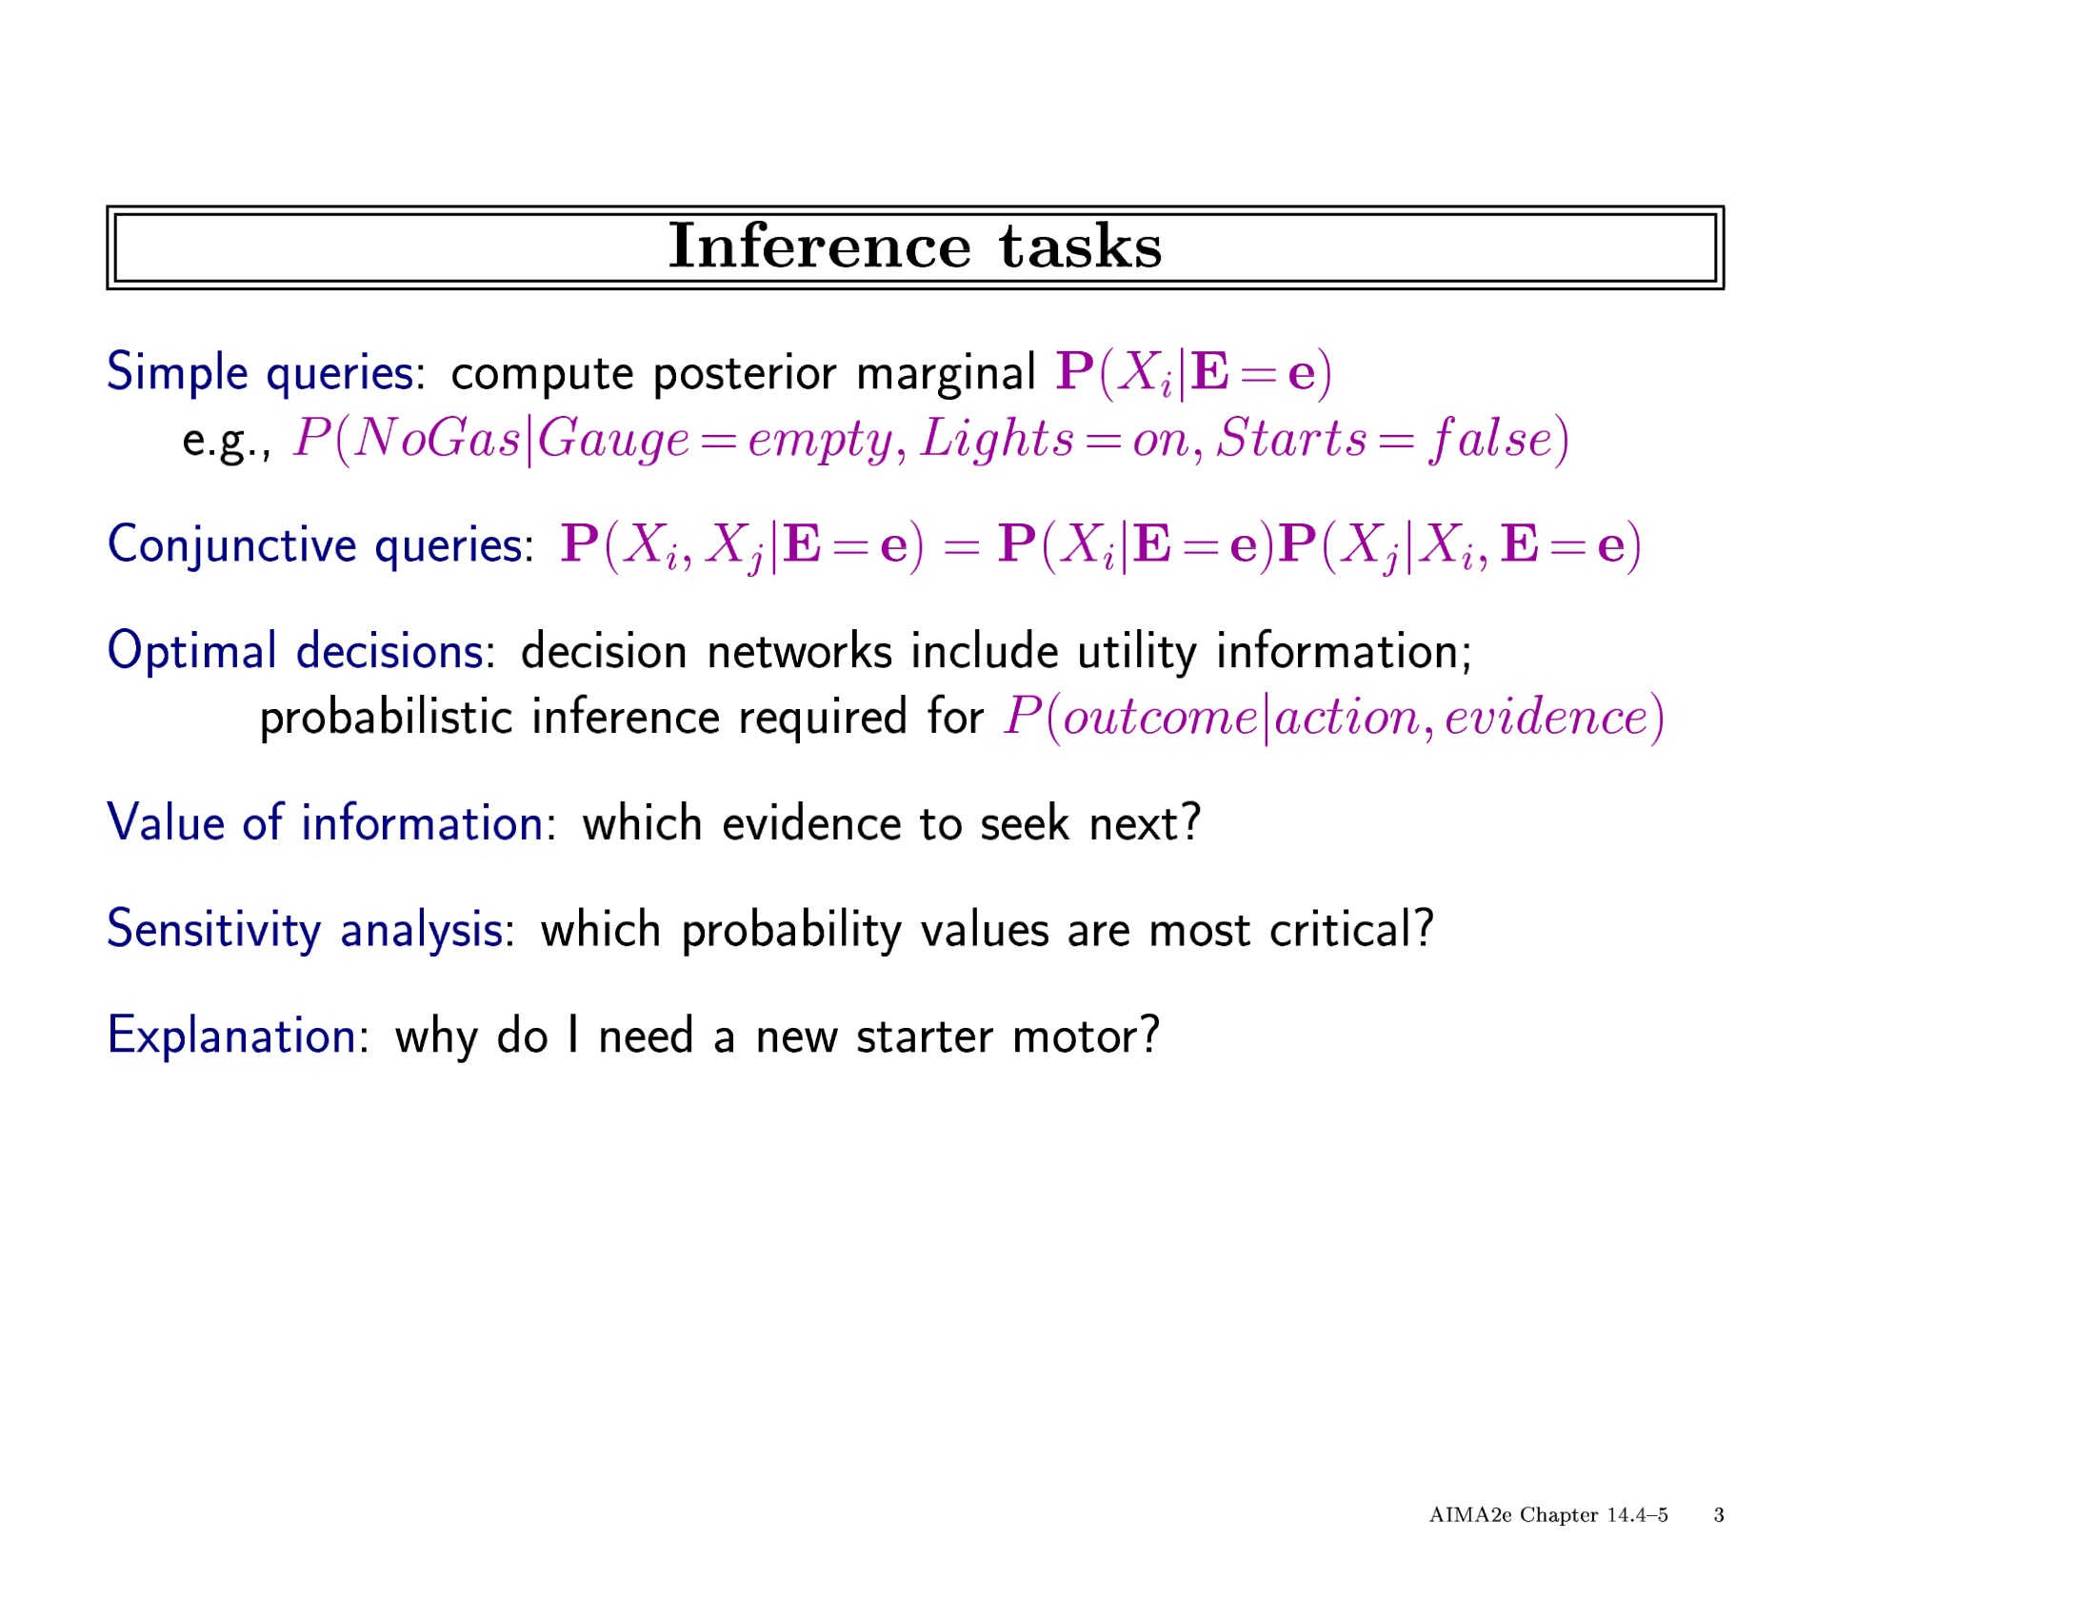

Slide 14
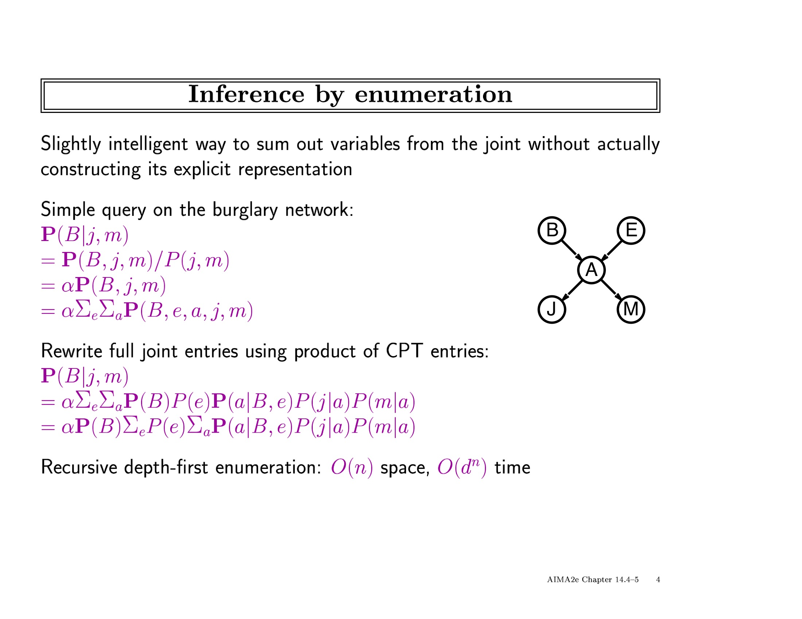

Slide 15
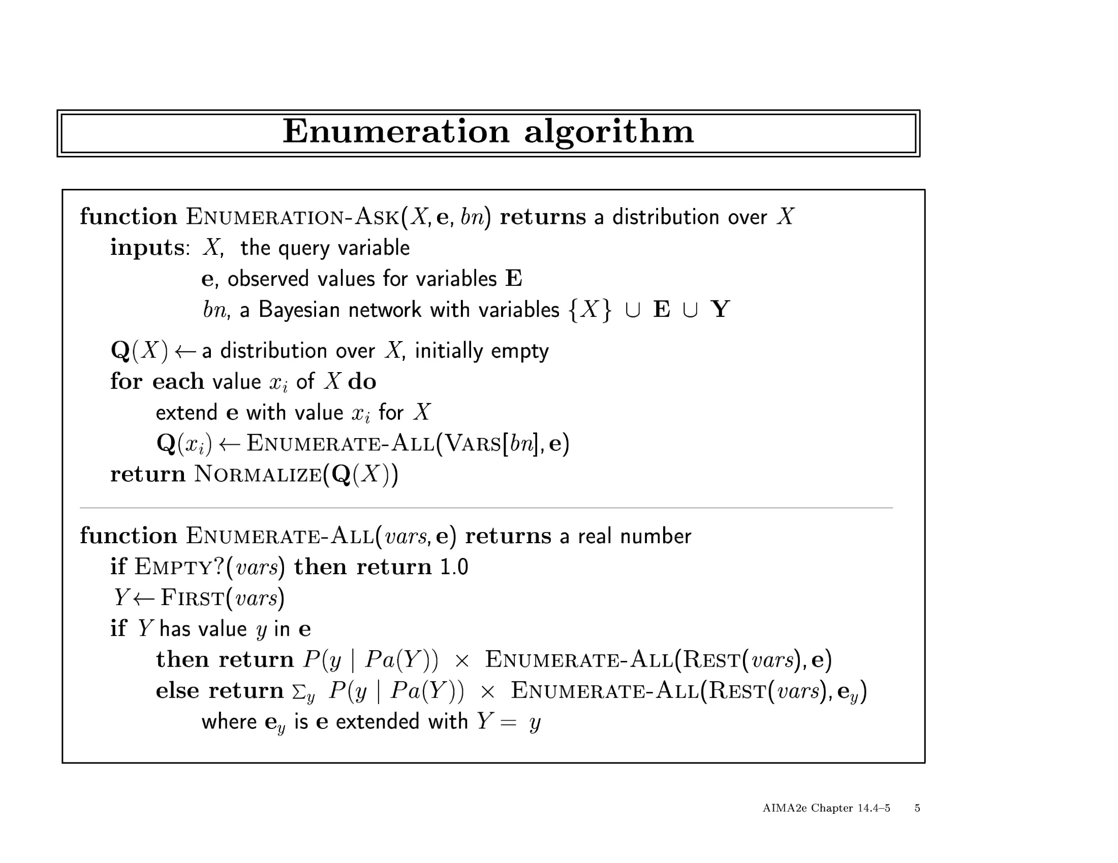

Slide 16
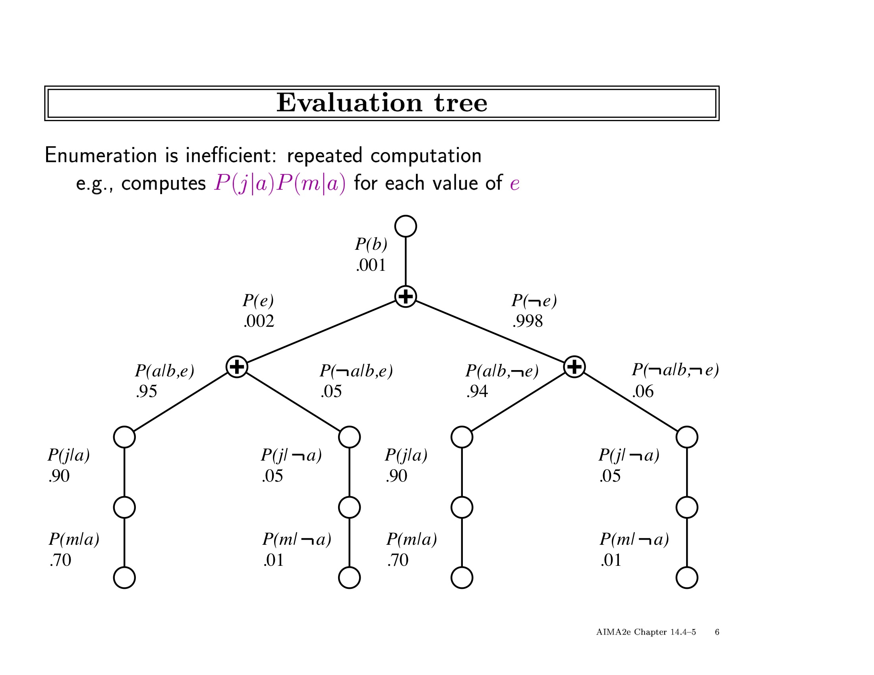

Slide 17
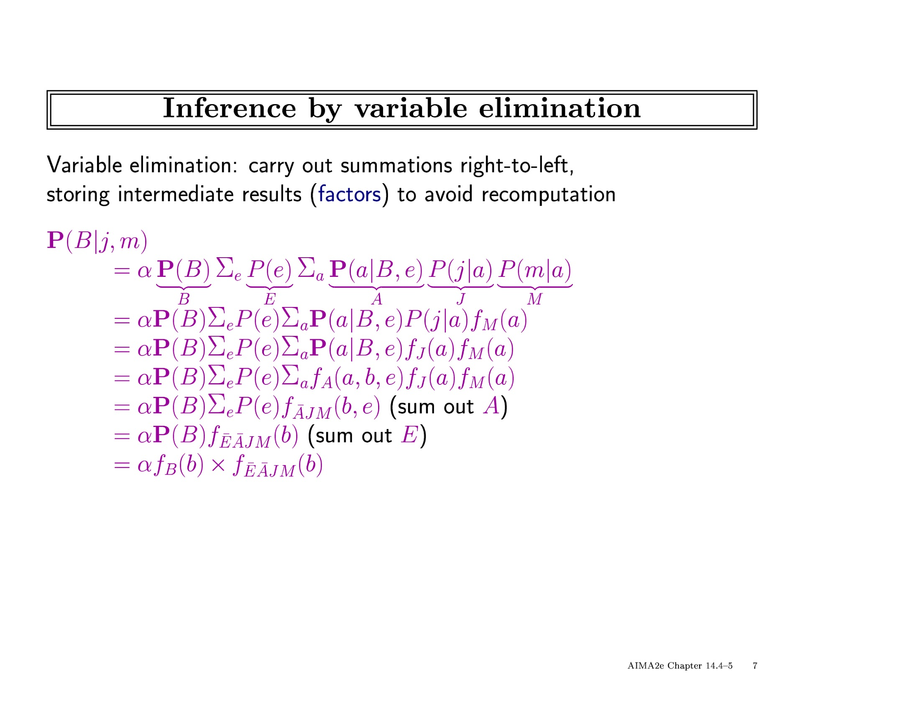

Slide 18
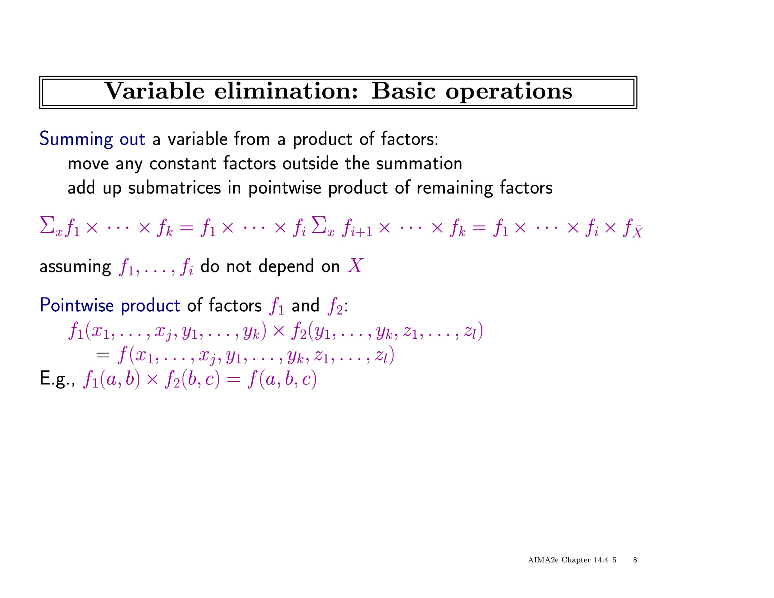

Slide 19
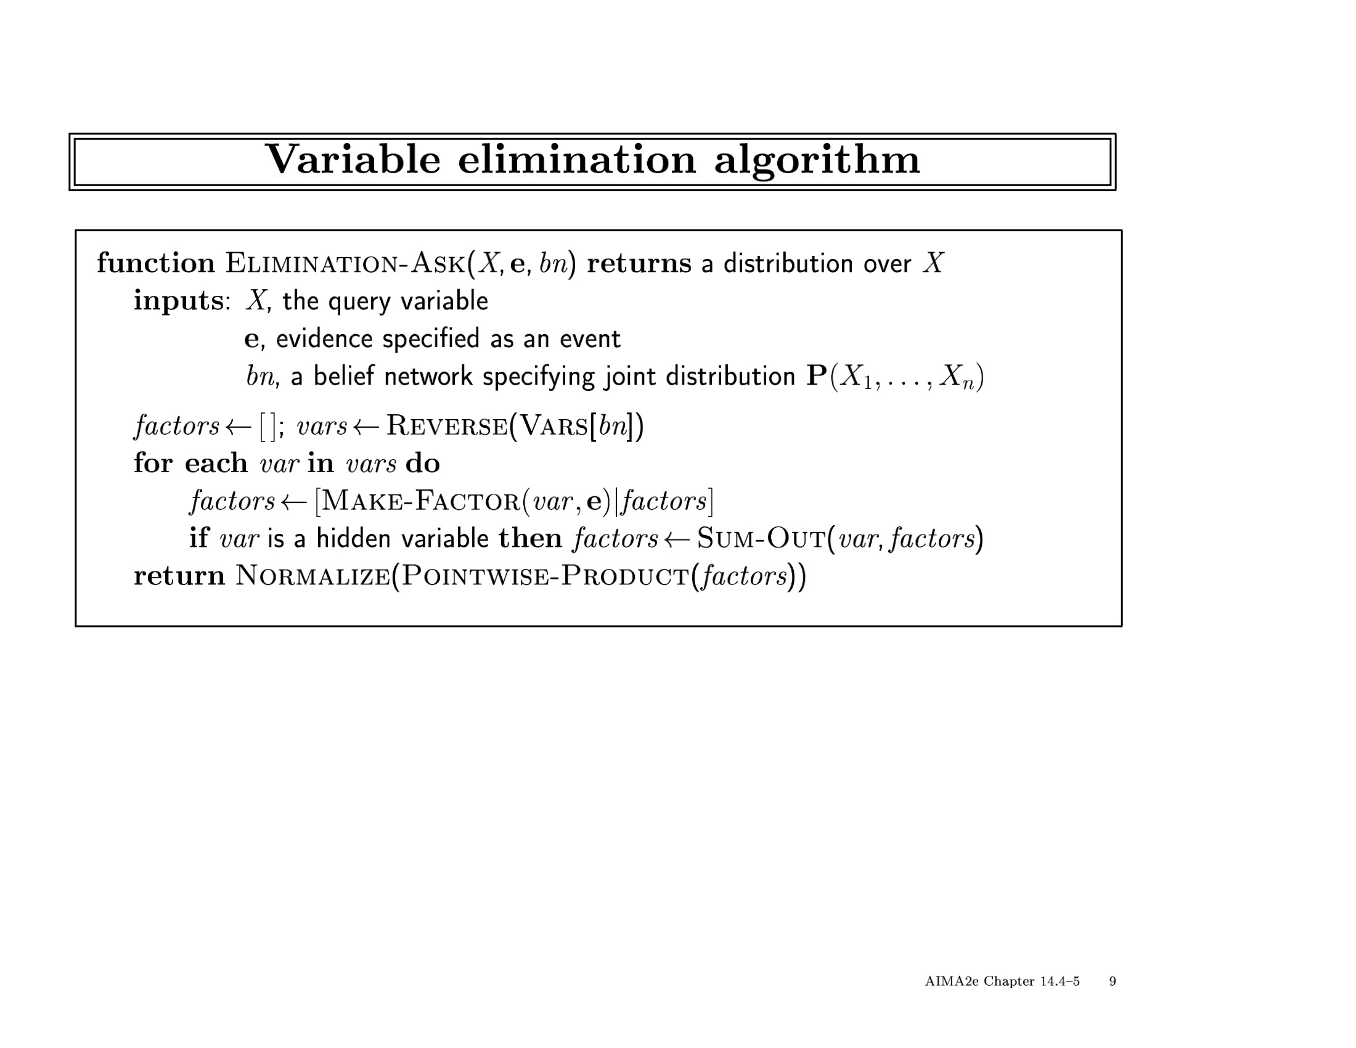

Slide 20
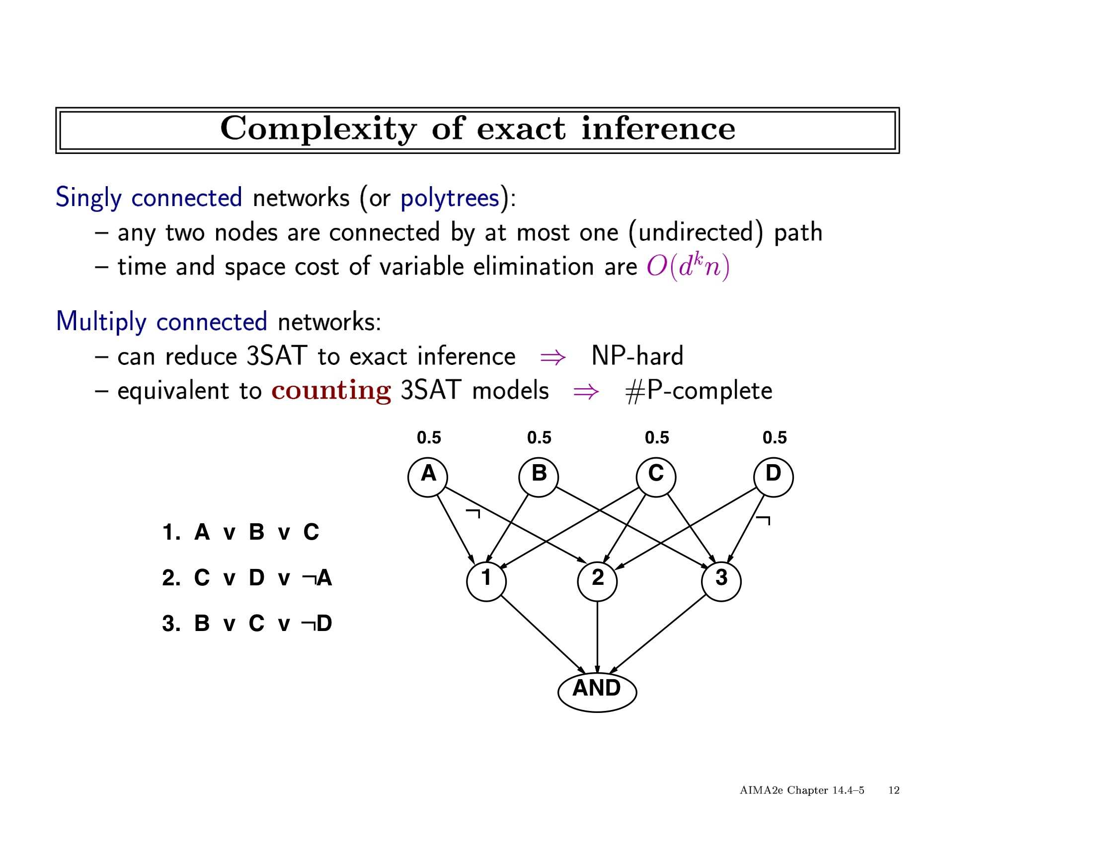

Slide 21
Exact Inference Algorithms
Bucket-elimination
COMPSCI 179, Spring 2010
Set 8: Rina Dechter
(Reading: chapter 14, Russell and Norvig

Slide 22
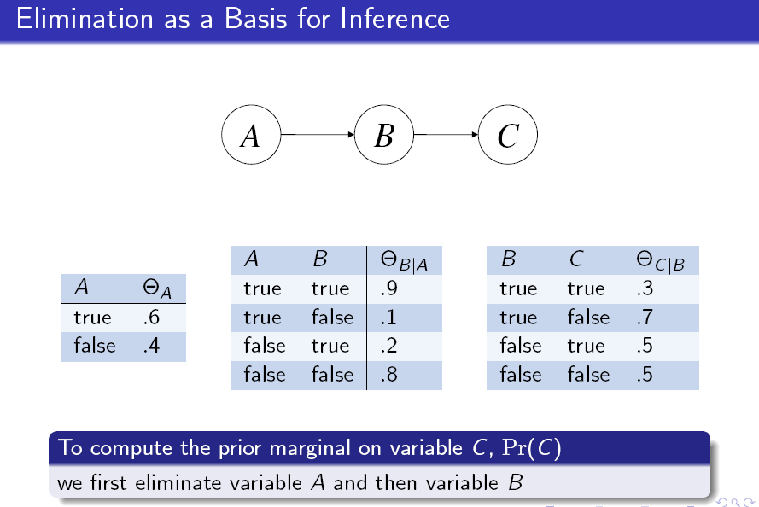

Slide 23
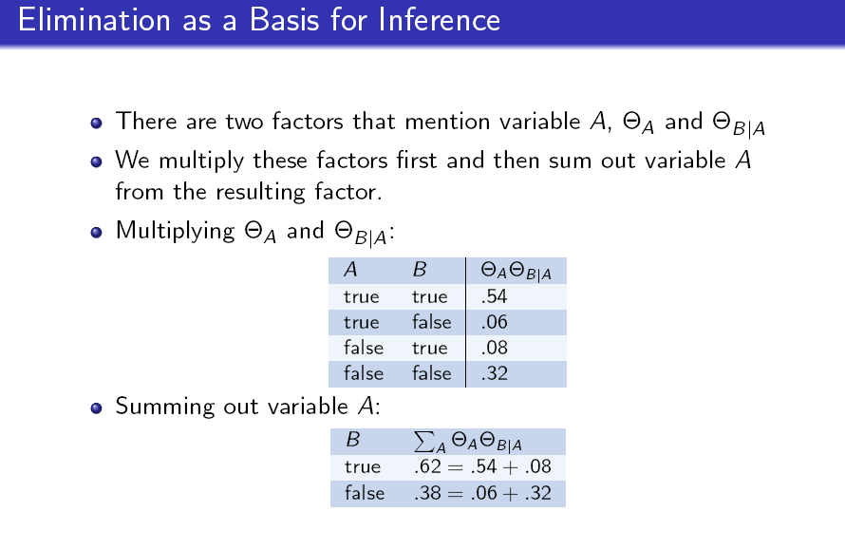

Slide 24
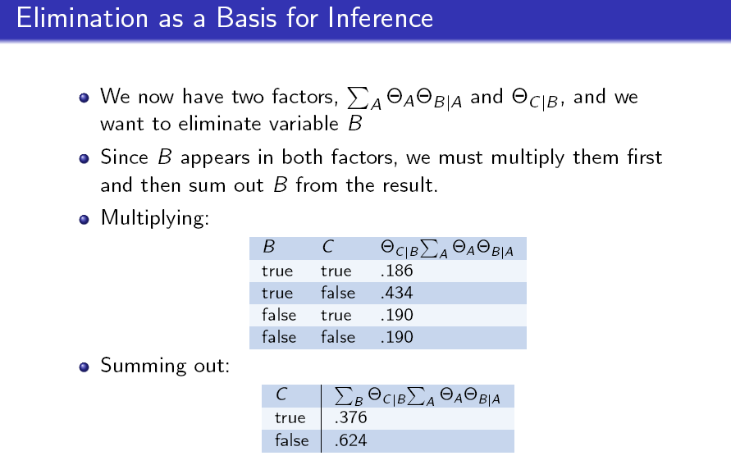

Slide 25
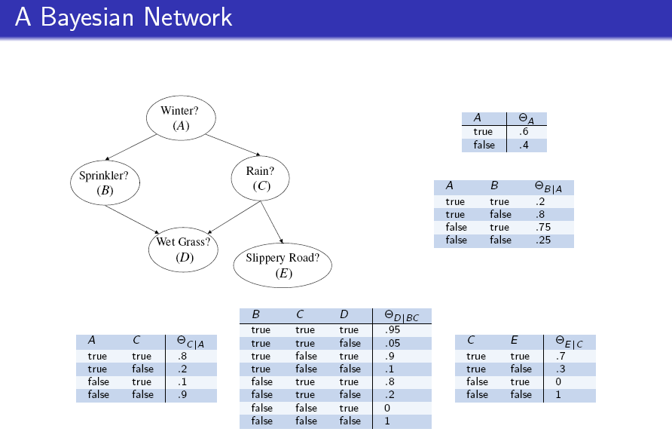

Slide 26
Belief Updating
Smoking
lung Cancer
Bronchitis
X-ray
Dyspnoea
P (lung cancer=yes | smoking=no, dyspnoea=yes ) = ?

Slide 27
Belief updating: P(X|evidence)=?
A
P(a|e=0)
P(a,e=0)=
B
C
B
C
P(a)P(b|a)P(c|a)P(d|b,a)P(e|b,c)=
D
E
D
E
“Moral” graph
P(a)
P(c|a)
P(b|a)P(d|b,a)P(e|b,c)
Variable Elimination

Slide 28
Bucket elimination
Algorithm BE-bel (Dechter 1996)
Elimination operator
bucket B:
P(b|a) P(d|b,a) P(e|b,c)
B
bucket C:
P(c|a)
C
bucket D:
D
bucket E:
e=0
E
bucket A:
P(a)
W*=4
”induced width”
(max clique size)
A
P(a|e=0)

Slide 29
A
B
C
D
E
“Moral” graph

Slide 30
BE-BEL

Slide 31
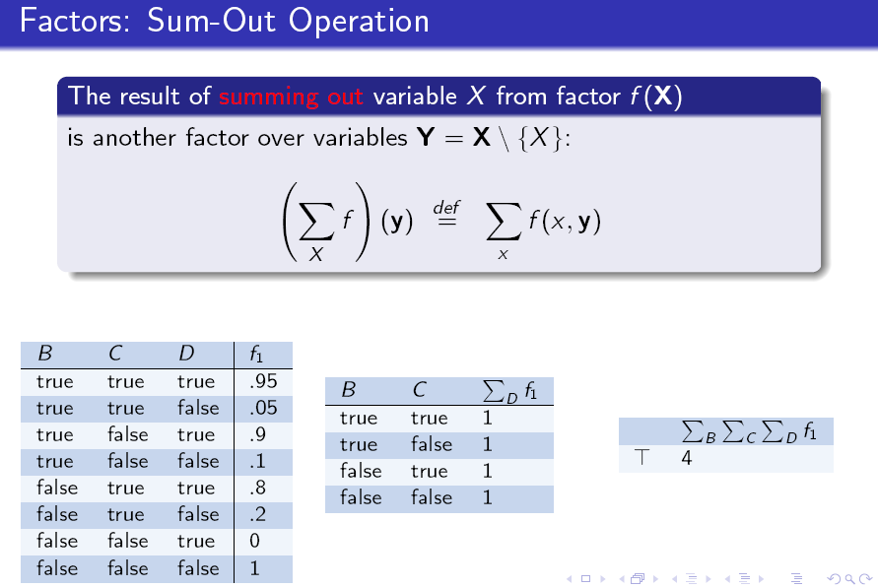

Slide 32
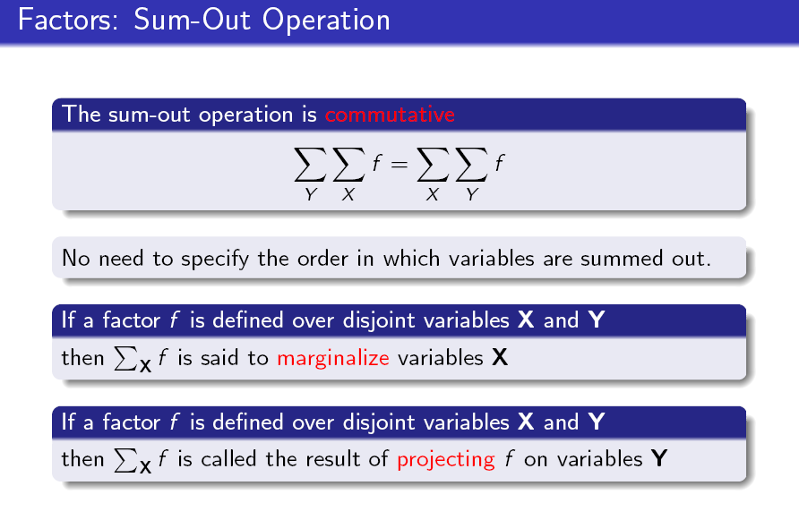

Slide 33
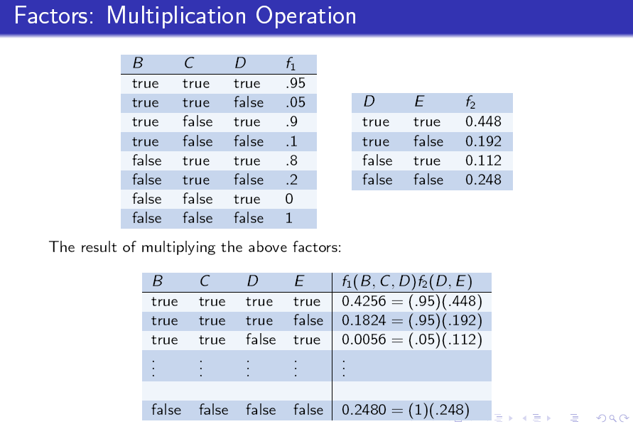

Slide 34
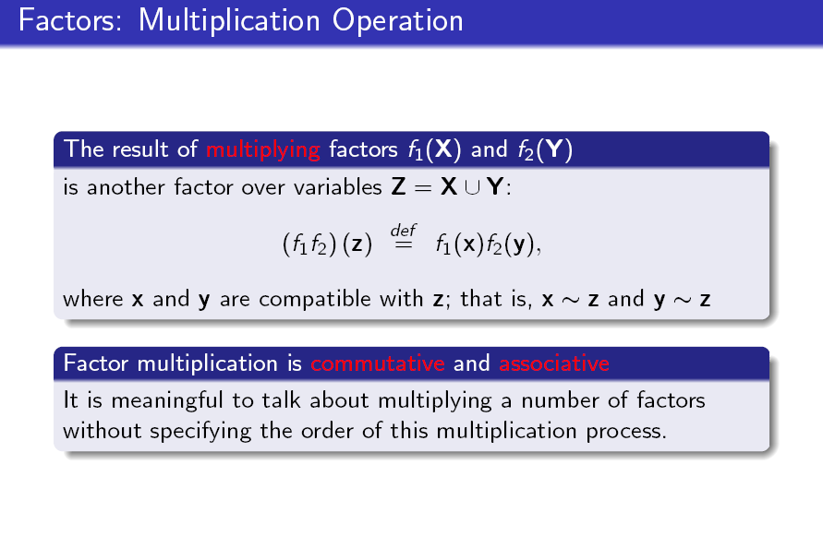

Slide 35
Student Network example
P(J)?
Difficulty
Intelligence
Grade
SAT
Apply
Letter
Job

Slide 36
E
D
C
B
A
B
C
D
E
A

Slide 37
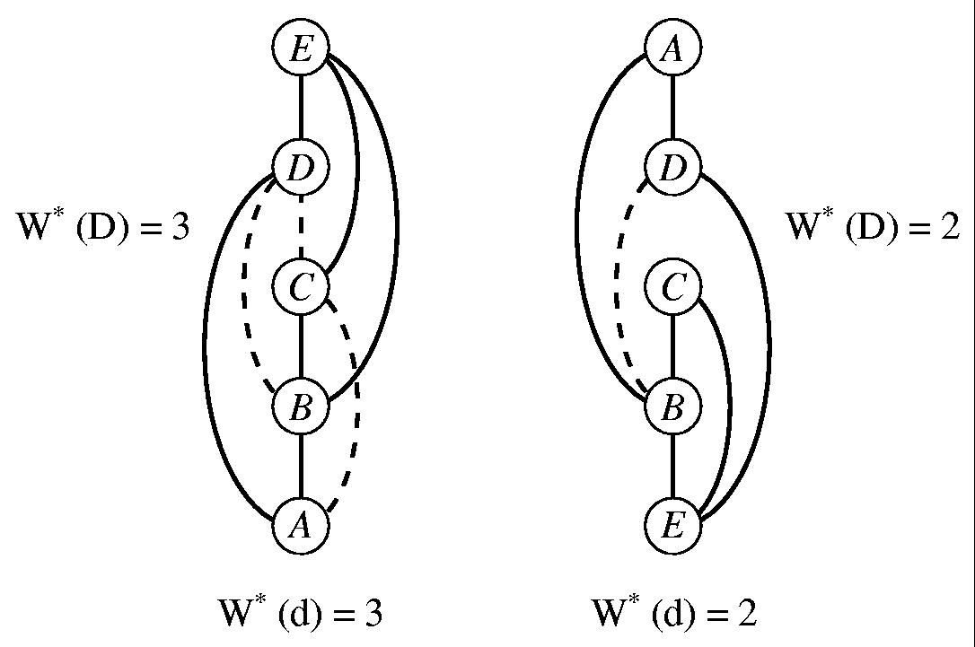
The induced-width
width: is the max number of parents in the ordered graph
Induced-width: width of induced graph: recursively connecting parents going from last node to first.
Induced-width w*(d) = the max induced-width over all nodes
Induced-width of a graph: max w*(d) over all d

Slide 38
Complexity of elimination
The effect of the ordering:
A
B
E
C
D
B
C
D
C
E
B
D
E
A
A
“Moral” graph

Slide 39
BE-BEL
More accurately: O(r exp(w*(d)) where r is the number of cpts.
For Bayesian networks r=n. For Markov networks?

Slide 41
The impact of observations
Moral graph
Induced Moral graph
Adjusted Graph for evidence in B
Induced-adjusted.

Slide 42
Probabilistic Inference Tasks
Belief updating:
Finding most probable explanation (MPE)

Slide 43
Algorithm elim-mpe (Dechter 1996)
Elimination operator
bucket B:
P(b|a) P(d|b,a) P(e|b,c)
B
bucket C:
P(c|a)
C
bucket D:
D
bucket E:
e=0
E
bucket A:
P(a)
W*=4
”induced width”
(max clique size)
A
MPE

Slide 44
Generating the MPE-tuple
B:
P(b|a) P(d|b,a) P(e|b,c)
C:
P(c|a)
D:
E:
e=0
A:
P(a)

Slide 45
Min-Cost Assignment
12”
14”
15”
12”
14”
15”
12” | 14” | 15”
105 | 120 | 155
75
80
105
+
30
40
50
=
S
 | I | II | III
12” | 45 | ∞ | ∞
14” | 50 | 60 | 70
15” | ∞ | 65 | 80
 | I | II | III
12” | 75 | ∞ | ∞
14” | 80 | 100 | 130
15” | ∞ | 105 | 140
12”
14”
15”
75
80
 | 60G | 80G
12” | 30 | 50
14” | 40 | 45
15” | 50 | ∞
105
30
+
P
H
40
I
II
III
50
30
40
60
I
II
III
60G
80G
 | 6C | 9C
I | 30 | 50
II | 40 | 55
III | ∞ | 60
MIN-SUM operators
CHAIN structure
30
B
40
6C
9C
60
What is minimum cost configuration?

Slide 47
BE-MPE
BE-MPE

Slide 48
Finding small induced-width
NP-complete
A tree has induced-width of ?
Greedy algorithms:
  Min width
  Min induced-width
  Max-cardinality
  Fill-in (thought as the best)
  See anytime min-width (Gogate and Dechter)

Slide 49
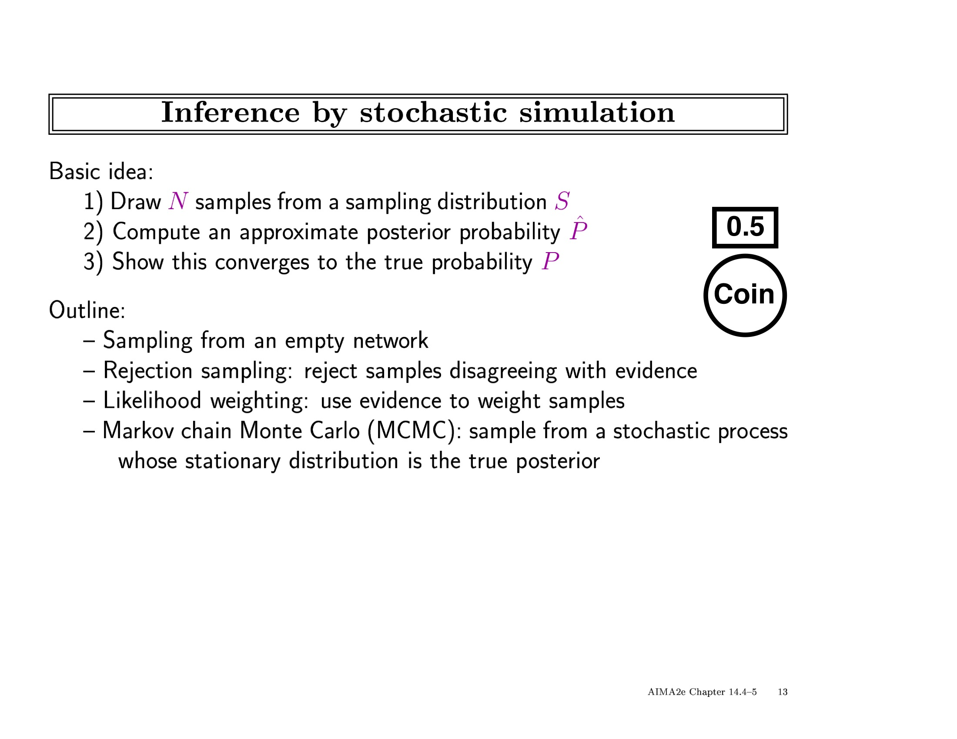

Slide 50
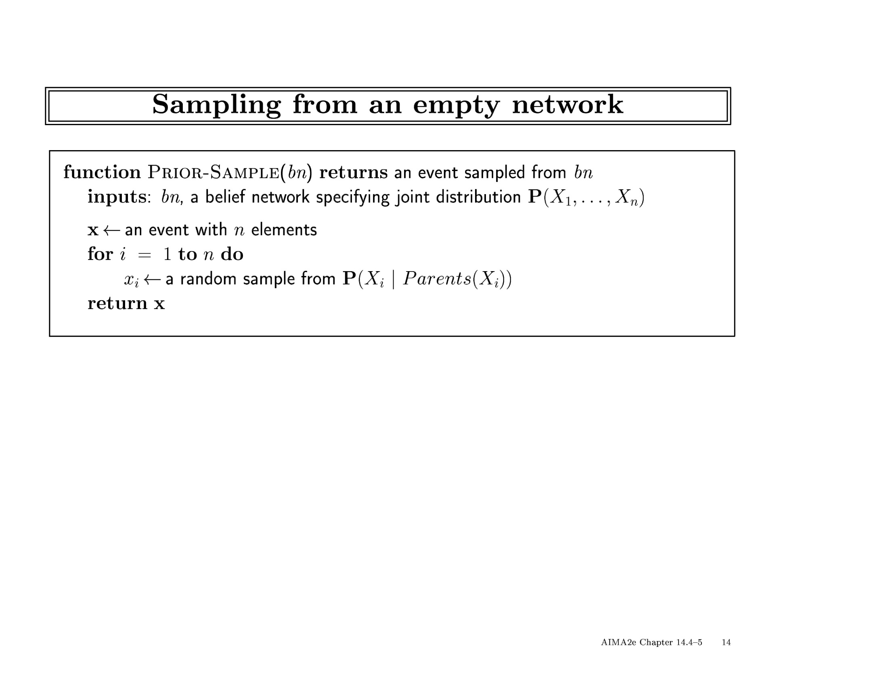

Slide 51
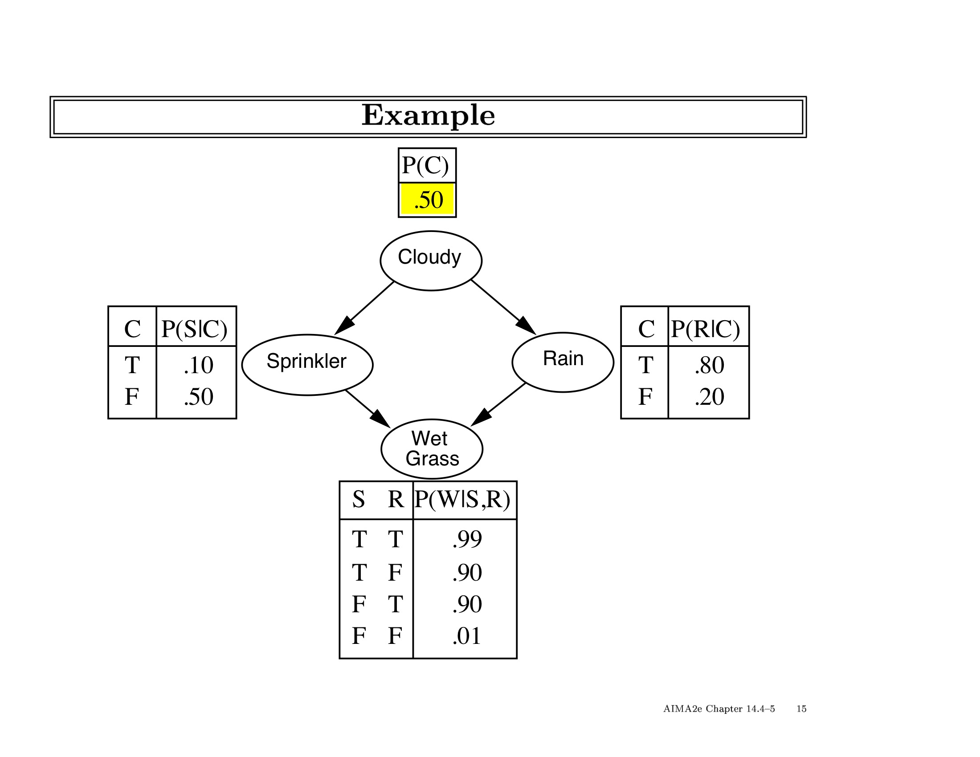

Slide 52
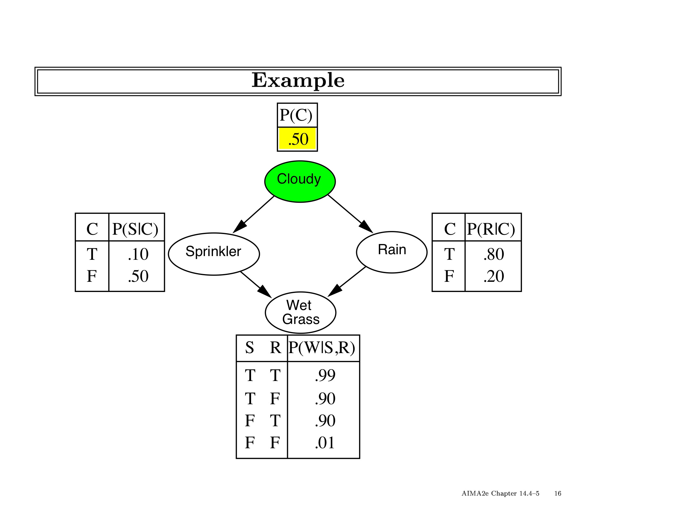

Slide 53


Slide 54
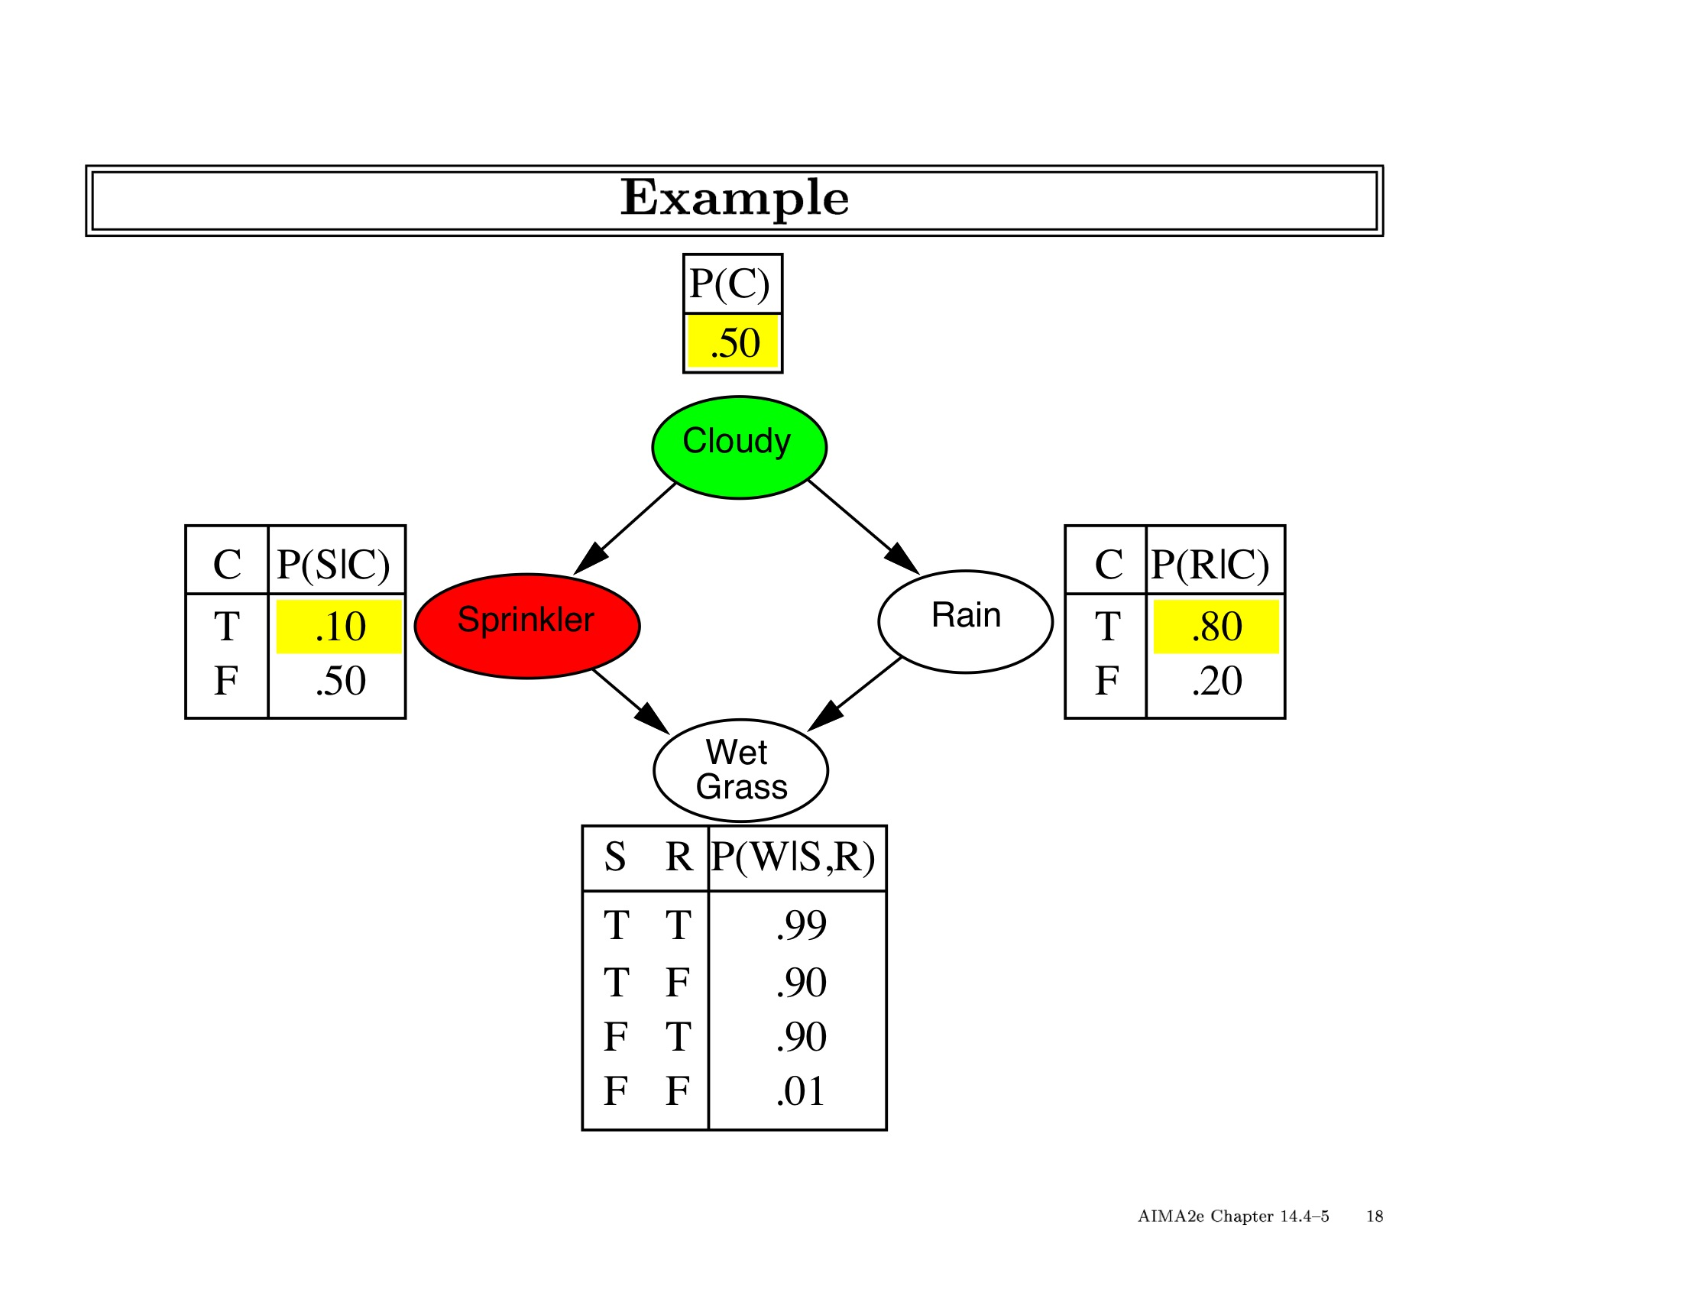

Slide 55
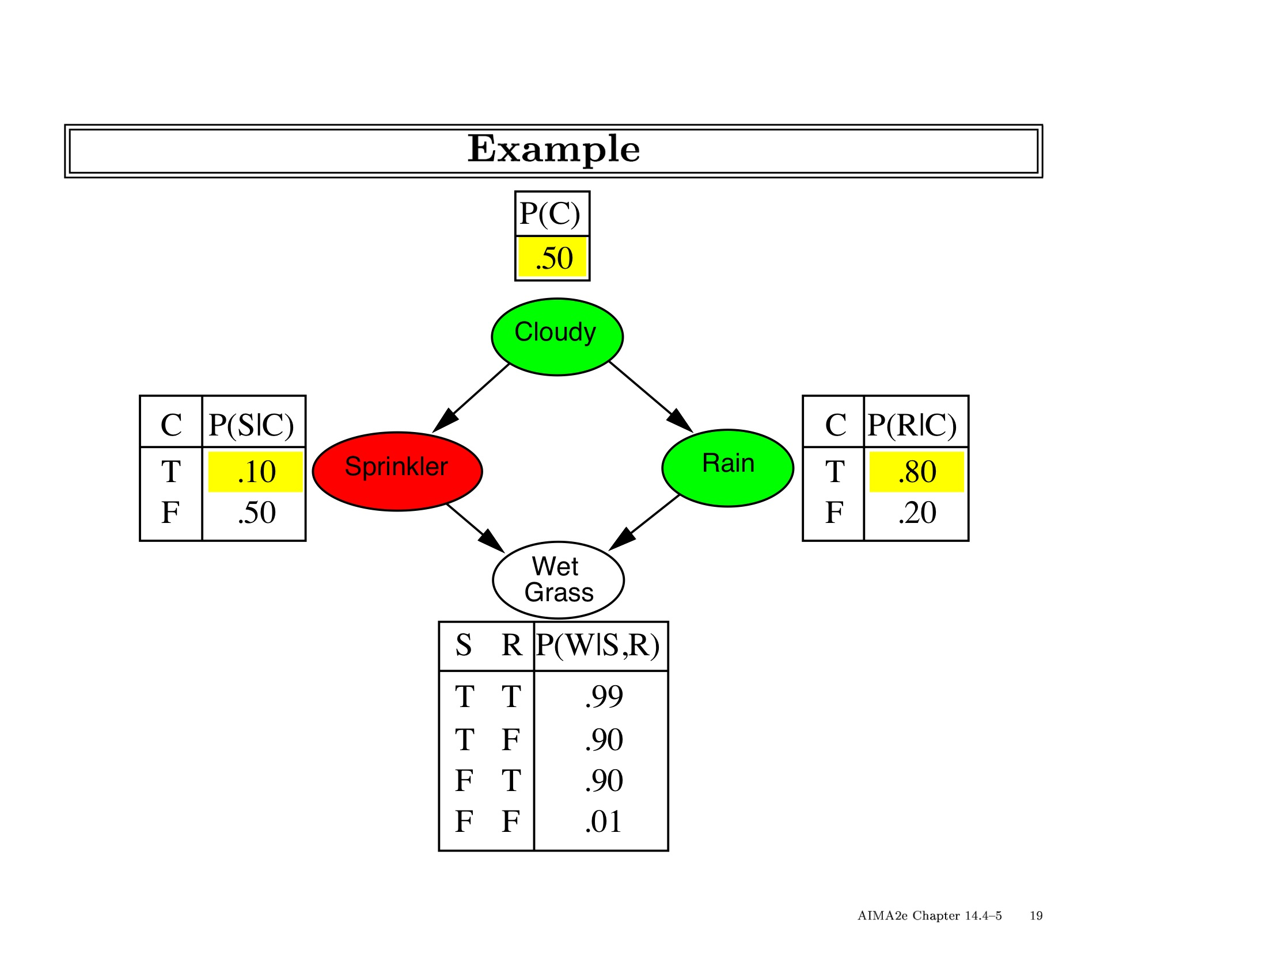

Slide 56
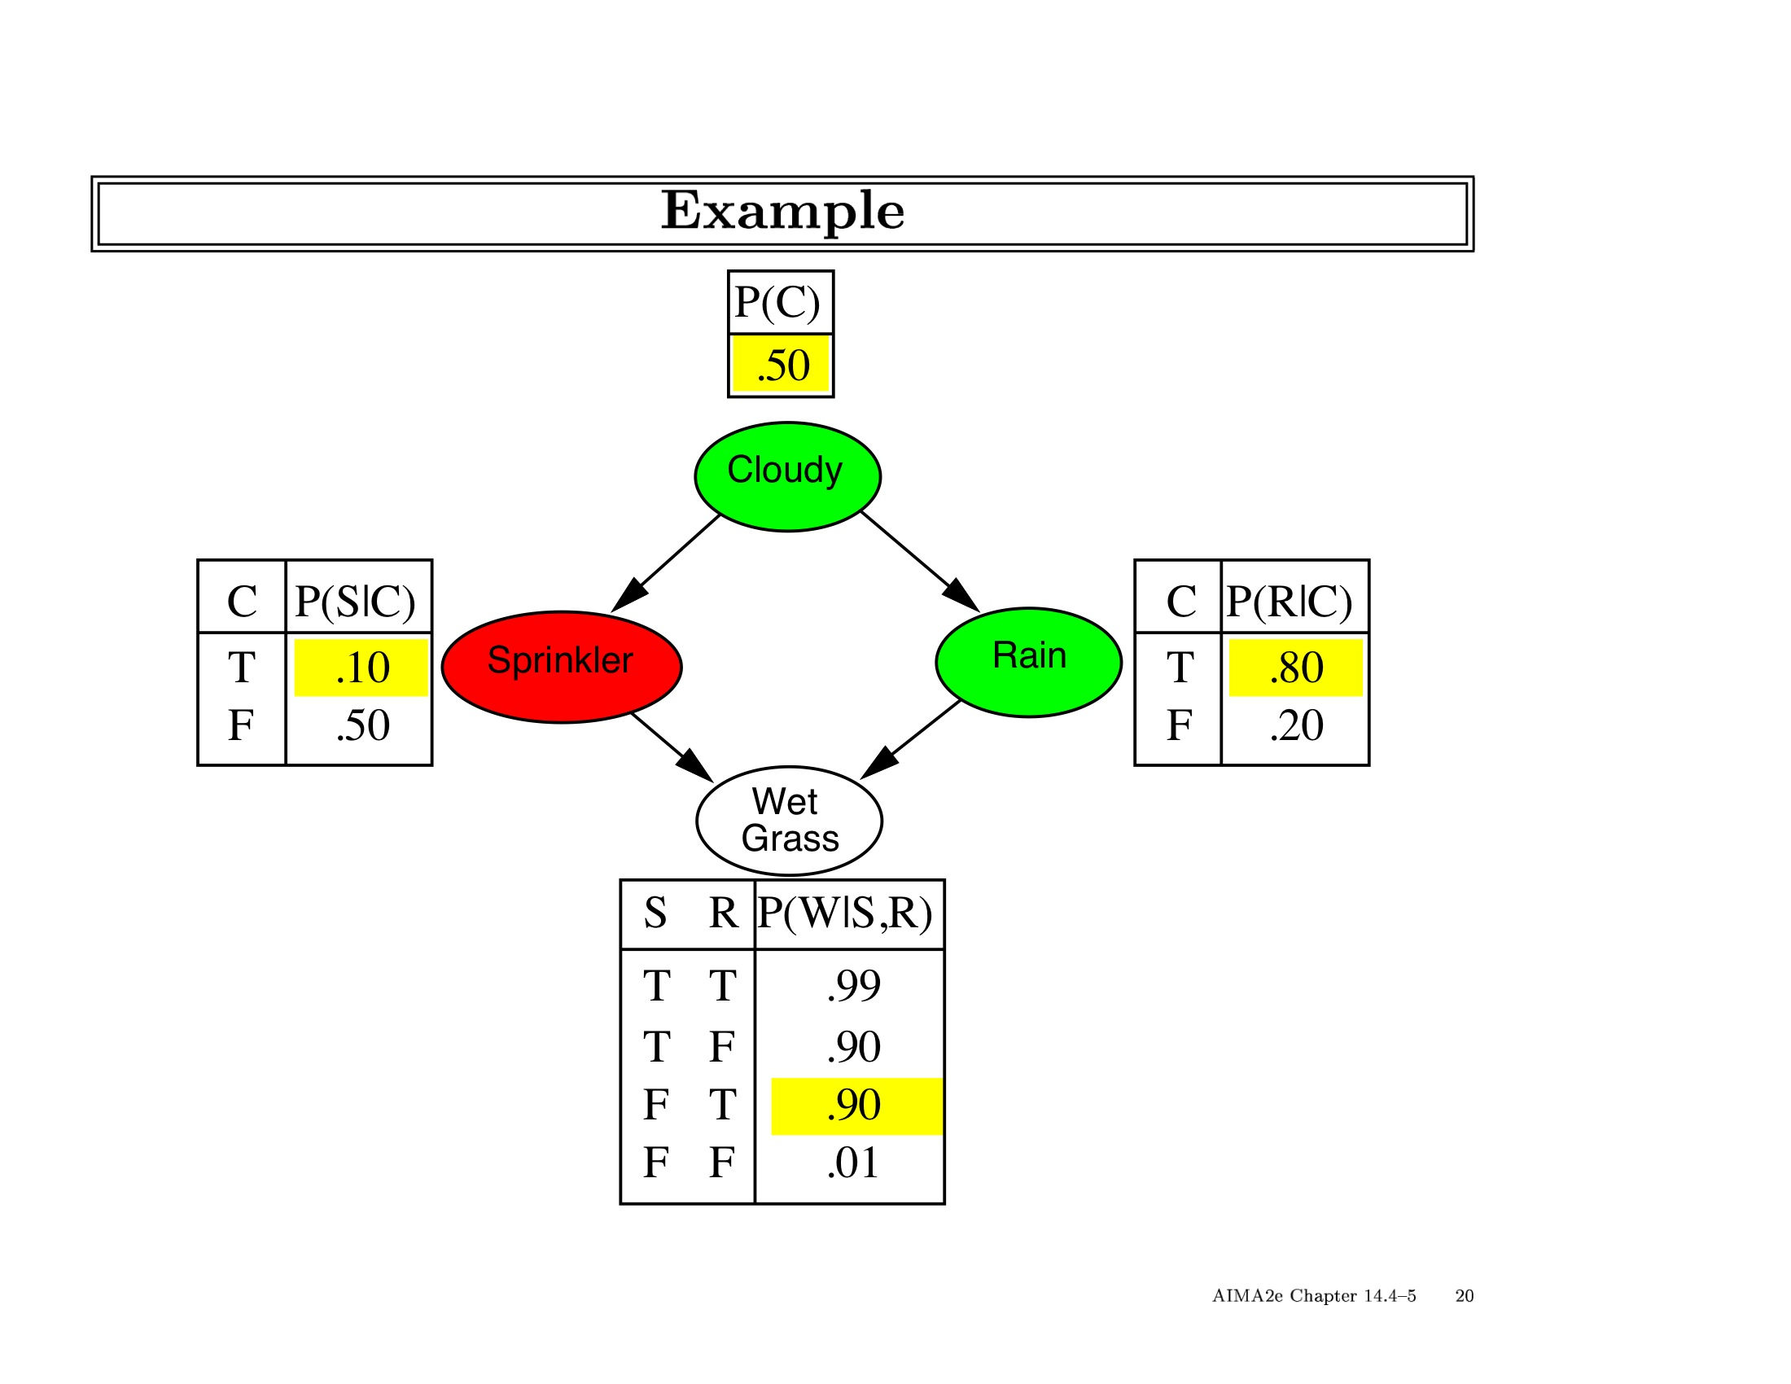

Slide 57
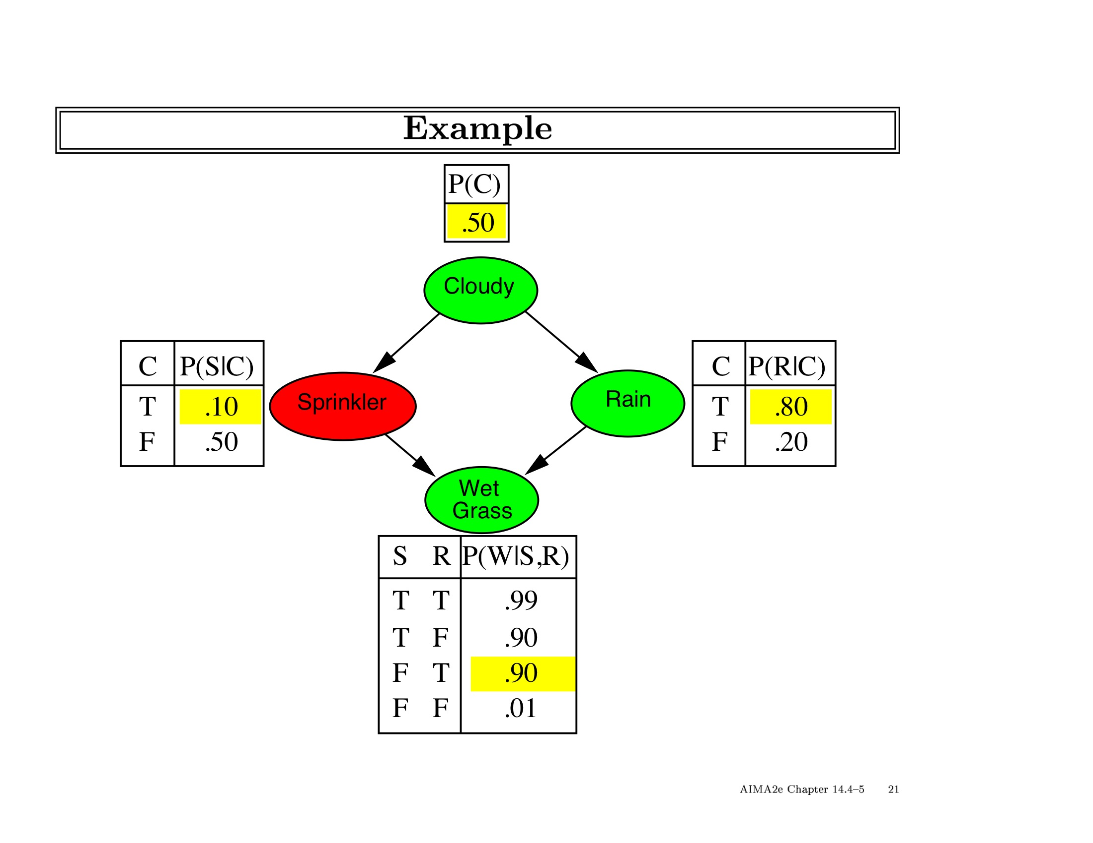

Slide 58
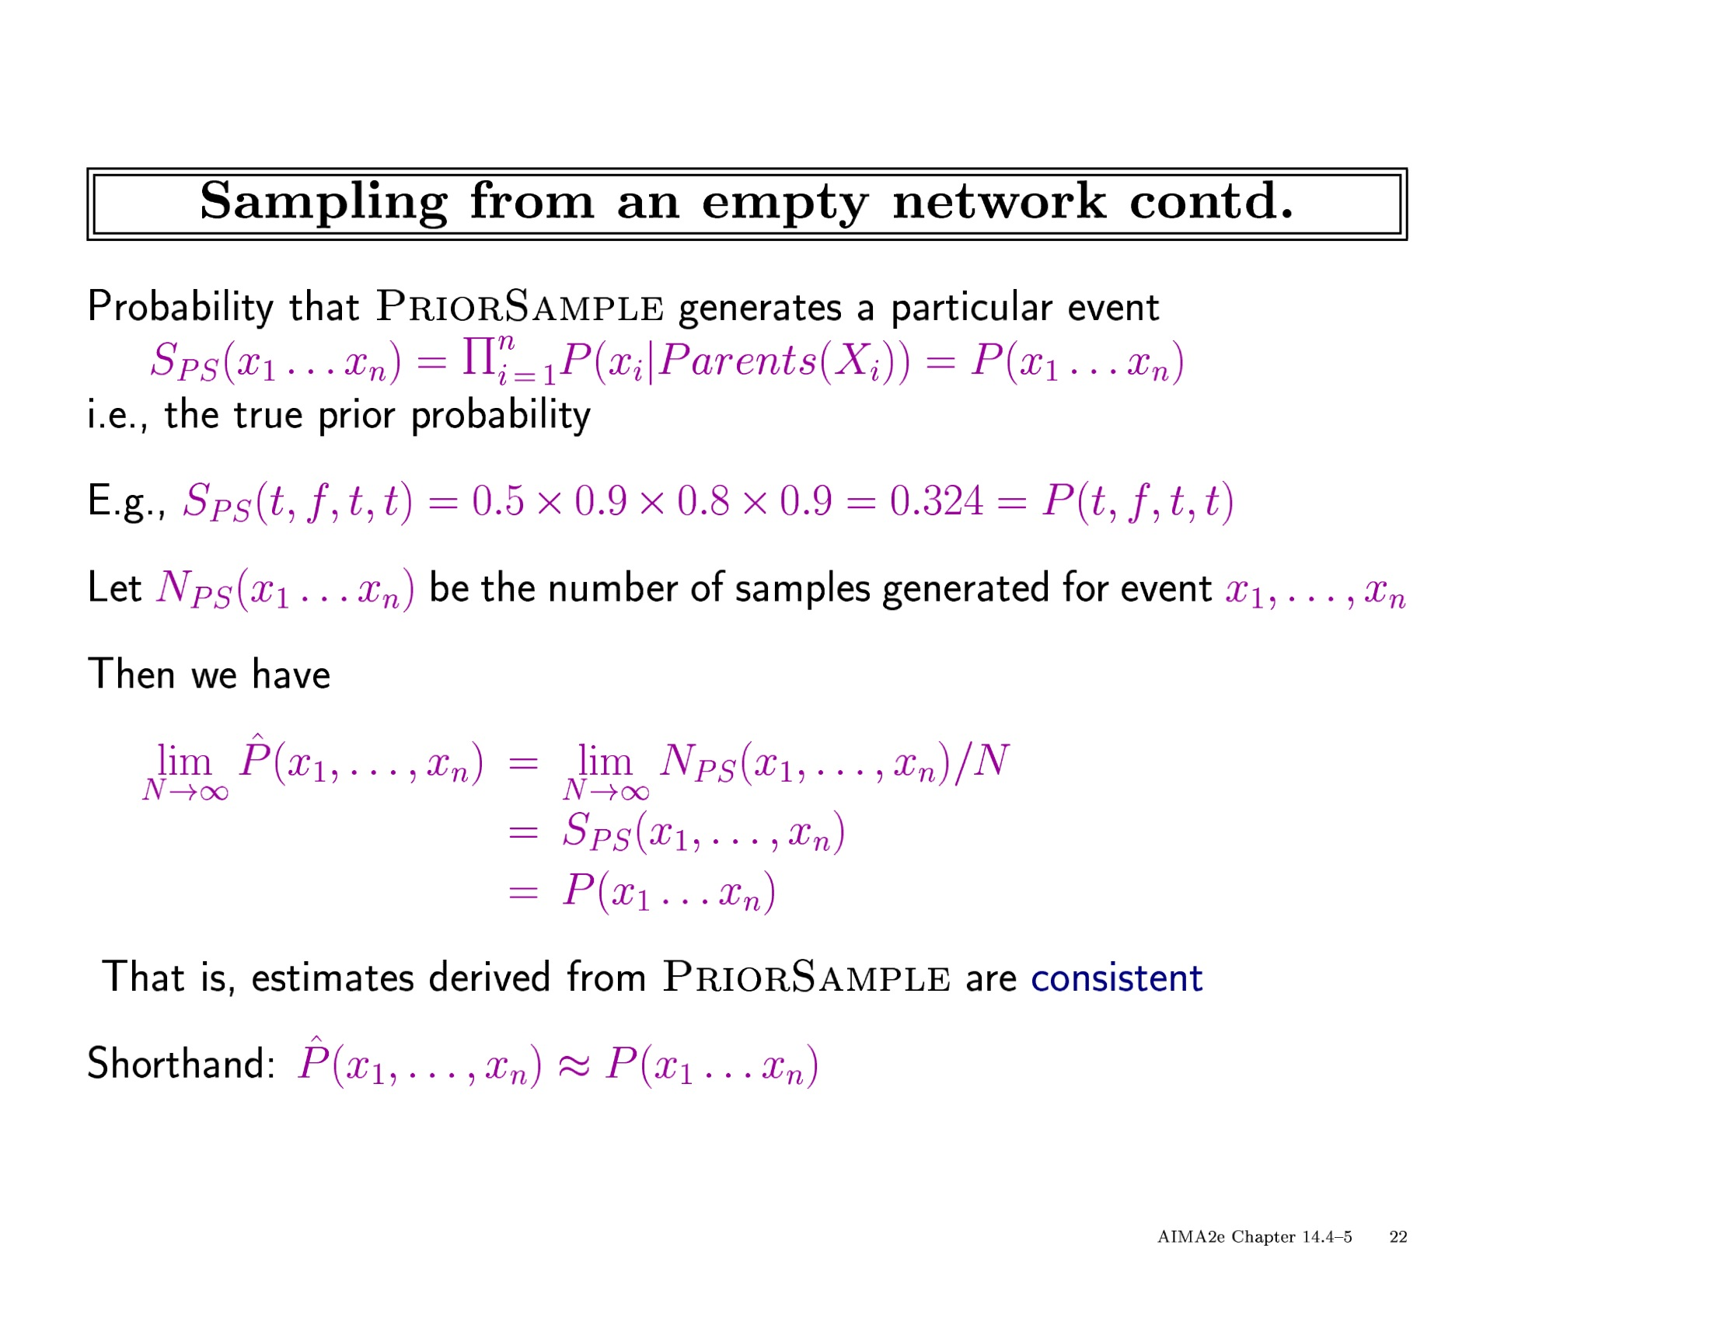

Slide 59
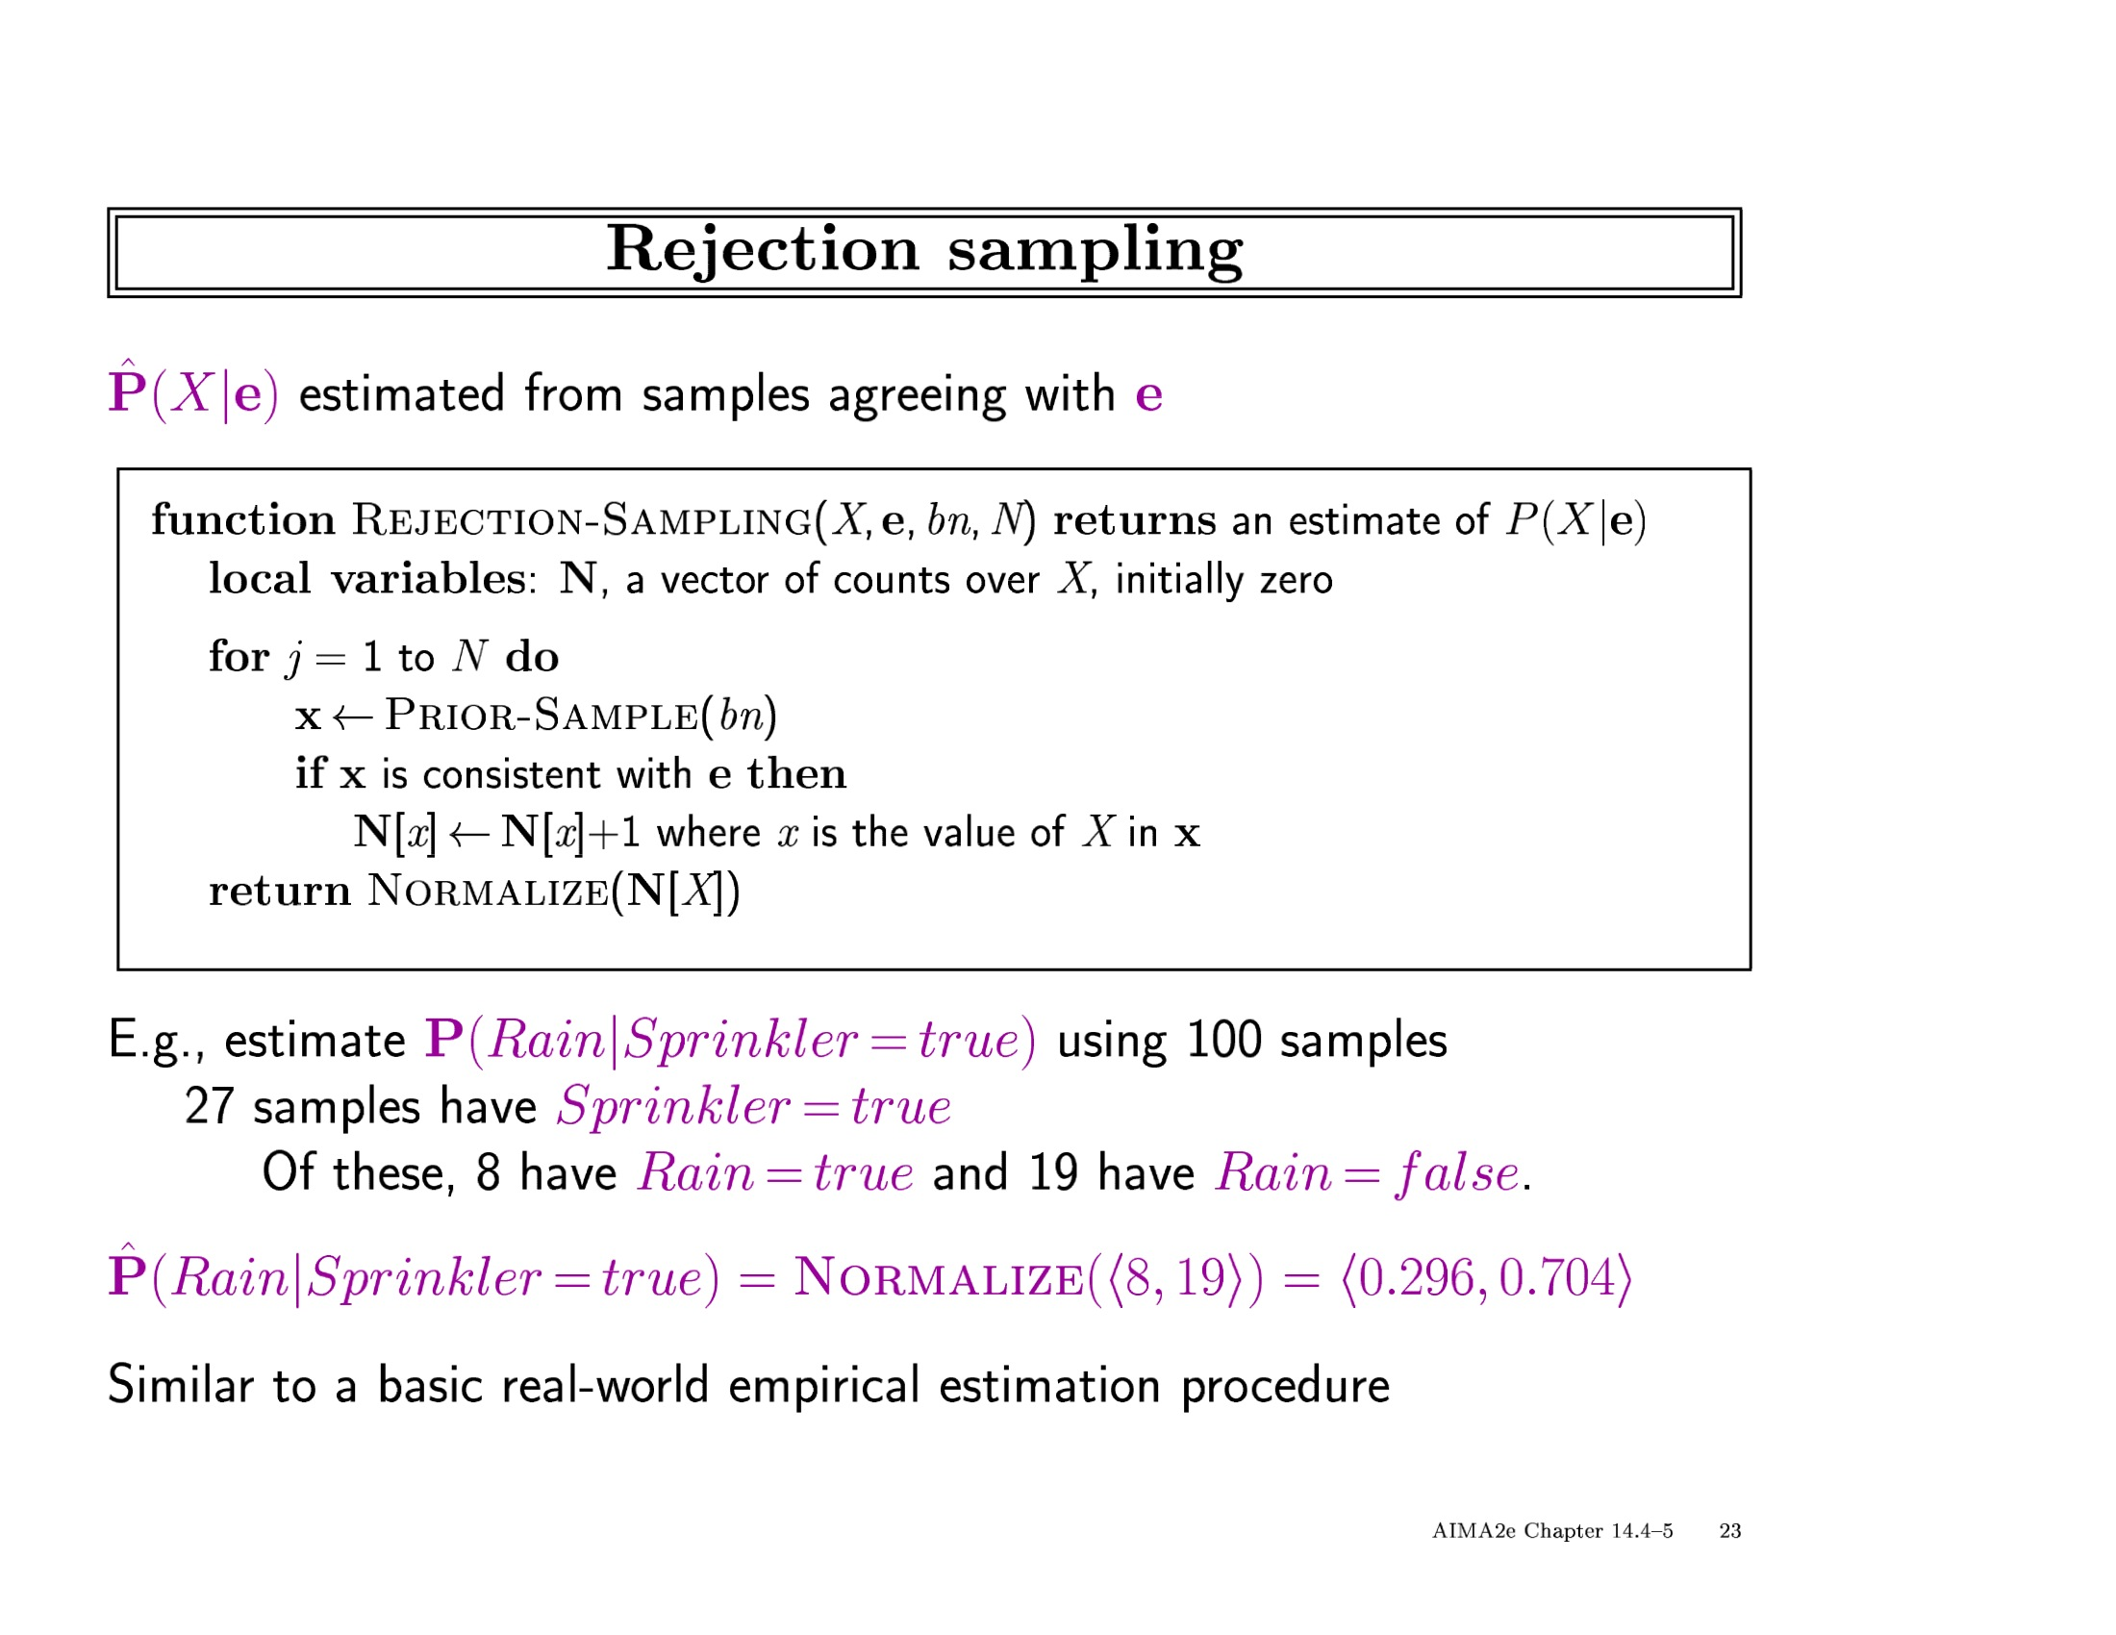

Slide 60
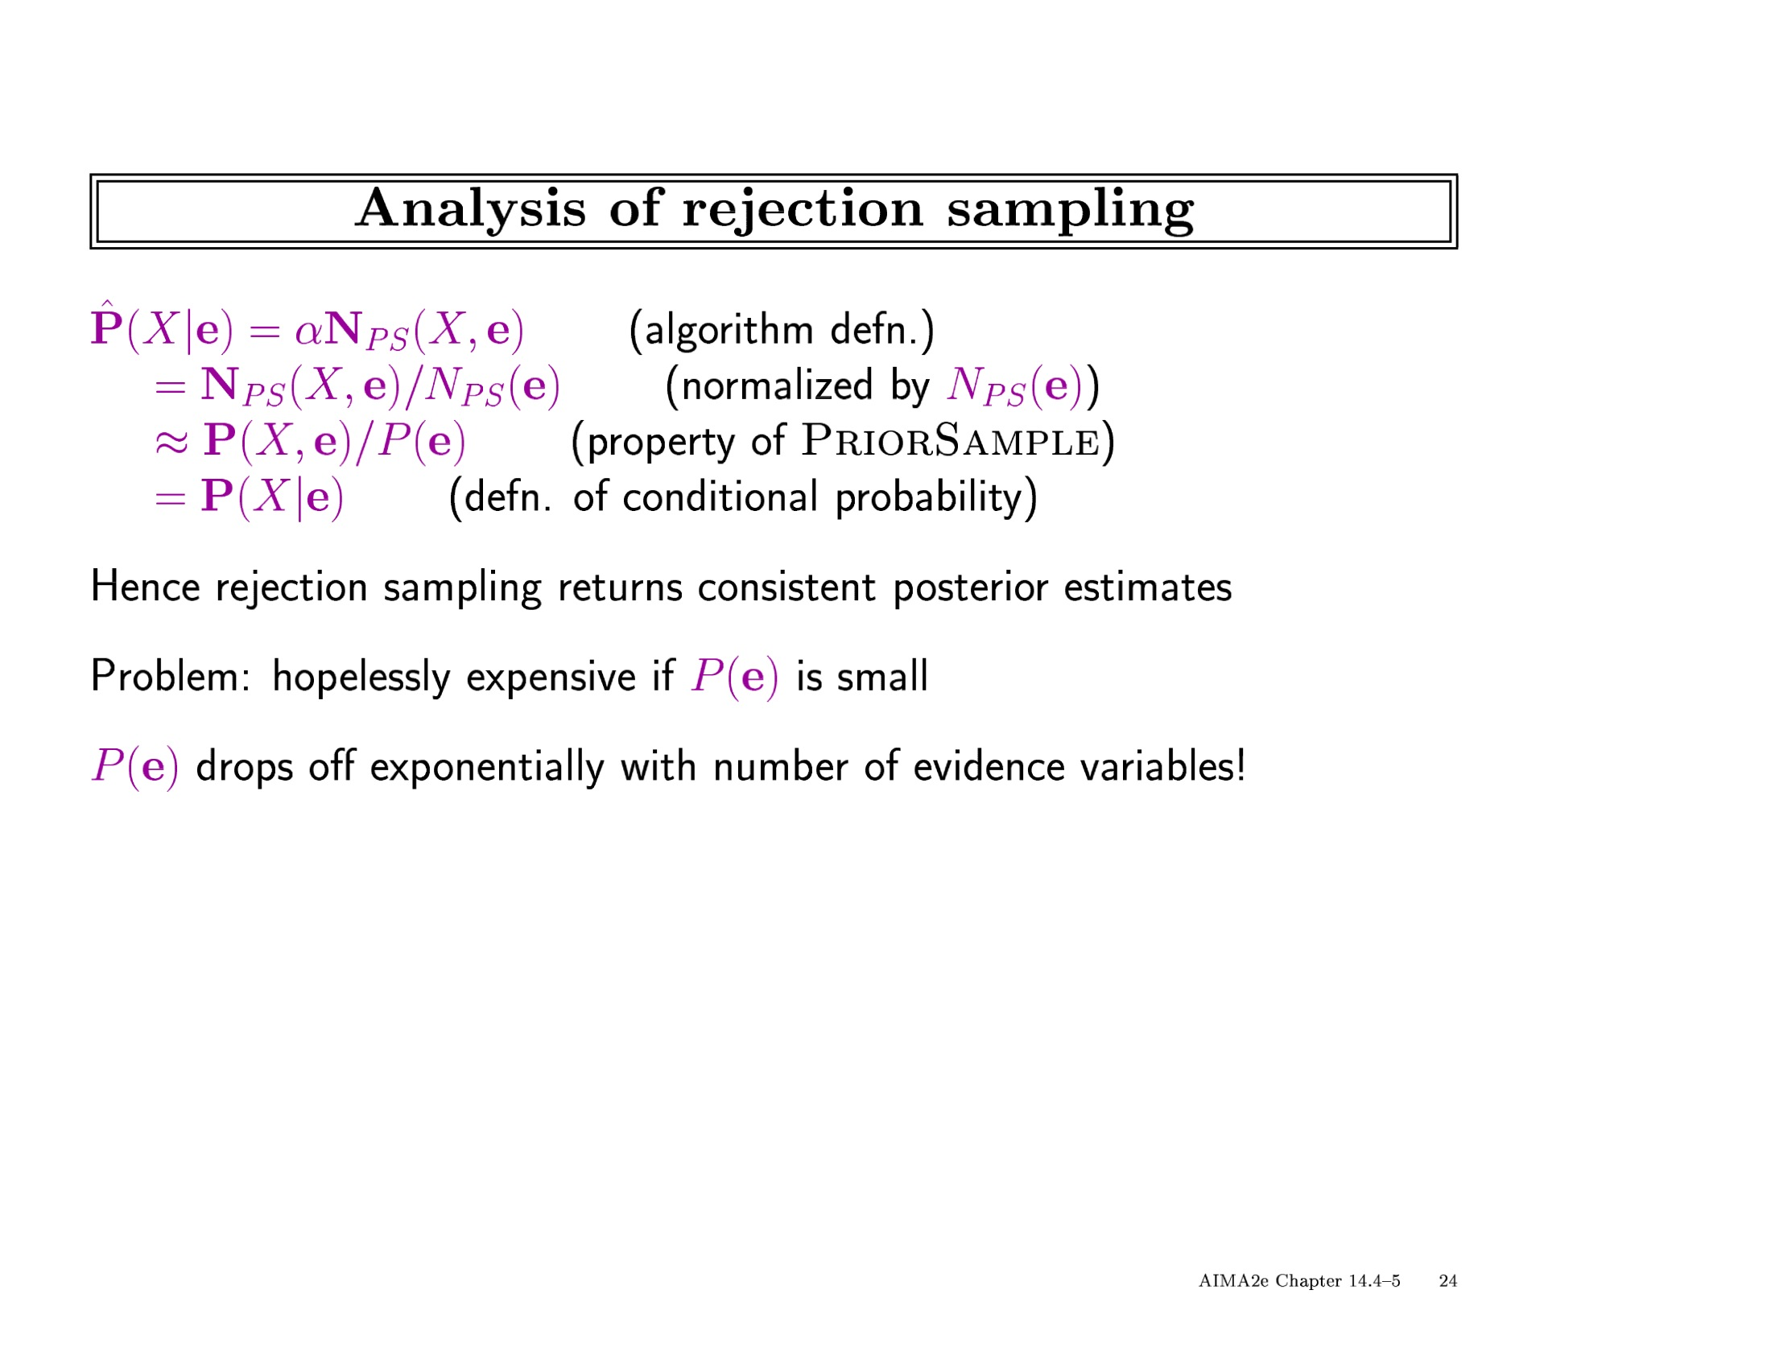

Slide 61
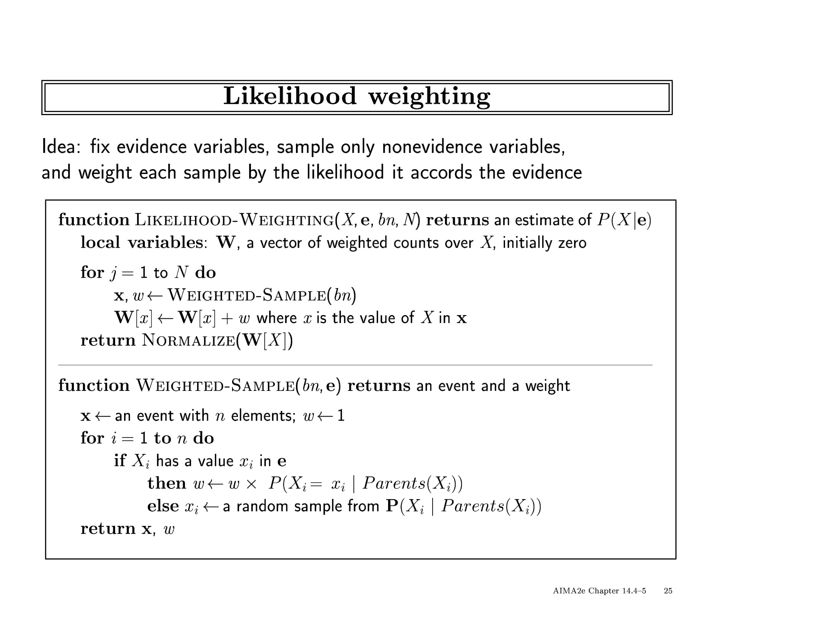

Slide 62
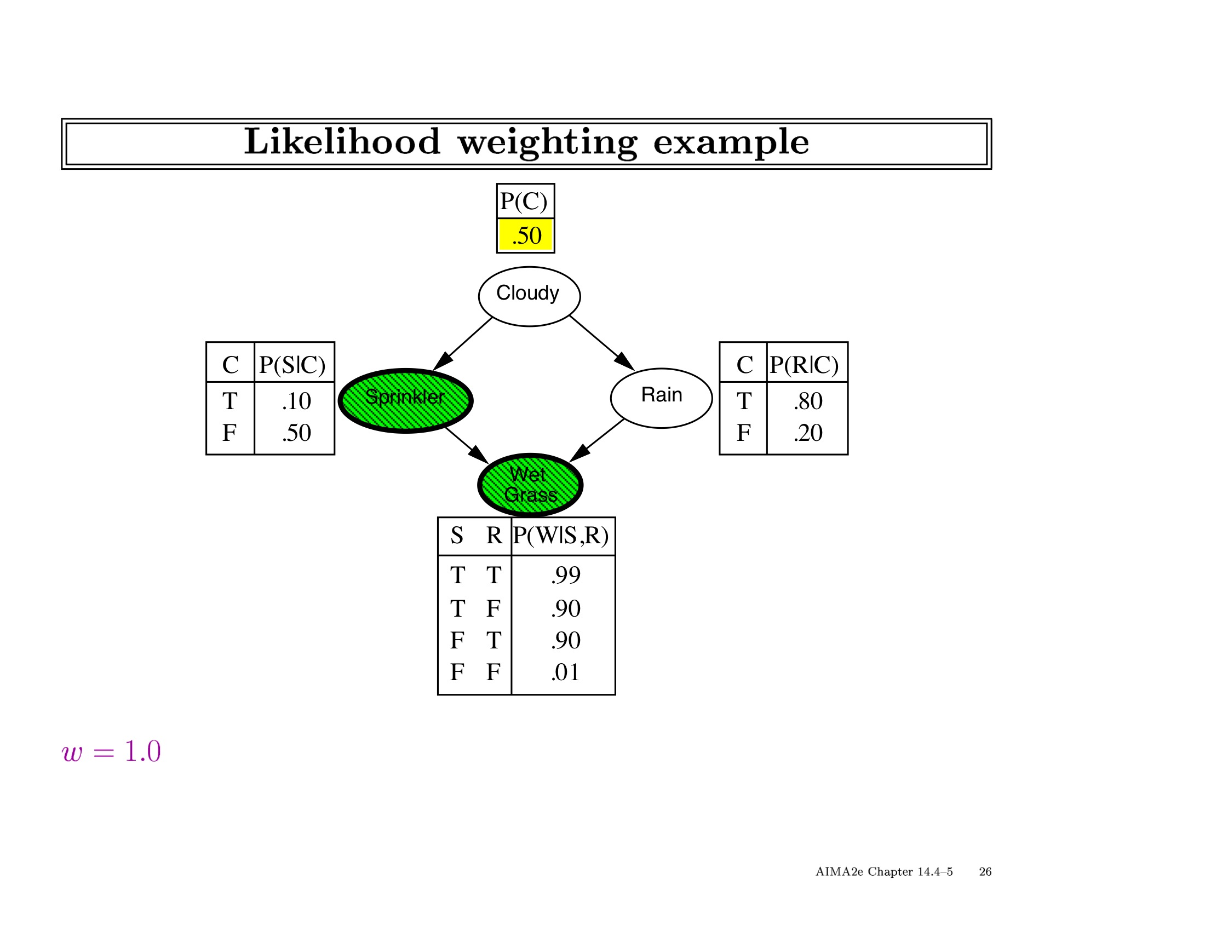

Slide 63
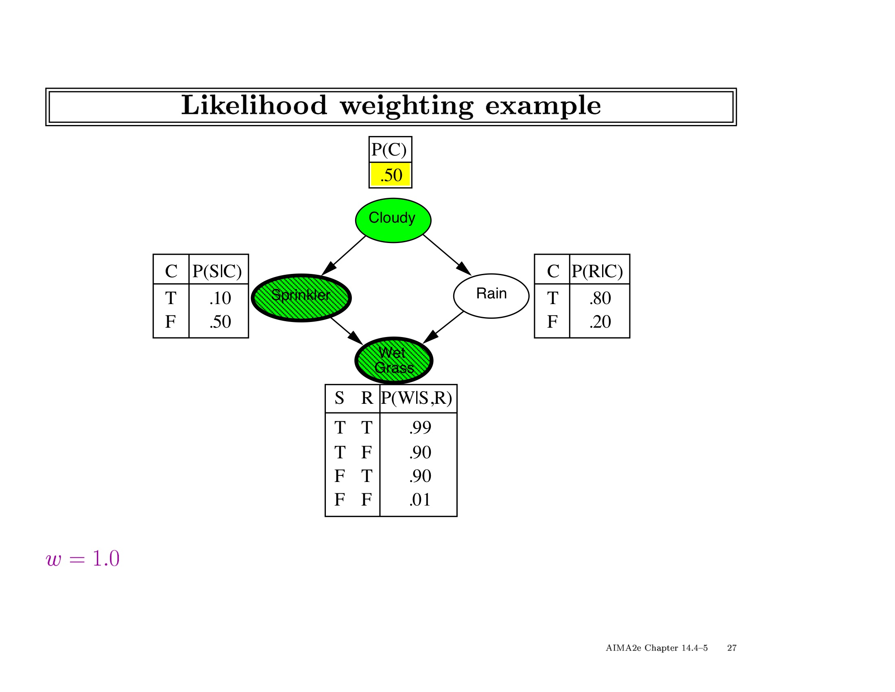

Slide 64
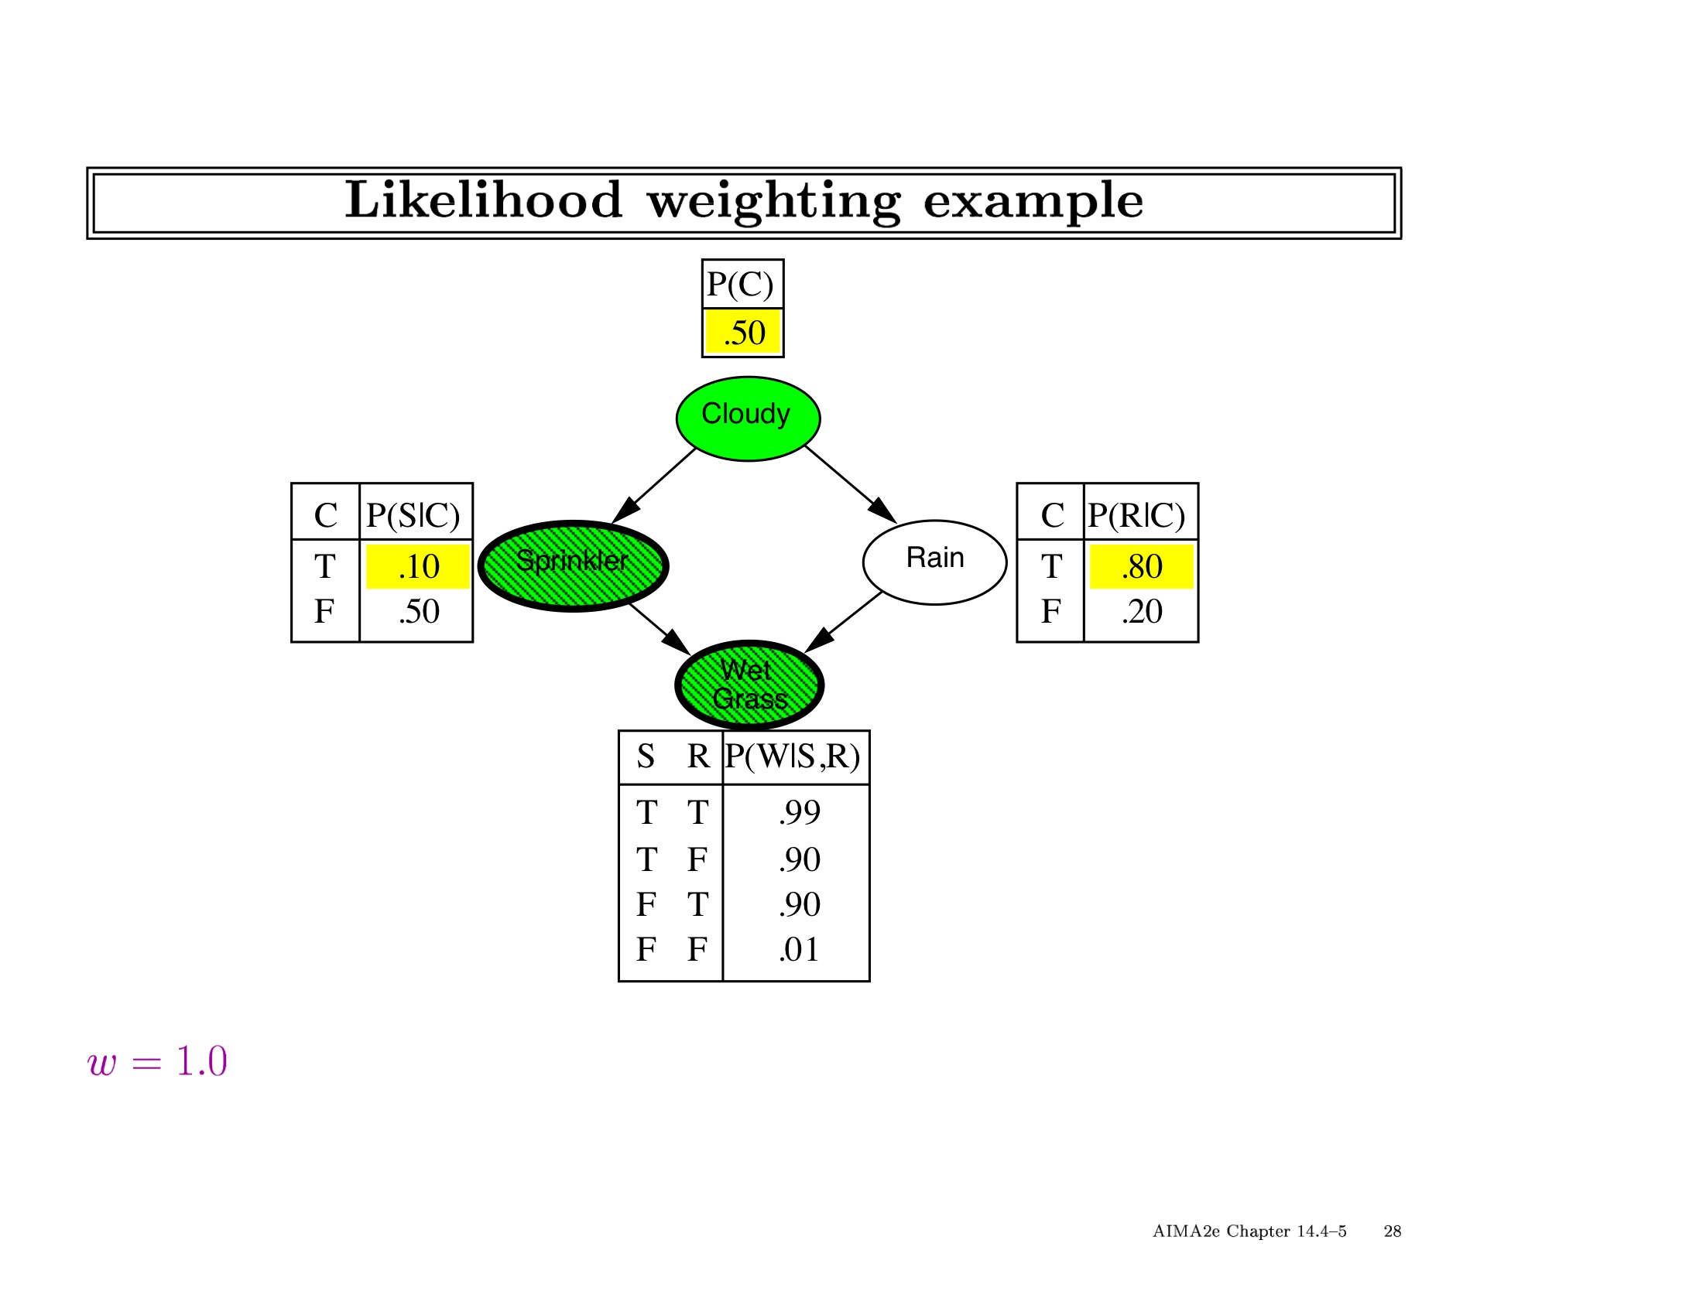

Slide 65


Slide 66
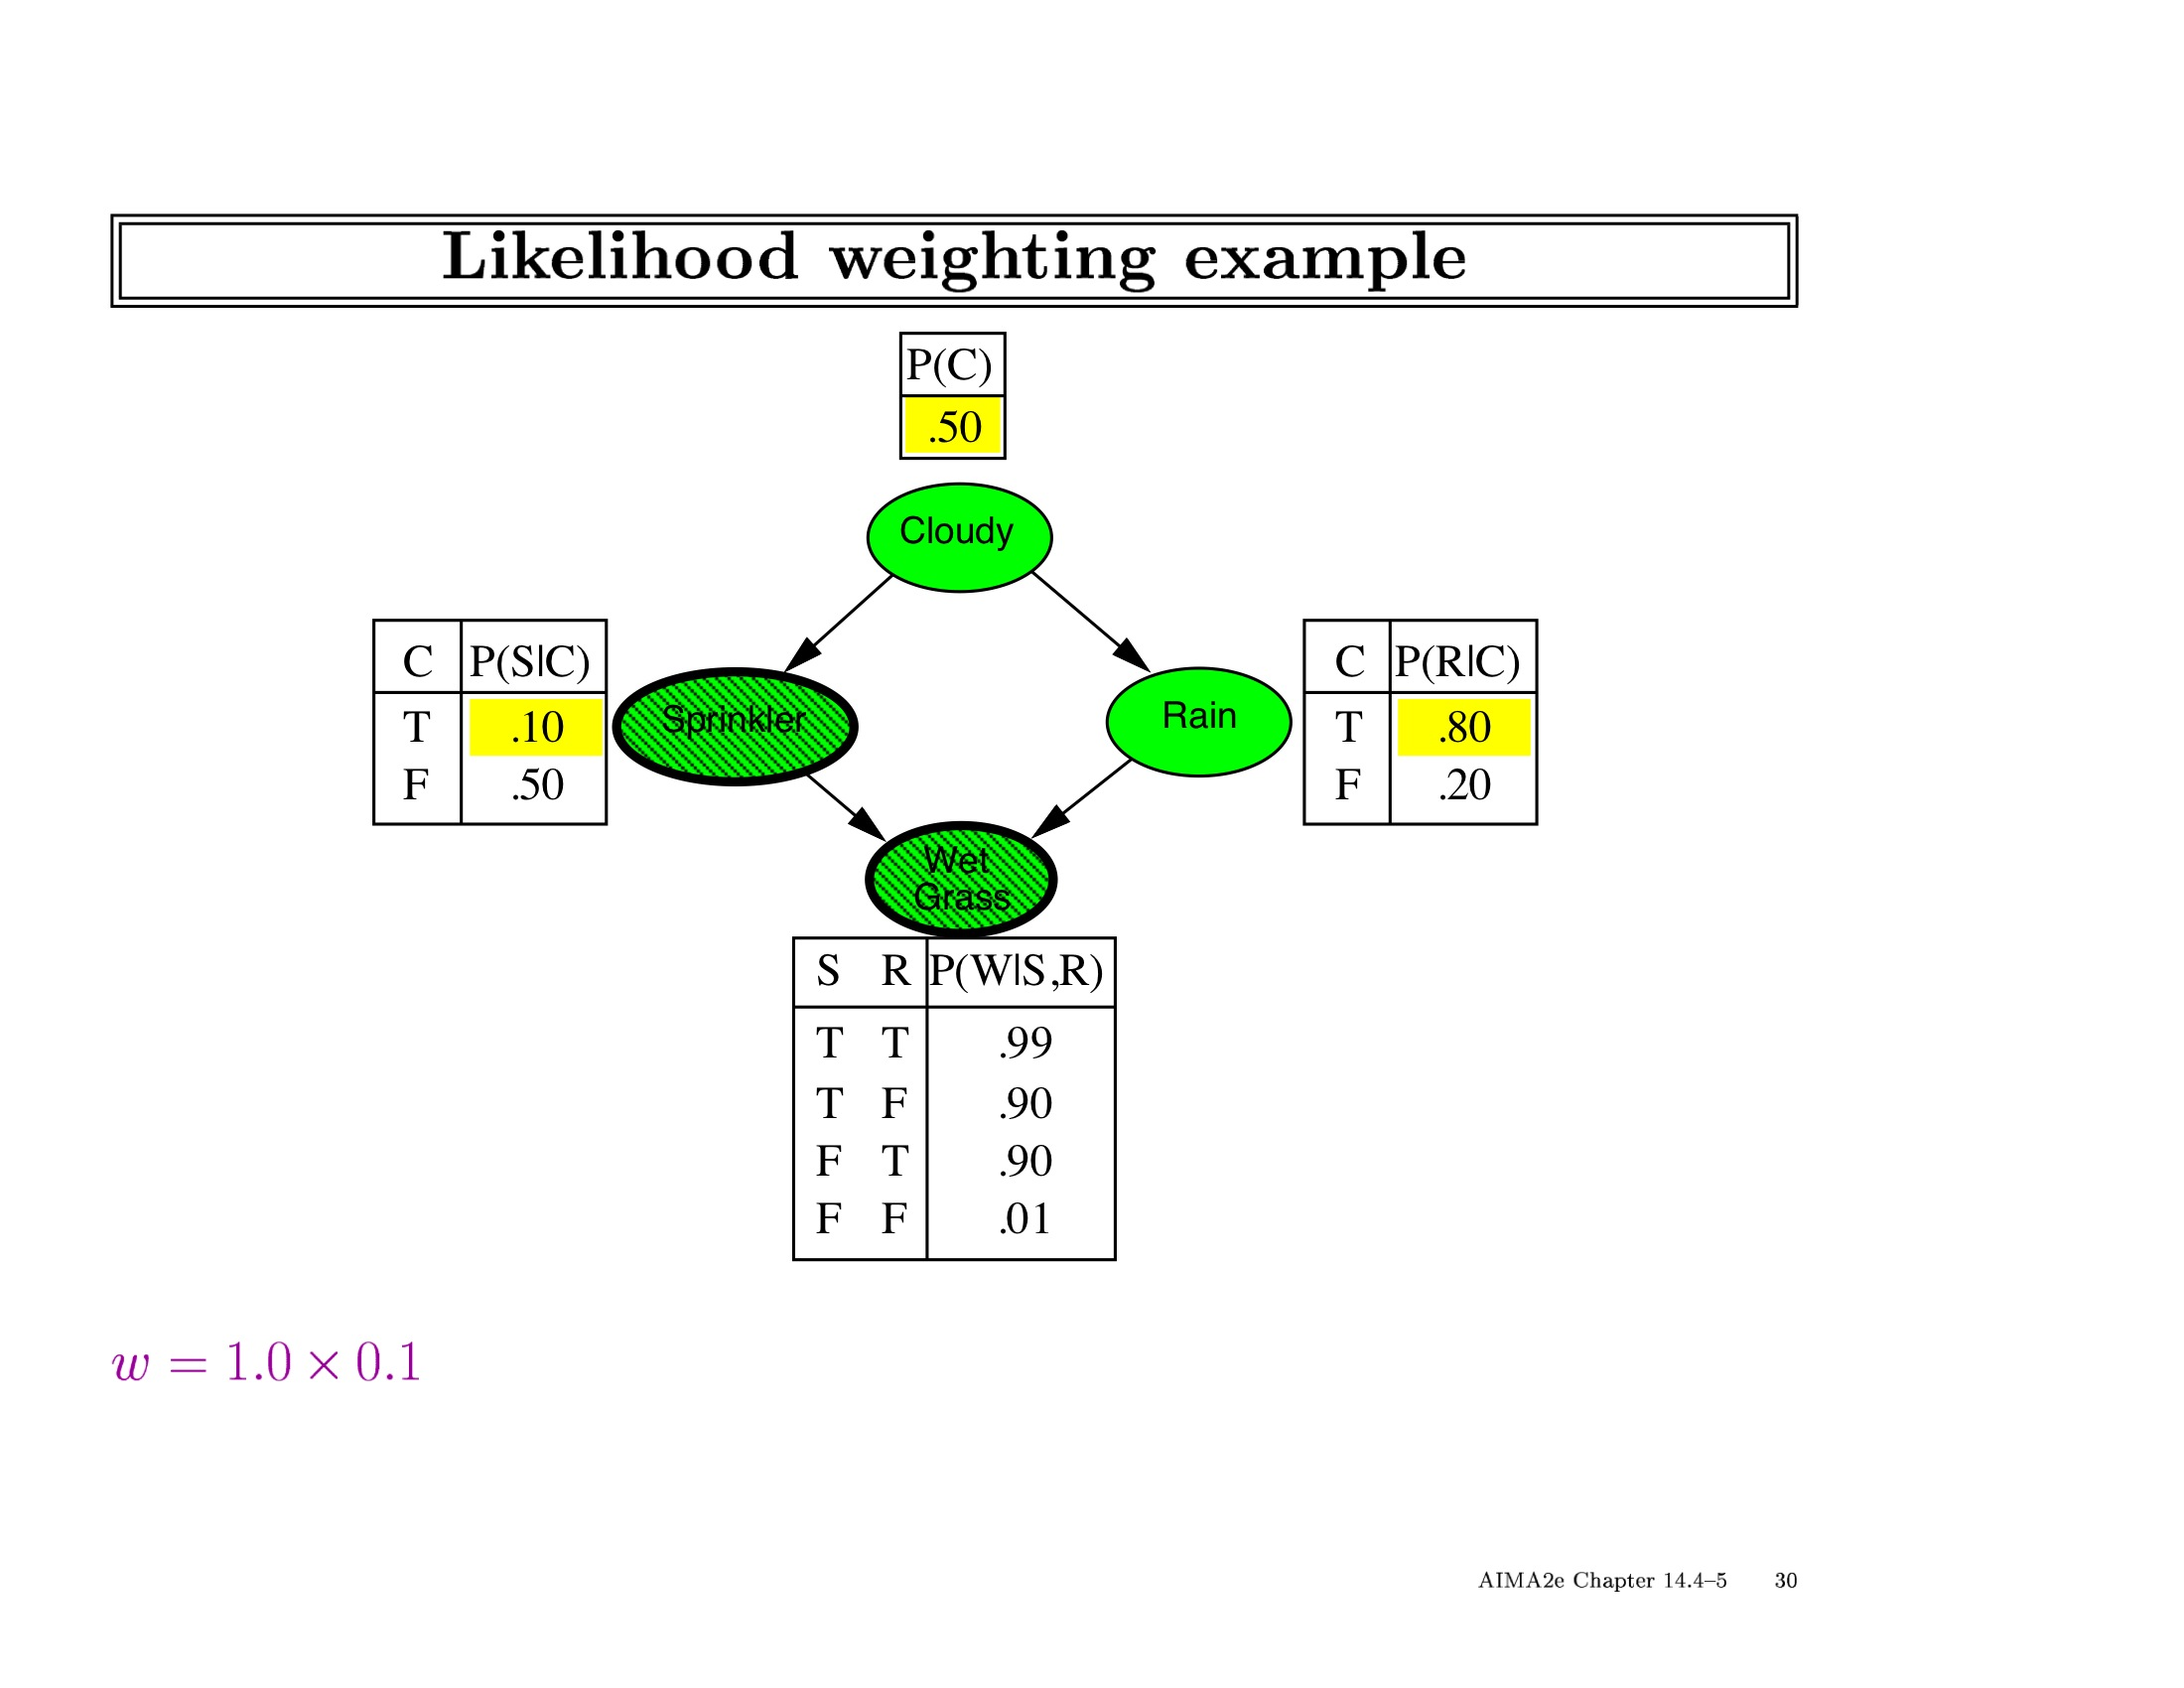

Slide 67


Slide 68
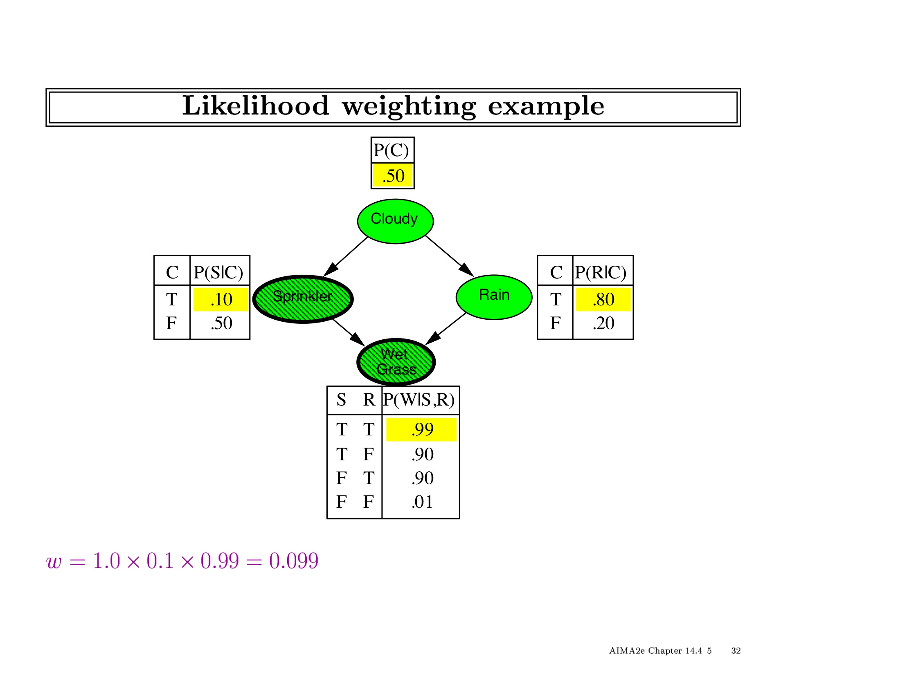

Slide 69
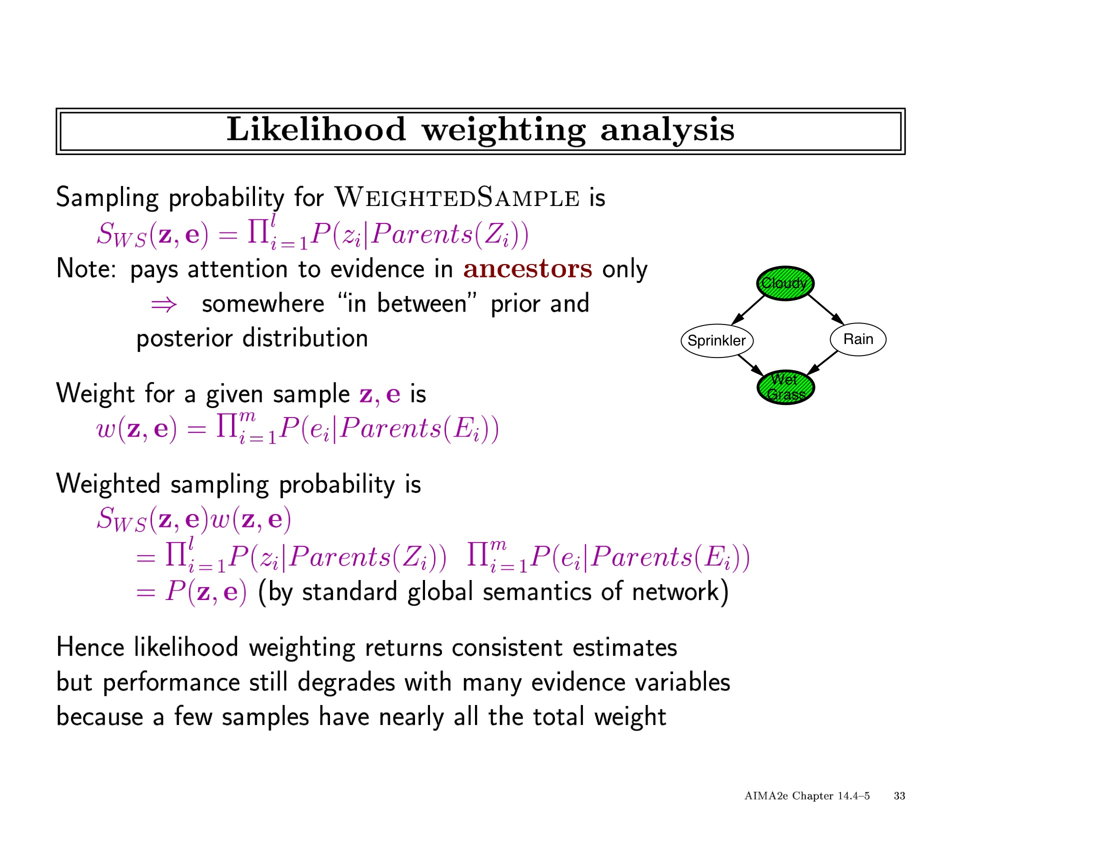

Slide 70
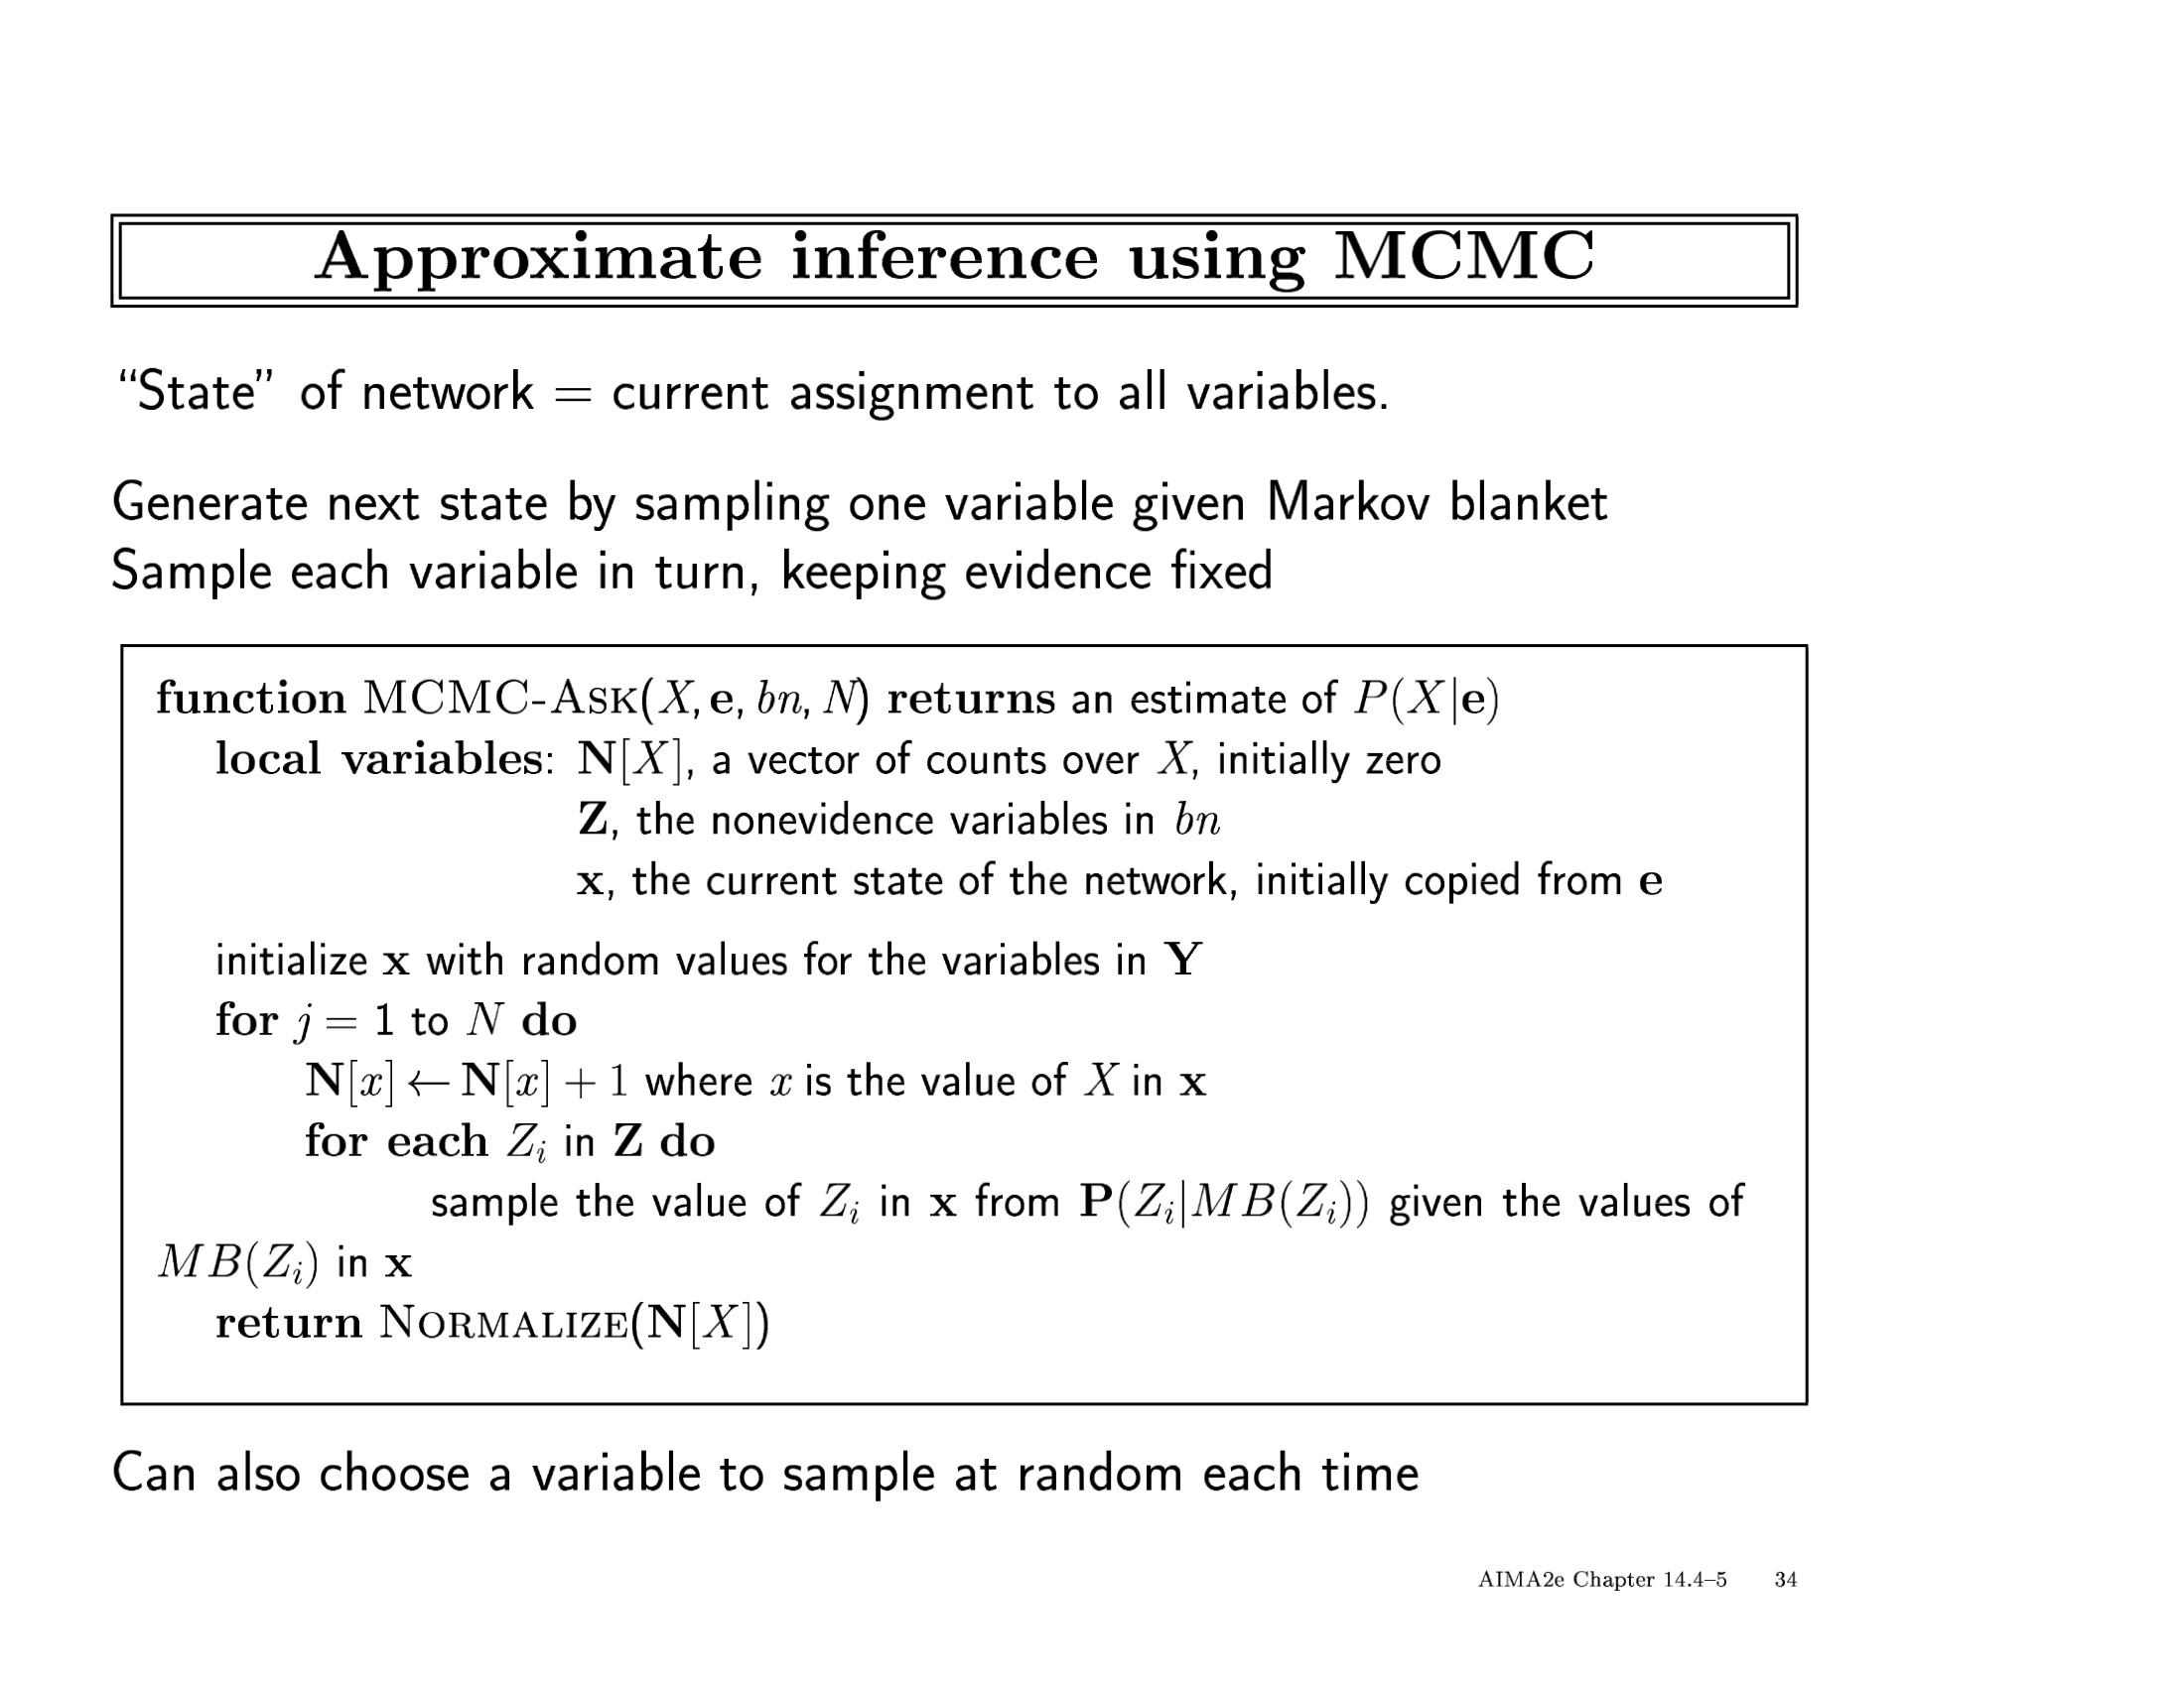

Slide 71
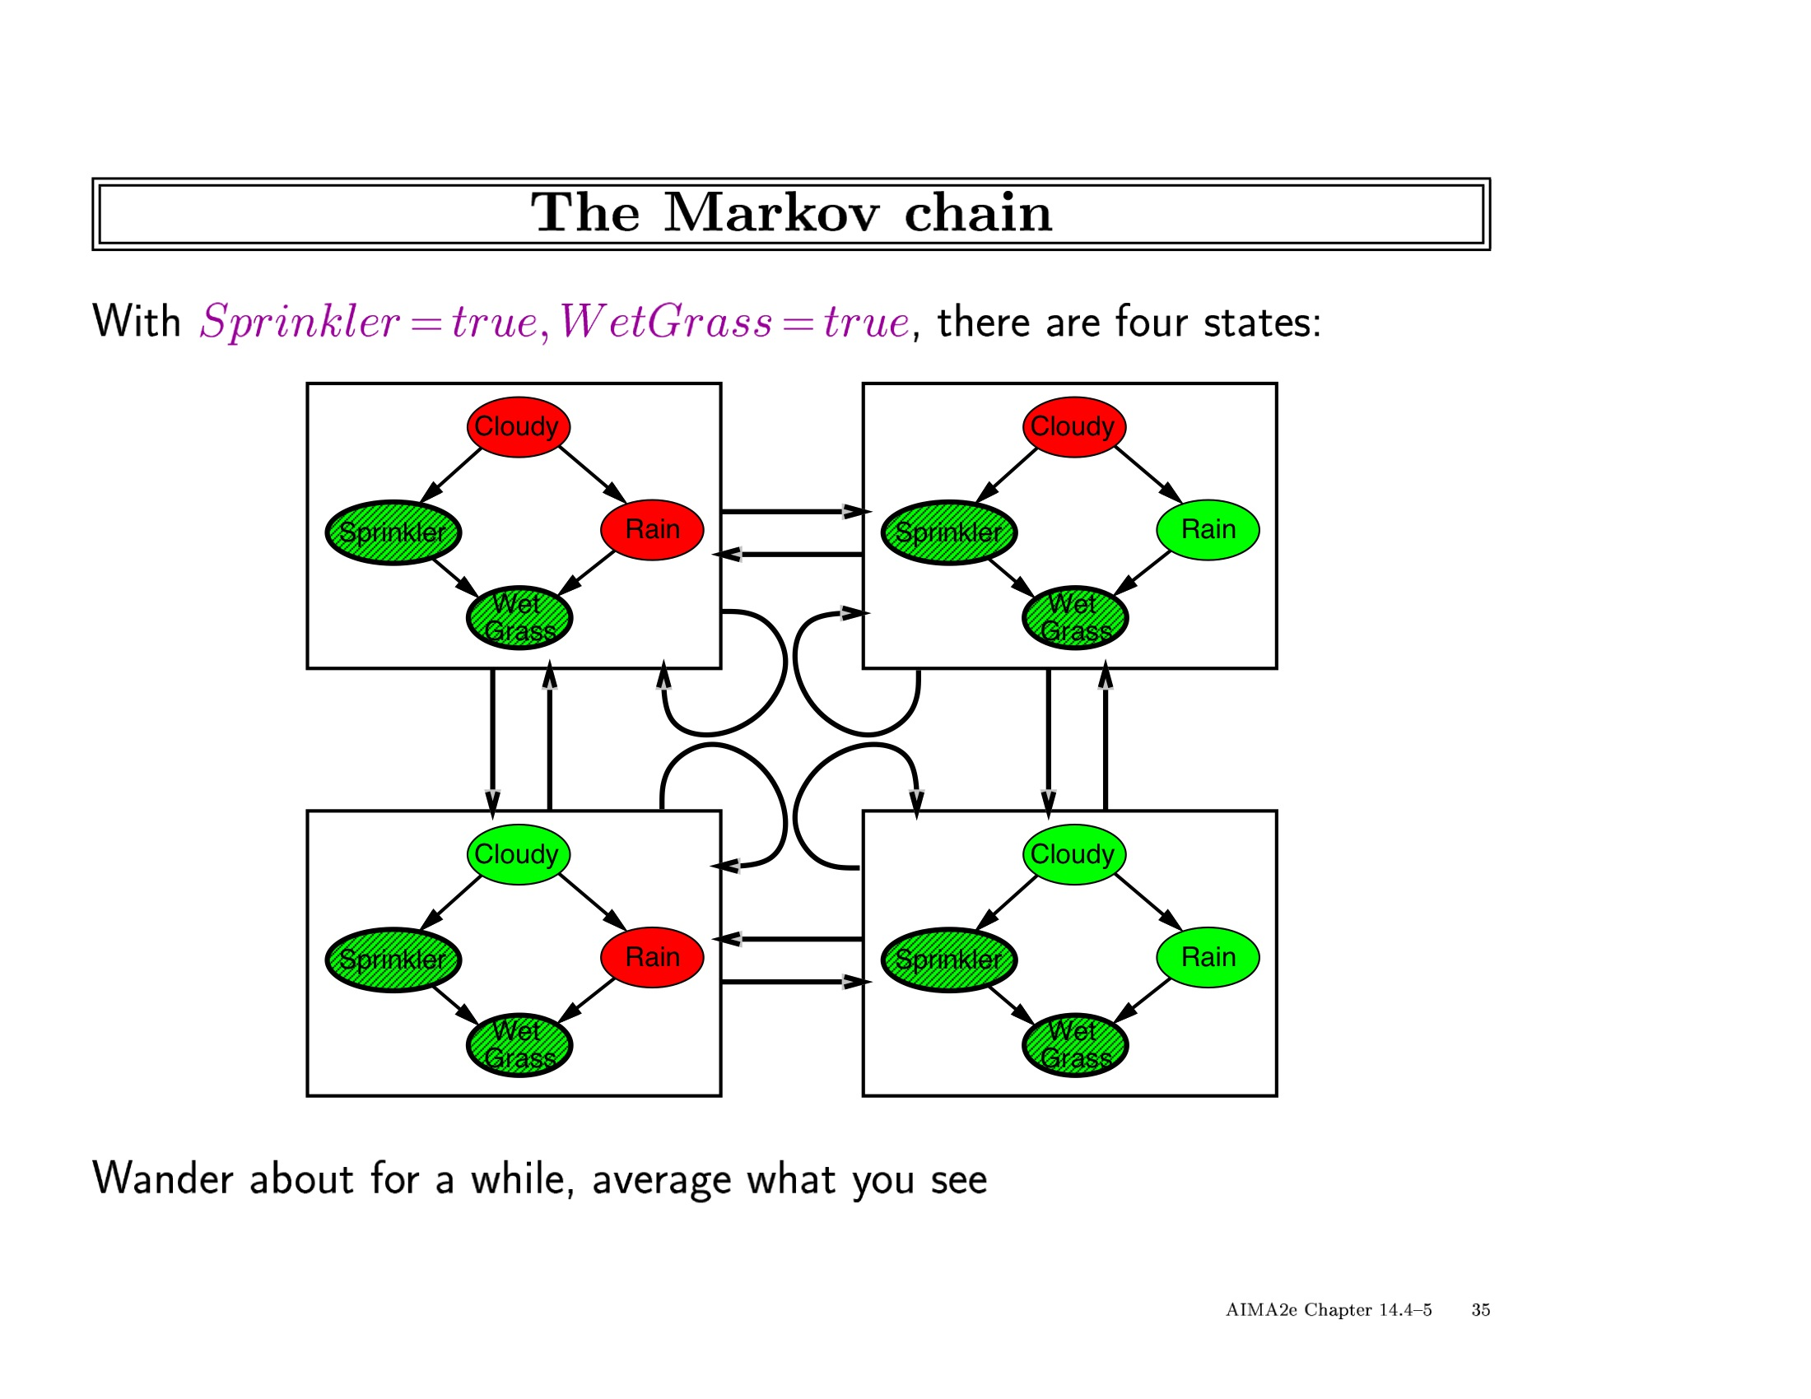

Slide 72
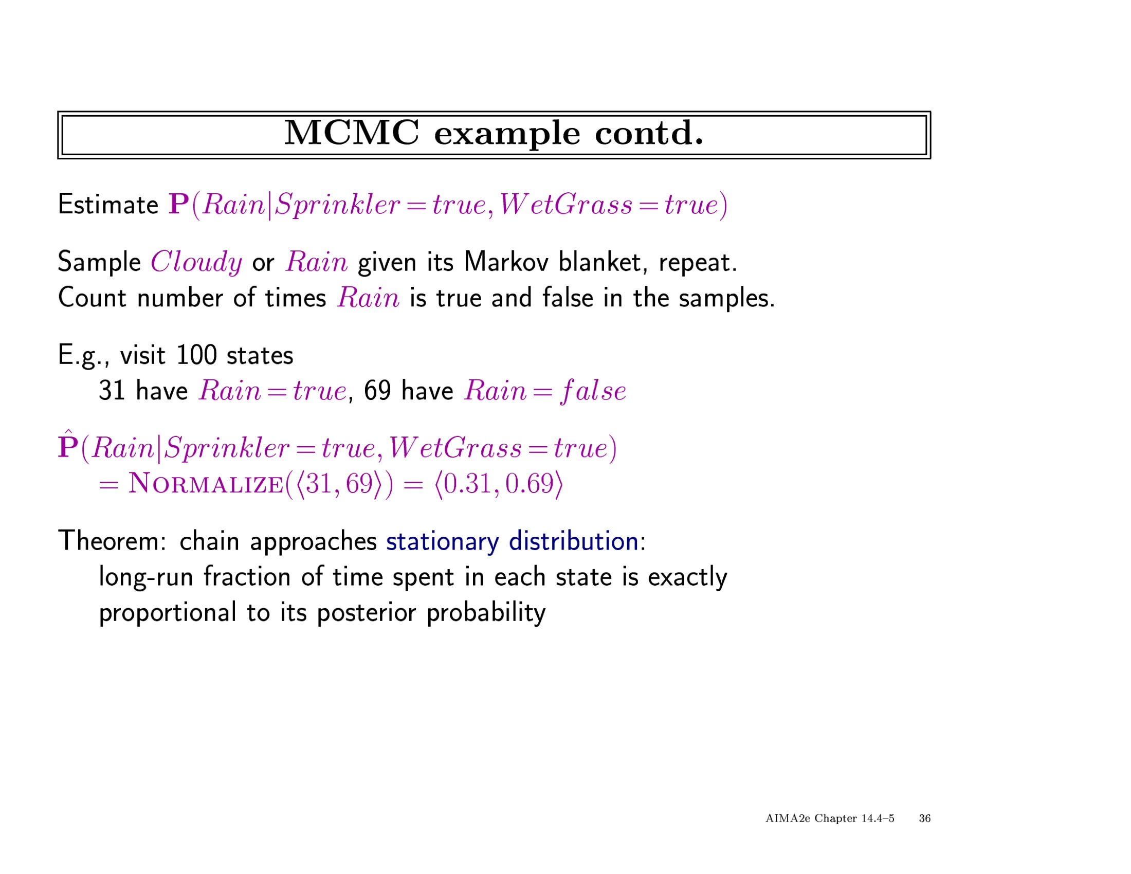

Slide 73
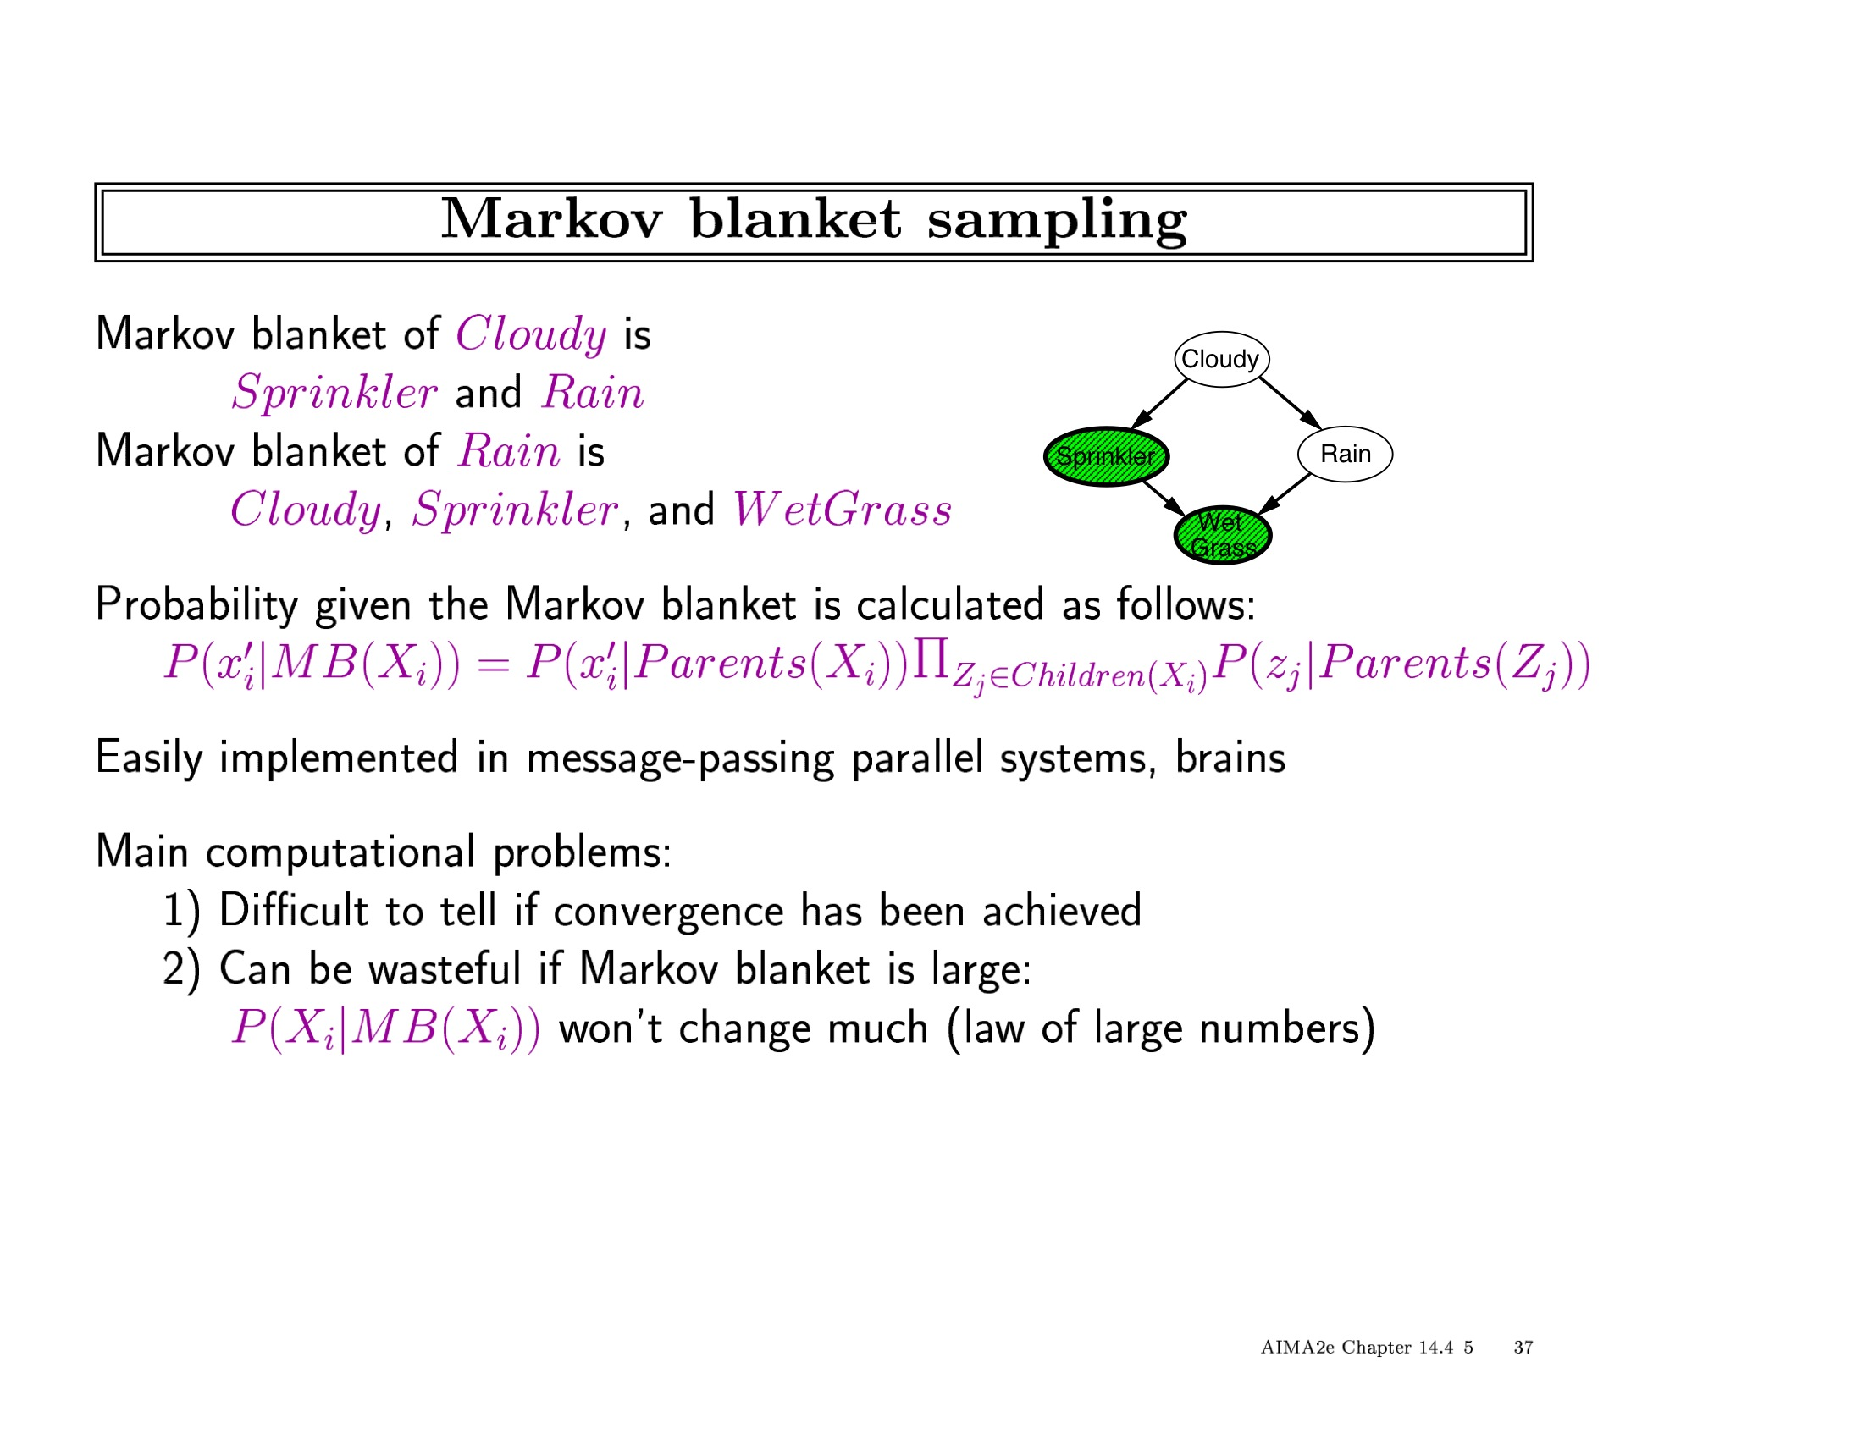

Slide 74
