Slide 1

Peeking into Your App without Actually Seeing It:
UI State Inference and Novel Android Attacks
Qi Alfred Chen, Zhiyun Qian†, Z. Morley Mao
University of Michigan, †University of California - Riverside

Slide 2
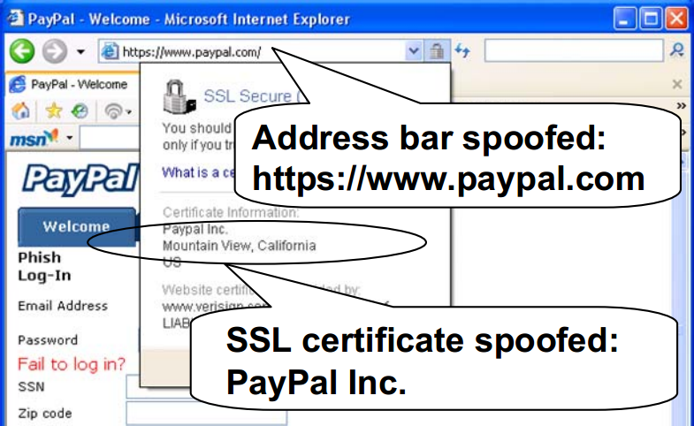

Importance of GUI Security
GUI content confidentiality and integrity are critical for end-to-end security
  UI Spoofing in desktop/browsers¹
  Screenshot capture on Android without privilege²
¹Chen, Oakland’07
²ScreenMilker, NDSS’14

Slide 3
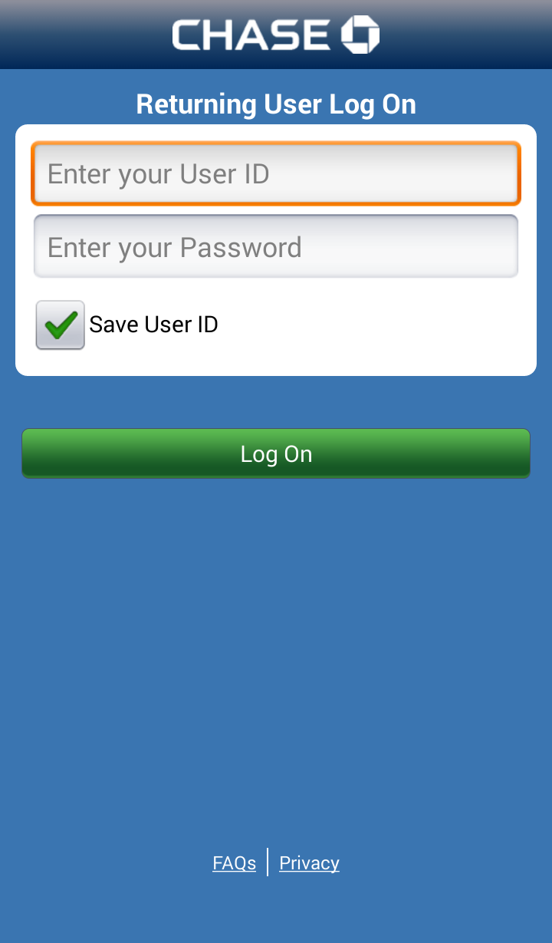
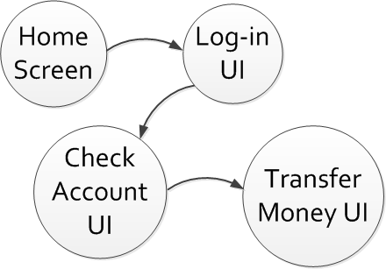



Another Form of GUI Confidentiality Breach
A weaker form
  UI state an app is in (e.g., login state) without knowing the exact pixels of the screen
Use UI state info for best timing
Hijack!
Serious security implications!

Slide 4

Enabled Attack: UI State Hijacking
Hijack sensitive UI state to steal private input
No glitches as we disable the animation
+ precise attack timing
Foreground:
Background:
Steal user name and password!
UI State 1
UI State 3
UI State 2
Tracking UI state!
Wait for Login UI state
Inject the phishing Login UI state!
Exploit UI preemption

Slide 5
UI State Hijacking Attack Demo
Video demo: UI state hijacking attack steals your password in H&R Block app

Slide 6
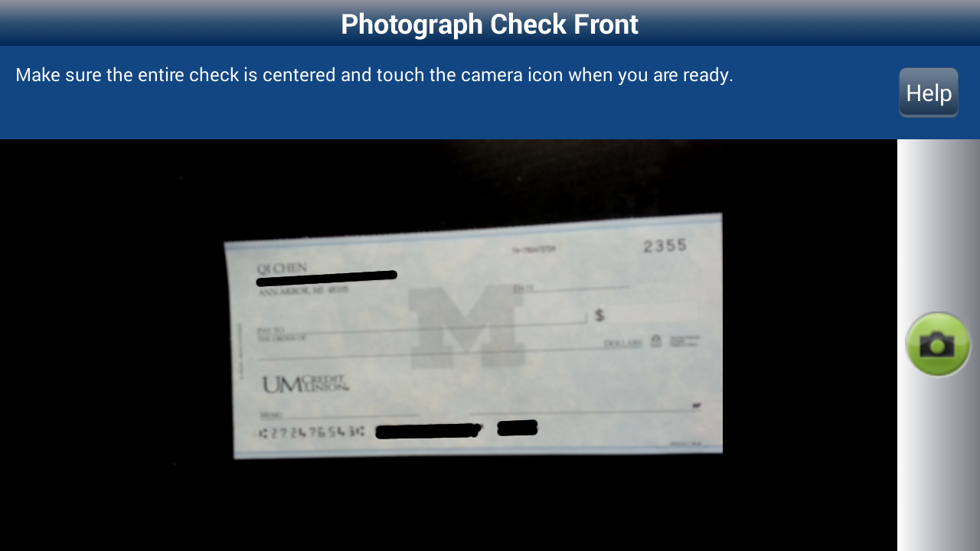



Other Enabled Attacks
An enabled attack: camera peeking
  Steal sensitive pictures taken in Android apps
  Breaks GUI confidentiality!
Monitor and analyze user behavior
  Breaks GUI confidentiality!
Enhance existing attacks in both stealthiness and effectiveness
Steal!

Slide 7
UI State Leakage is Dangerous
Lead to both GUI integrity and confidentiality breaches
UI state information is not protected well
  An unprivileged application can track another app’s UI states in real time

Slide 8
UI State Inference Attack
UI state: a mostly consistent UI at window level for certain functionality (e.g., log-in)
  On Android: Activity (full-screen window)
Also called Activity inference attack
  An unprivileged app can infer the foreground Activity in real time
  Requires no permission

Slide 9





Underlying Causes
Android GUI framework design leaks UI state changes through a publicly-accessible side channel
  A newly-discovered shared-memory side channel
  Affects nearly all popular OSes

Slide 10
Attack General Steps
A single bit
of information
UI state based attacks:
UI state hijacking
Activity
transition detection
Activity
inference
Camera peeking
Newly-discovered Shared-memory
side channel
Other side channels (e.g., CPU, network activity)

Slide 11

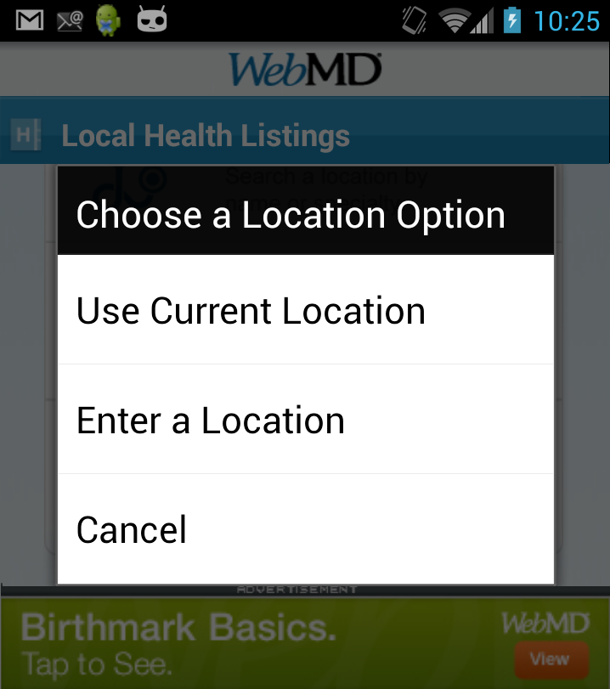

Shared-Memory Side Channel
Finding: shared virtual memory size changes are correlated with Android window events
Window
pop-up
Window
close
Shared virtual memory size in public file
/proc/pid/statm
Proportional to window size

Slide 12
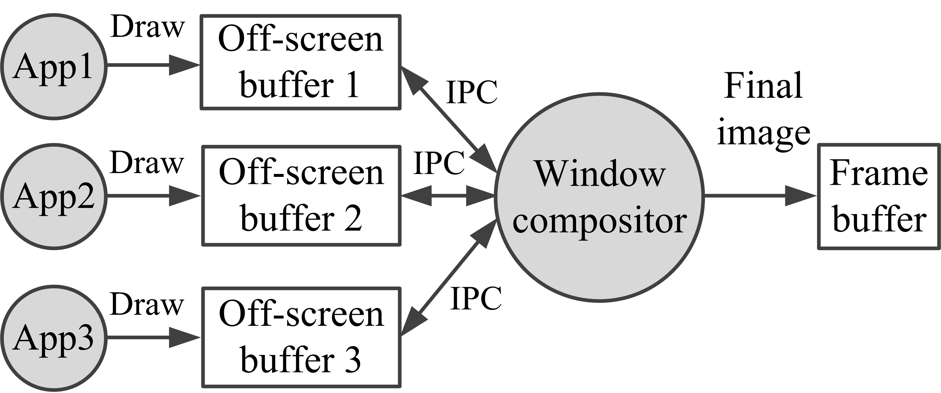
Shared-Memory Side Channel
Root cause for this correlation
  Window manager design in Android
Confirmed that shared memory is used in GUI design for many OSes, including
For better UI drawing performance, Android uses shared memory as IPC
The changed size is the off-screen buffer size
The root cause is here

Slide 13
Activity Transition Detection
Detect shared-memory size change pattern
  Nice properties:
Fixed
(Full screen)
Clean channel
+
Buffer deallocation for the previous Activity
Buffer allocation for the new Activity
Unique patterns
+

Slide 14


Activity Inference
Activity signature + Activity transition graph
Training phase (offline):
Activity transition graph
Transition model
Trigger Activity transition automatically
Collect transition feature data
Activity signature
Attacking phase (online):
Trigger Activity transition
Collect transition feature data
Activity inference result

Slide 15
Activity Signature Design
Consists of various features
Activity 1
Activity 2
Content
Provider
feature
Network
event
feature
Input method
feature
CPU utilization time feature

Slide 16
Remaining Steps of Activity Inference
Create an Activity transition model
  Hidden Markov Model (HMM)
Inference results
  A list of Activities in decreasing order of their probabilities

Slide 17






Evaluation Methodology
Implementation: ~ 2300 lines of C++ code compiled with Android NDK
Data collection: using automated Activity transition tool on Samsung Galaxy S3 devices with Android 4.2
Experimented on 7 popular Android apps:

Slide 18
Evaluation Results
Activity transition detection, for all apps
  Detection accuracy ≥ 96.5%
  FP and FN rates both ≤ 4%
Activity inference accuracy
  80–90% for 6 out of 7 popular apps
    Important features: CPU, network, transition model
Inference computation & delay
  Inference computation time: ≤ 10 ms
  Delay (Activity transition → inference result): ≤ 1.3 sec
    Improved to ≤ 500 ms for faster and more seamless Activity hijacking
Overhead
  Increase power usage by 2.2–6.0%

Slide 19
Defense Discussion
Eliminate the side channel
  Proc file system access control
    Android already limits some, but more is needed
  Window buffer reuse
    Pre-allocate double the buffers and reuse them
    More memory consumption (several MBytes per buffer)
Mitigate those follow-up attacks
  For example, for UI state hijacking
    Build trusted paths between user and app
Defense is non-trivial, more effort is required

Slide 20
Summary
  Demonstrated serious security implications for a new form of GUI confidentiality breach
  Formulated a general UI state inference attack
    Infer UI state in real time
  Discovered a new side channel for UI state inference
    Potentially affecting all popular GUI systems
  Designed and implemented it on Android, and further built several new attacks (e.g., UI state hijacking)
  Attack video demos at our website
  http://tinyurl.com/UIStateInference

Slide 21
Questions?
  http://tinyurl.com/UIStateInference

