Slide 1


MitM Attack by Name Collision:
Cause Analysis & Vulnerability Assessment in the New gTLD Era
Qi Alfred Chen, Eric Osterweil†, Matthew Thomas†, Z. Morley Mao
University of Michigan, †Verisign Labs

Slide 2




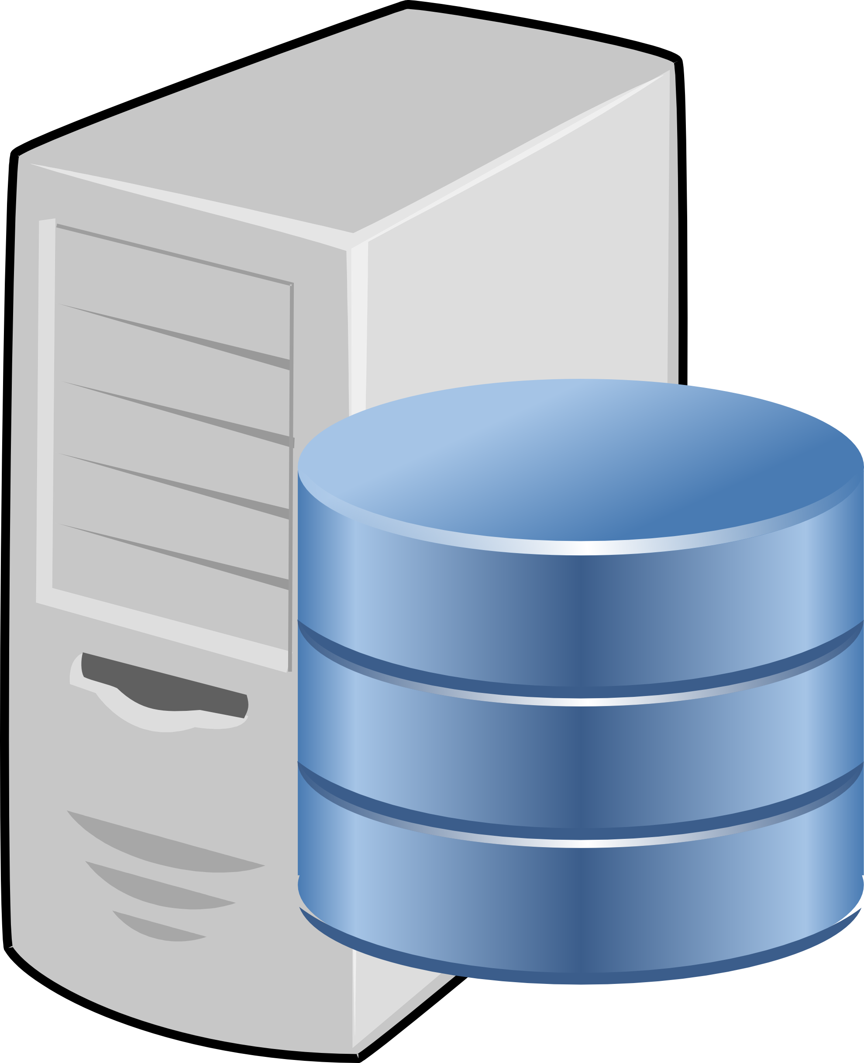
MitM: Name collision + WPAD query leakage
Intercept user’s web traffic with a vulnerable domain and a proxy server
Phishing,
code injection
Password,
confid. doc
FREAK, Logjam¹
Proxy
Web
Vulnerable domain
¹Adrian et al., CCS’15

Slide 3


Background: Public DNS namespace
Root
TLD
SLD
.
.tld1
.example
.tld2
...
example.tld1
TLD registry
Registrant

Slide 4
Background: Internal DNS namespace
Root
TLD
SLD
.
.tld1
.example
.tld2
...
example.tld1
Internal/local namespace:
company.itld
www.company.itld
company.itld

Slide 5
Background: Internal DNS namespace
Root
TLD
SLD
.
.tld1
.example
.tld2
...
example.tld1
Internal/local namespace:
company.itld
.company
www.company.itld
company.itld
company.itld
Name collision

Slide 6
Use non-delegated TLDs as iTLDs
Root
TLD
SLD
.
.tld1
.example
.tld2
itld ≠
existing TLD
...
example.tld1
Internal/local namespace:
company.itld
www.company.itld
company.itld

Slide 7
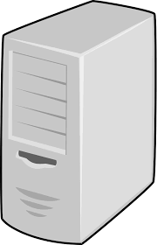
WPAD: Web proxy auto discovery
Root
TLD
SLD
.
.tld1
.example
.tld2
...
example.tld1
Internal/local namespace:
company.itld
wpad.company.itld
www.company.itld
Proxy config
company.itld
Web
Proxy

Slide 8
WPAD: Web proxy auto discovery
Root
TLD
SLD
.
.tld1
.example
.tld2
...
example.tld1
Internal/local namespace:
company.itld
wpad.company.itld
www.company.itld
Proxy config
company.itld
Web
Proxy

Slide 9
WPAD query leakage
Root
TLD
SLD
.
.tld1
.example
.tld2
...
example.tld1
From 2 out of 13 DNS root servers,
> 20 million leaked queries every day
WPAD query leakage
wpad.company.itld

Slide 10
WPAD query leakage: Was not easily exploitable
Root
TLD
SLD
.
.tld1
.example
.tld2
...
example.tld1
No such
name
(NXDomain)
itld ≠
existing TLD
WPAD query leakage
wpad.company.itld

Slide 11
Name collision from new gTLD delegation
Root
TLD
SLD
.
.tld1
.example
Added 900+ since 2013
.tld2
...
example.tld1
New gTLDs
.<itld>
.company
No such
name
(NXDomain)
WPAD query leakage
WPAD query leakage
company.itld
WPAD query leakage
Name collision
wpad.company.itld

Slide 12
Name collision + WPAD query leakage MitM
Root
TLD
SLD
.
.tld1
.example
Added 900+ since 2013
.tld2
...
example.tld1
New gTLDs
.<itld>
.company
company.itld
WPAD query leakage
Proxy config. info
FREAK, Logjam¹
Password,
confid. doc
Phishing,
code injection
wpad.company.itld
Web
¹Adrian et al., CCS’15
Proxy

Slide 13
Name collision + WPAD query leakage MitM
Root
TLD
SLD
.
.tld1
.example
Added 900+ since 2013
.tld2
...
example.tld1
New gTLDs
WPAD name collision attack
.company
.<itld>
company.itld
WPAD query leakage
Proxy config. info
FREAK, Logjam¹
Password,
confid. doc
Phishing,
code injection
wpad.company.itld
Web
¹Adrian et al., CCS’15
Proxy

Slide 14
This work
First systematic study on WPAD name collision attack
Cause analysis
  Why internal WPAD query leaks?
Vulnerability assessment
  Propose a measurable attack surface definition & quantification
    Highly-vulnerable domains (HVDs)
    HVD = high persistence + high volume
Dataset:
  2-year NXDomain traffic at DNS root server A & J

Slide 15
Leak cause analysis
Finding: Home access network ASes dominate the WPAD leakage traffic
Top 12 leak ASes
Related to user behavior at home!
(85% of total leaks)
A1
A2
A3
A4
A11
A12
A5
A6
A7
A8
Legend
A9
A10
A
Home access network
A
Run popular public resolvers

Slide 16

Leak domain suffix analysis
Finding: Instead of home devices, domain suffixes are actually corporate related
Hypothesis: the leaks come from individuals using corporate laptops at home
  Should create high domain suffix entropy
defense contractor
real estate
manufacturing
consulting
bank

Slide 17
Leak domain suffix entropy
Finding: Home network related ASes with top leakage volumes also dominate entropy!
Top 12 leak ASes
Top 11 high entropy ASes
(85% of total leaks)
A1
A2
A3
A4
A11
A13
A12
A5
A6
A7
A8
A9
A10
Legend
A
Home access network
A
Run popular
public resolvers
A
Other

Slide 18
Leak domain suffix entropy
Finding: Home network related ASes with top leakage volumes also dominate entropy!
Top 12 leak ASes
Top 11 high entropy ASes
End devices mistakenly issue internal WPAD queries when outside of internal network.
(85% of total leaks)
A1
A2
A3
A4
A11
A13
A12
A5
A6
A7
A8
A9
A10
Legend
A
Home access network
A
Run popular
public resolvers
A
Other

Slide 19
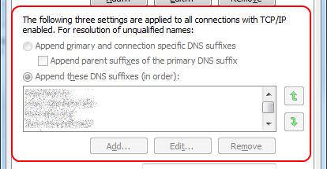
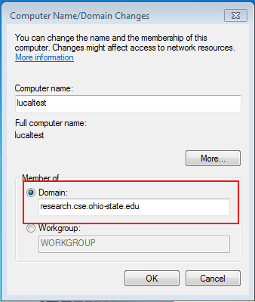
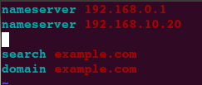
Device-side causes
Finding: Under common OS settings, devices mistakenly issue queries into public DNS
Set device domain name
Set domain search list

Slide 20
Attack surface quantification
HVD = high persistence + high volume
Persistence: Leaked in every p-day period for at least n days
  E.g., p = 1, n = 365: Leaked every day for 1 year
Next, find high query volume domain set
  Systematically explore different p and n until local maximum is reached
Evaluation: effective in finding HVDs in the victim ASes

Slide 21
Attack surface characterization
Finding: A large portion of the attack surface domains are victim AS specific
  For top 10 leak ASes: out of ~9000 HVDs in total, only 90 in common
  Pick 3 top leak ASes to compare pair-wisely
HVDs
~80% HVDs in A indeed has nearly no queries in the other AS
A
HVDs
for
A_{x}
for
A_{y}

Slide 22
Registration status characterization
Once registered, can start exploits at any time
Data: Zone file & Whois data as of 09/26/2015
HVD registration ratio: 7-13% overall
  Still in the early stage
Trend estimation: 60% TLDs’ attack surface are likely to be fully registered in 2 years
  Attack window is opening quickly
Now is a good time for proactive mitigation!

Slide 23
Remediation strategy discussion
1.New gTLD
registry level
TLD
Scrutinize HVD registration:
- Deploy #: ~900
New gTLDs
2. Victim AS level
Filter leaked WPAD queries:
- Use customized list
- Deploy #: ~11000
WPAD query leakage
3. End user level
AS with WPAD query leakage
Stop OS domain hard-coding:
- Deploy #:
> 6 million
wpad.company.itld

Slide 24
Summary
Performed a systematic study of WPAD name collision attack in the new gTLD era
Quantified the problem severity, uncovered the likely problem cause
Proposed a candidate attack surface definition, and quantified the vulnerability status in the wild
  Illustrated real threat, provided a strong and urgent message to deploy proactive protection
Discussed remediation strategies with empirical data analysis
  US-CERT Alert (TA16-144A):
  WPAD Name Collision Vulnerability

Slide 25
Questions?
  US-CERT Alert (TA16-144A):
  WPAD Name Collision Vulnerability

