Slide 1


QoE Doctor: Diagnosing Mobile App QoE with
Automated UI Control & Cross-layer Analysis
Qi Alfred Chen, Haokun Luo, Sanae Rosen, Z. Morley Mao,
Karthik Iyer†, Jie Hui†, Kranthi Sontineni†, Kevin Lau†
University of Michigan, †T-Mobile USA Inc.
*The views presented in this talk are as individuals and do not necessarily reflect any position of T-Mobile.

Slide 2

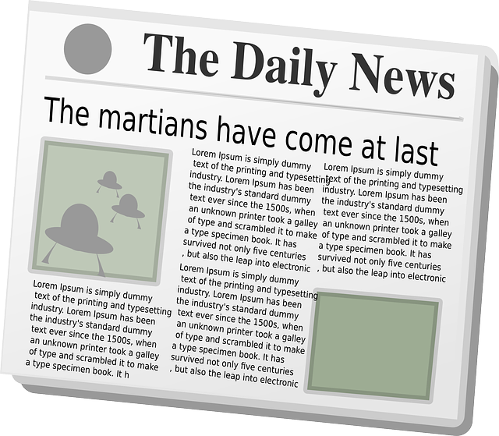
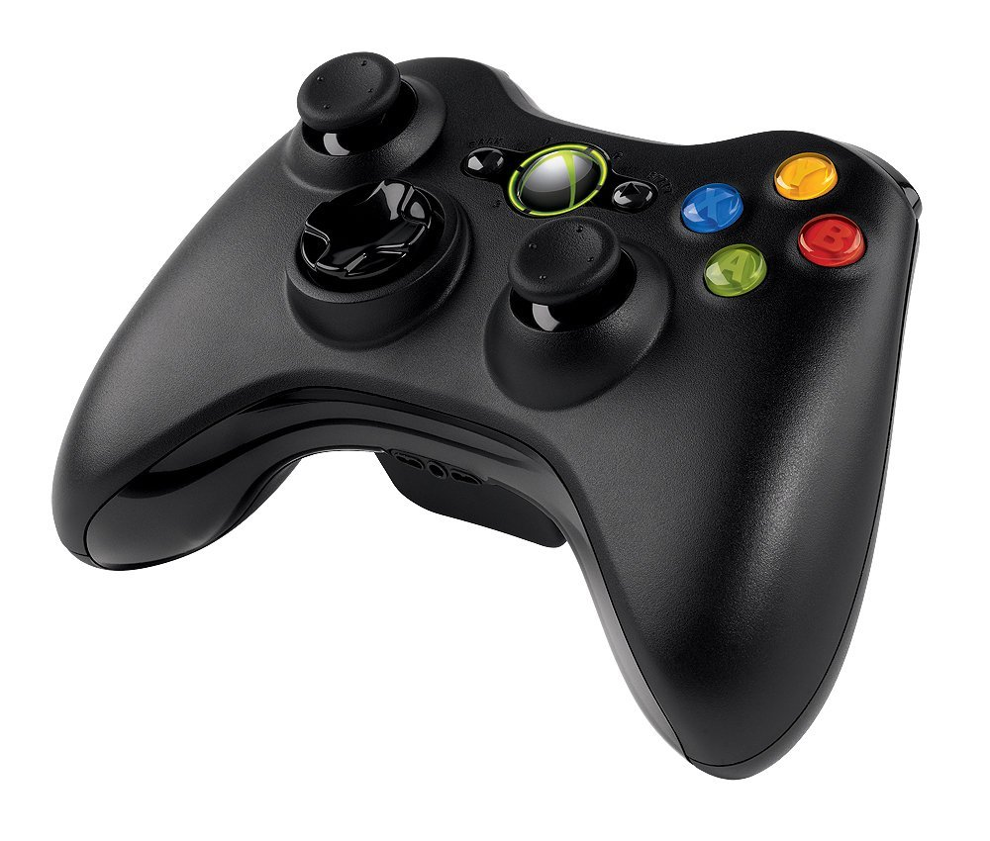





Mobile app QoE
Mobile apps are increasingly important for our daily lives

Slide 3

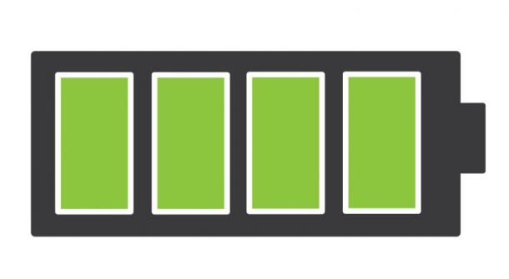
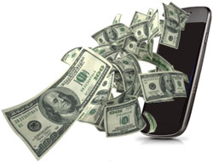
Mobile app QoE
Mobile apps are increasingly important for our daily lives
Faster response
Quality of
Experience (QoE)
Expect
Less energy
Less mobile data

Slide 4


Challenges in studying QoE
Measurement methodology
  Relying on user study
    Costly, hard to control behavior variations
  Instrumenting the source code or binary
    Hard to automate testing
    Not applicable to popular apps like Facebook
Result analysis
  Complicated by multi-layer dynamics & inter-dependencies in system & network stacks

Slide 5




Our solution: QoE Doctor
Support more accurate, systematic, and repeatable QoE measurements & analysis
Introduce UI automation into QoE measurement
  Automatically replay user behavior
  Accurately measure UI layer QoE metrics
  No need to modify app source code or the system

Slide 6
Our solution: QoE Doctor
Result analysis
  Support multi-layer diagnosis of QoE problems
    Collect data across application, transport, network, and cellular radio link layers
    Enable cross-layer analysis

Slide 7
Related work
Test automation
Popular apps
Cross-layer analysis
QoE
Monkey, PUMA, AMC, etc.
✗
✓
✓
✗
Joumblatt, et al. Infocom’13, etc.
✓
✗
✓
✗
AppInsight, Timecard, SIF, etc.
✓
✓
✗
✗
Prometheus
✓
✓
✗
✗
QoE Doctor
✓
✓
✓
✓

Slide 8

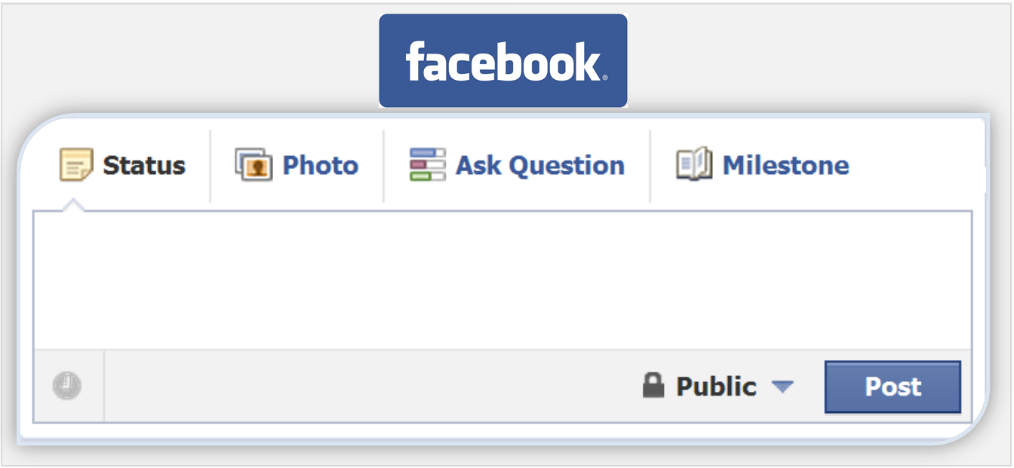
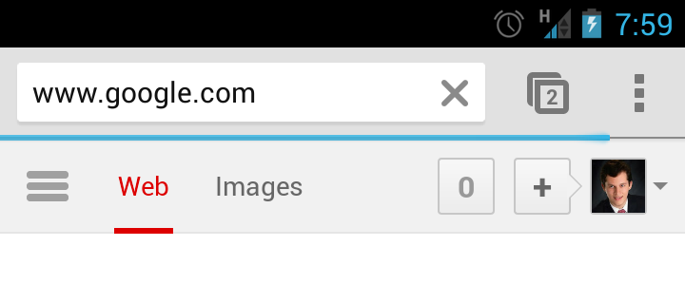
QoE metrics in focus
In this work, we focus on measuring
  User-perceived latency
  Mobile data consumption
  Mobile energy consumption
    Network energy

Slide 9
Design overview
QoE-aware UI controller
Multi-layer QoE analyzer
UI
controller
QoE-related UI logger
Application layer
analyzer
Cross-layer
analyzer
App-specific QoE-related
behavior
control
Network logger
Transport/network layer analyzer
Cross-layer
analyzer
RRC/RLC logger
RRC/RLC layer
analyzer

Slide 10
Design overview
QoE-aware UI controller
Multi-layer QoE analyzer
UI
controller
QoE-related UI logger
UI
controller
Application layer
analyzer
Cross-layer
analyzer
App-specific QoE-related
behavior
control
Network logger
Transport/network layer analyzer
Cross-layer
analyzer
RRC/RLC logger
RRC/RLC layer
analyzer

Slide 11
UI controller
Use Android built-in UI testing APIs
  Send UI events to the app
  Designed for developer self-testing
    Can be used to test any apps after re-signing the apk
  Powerful in QoE study
    Share app data, can directly access UI tree in real time
      Important for user-perceived latency measurement
  We are the first to use this UI automation technique for mobile app QoE measurement

Slide 12






UI controller
A unique feature due to user-perceived latency measurement:
Wait until the right UI events instead of using a heuristic timer
UI control paradigm:
See
Inter-act
Wait
latency

Slide 13
Design overview
QoE-aware UI controller
Multi-layer QoE analyzer
UI
controller
QoE-related UI logger
UI
controller
Application layer
analyzer
Cross-layer
analyzer
App-specific QoE-related
behavior
control
App-specific QoE-related
behavior
control
Network logger
Transport/network layer analyzer
Cross-layer
analyzer
RRC/RLC logger
RRC/RLC layer
analyzer

Slide 14
User behavior replay
Replay using UI control:
  Facebook:
    Post status/check-in/photos
    Pull-to-update
  YouTube:
    Watch videos
  Web browsers
  (Chrome, Firefox, …)
    Load web pages
Measure
Upload latency
Update latency
Initial loading time
Rebuffering ratio
Page loading time

Slide 15
Design overview
QoE-aware UI controller
Multi-layer QoE analyzer
UI
controller
QoE-related UI logger
QoE-related UI logger
Application layer
analyzer
Application layer
analyzer
User-perceived latency
Wait
Cross-layer
analyzer
App-specific QoE-related
behavior
control
Network logger
Transport/network layer analyzer
App-specific QoE-related
behavior
control
Network logger
Transport/network layer analyzer
Mobile data consumption
TCPDUMP
Cross-layer
analyzer
RRC/RLC logger
RRC/RLC layer
analyzer
RRC/RLC logger
RRC/RLC layer
analyzer
QxDM
Mobile energy consumption

Slide 16
Design overview
QoE-aware UI controller
Help diagnose root cause of QoE problems
Multi-layer QoE analyzer
UI
controller
QoE-related UI logger
Application layer
analyzer
Cross-layer
analyzer
Cross-layer
analyzer
App-specific QoE-related
behavior
control
Network logger
Network logger
Transport/network layer analyzer
Cross-layer
analyzer
Cross-layer
analyzer
RRC/RLC logger
RRC/RLC layer
analyzer

Slide 17
Cross-layer analyzer
User-perceived latency
Application
layer
Transport layer
TCP flow
Network layer
IP packet
IP packet
…
IP packet
Cellular radio
link layer
PDU
PDU
PDU
PDU
PDU
…
PDU
PDU

Slide 18
Experiments: study app QoE
Quantify factors that may impact QoE of popular apps
Various factors we studied:
  Network type and quality
  Design & configuration in apps
  Design & implementation on carrier side

Slide 19
YouTube: carrier throttling impact
A carrier policy: traffic throttled after exceeding the data limit
  How much does it affect QoE?
Compare throttled vs. unthrottled for YouTube videos
  Throttle to ~120 kbps in 3G & LTE by the carrier
  100 random YouTube videos (total length ~ 35 hrs)
    Diverse in both the video length (1 min to 0.5 hr) and video popularity (1000 – 10 billion views)

Slide 20
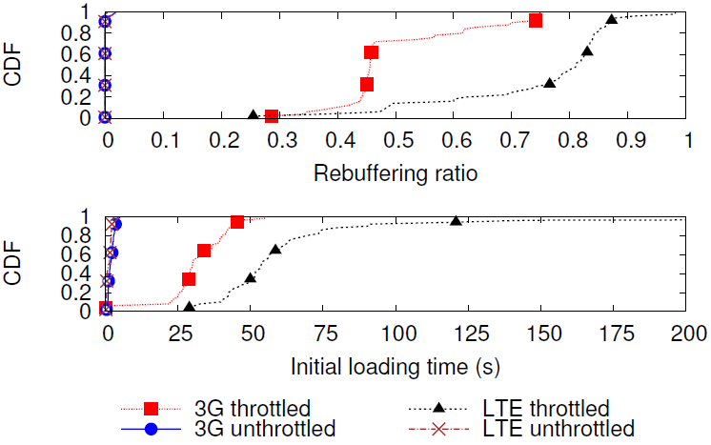
YouTube: carrier throttling impact
Throttling causes > 30 sec (15×) more initial loading time and increases the rebuffering ratio from ~ 0% to 50% on average.

Slide 21
YouTube: carrier throttling impact
Better initial loading time and rebuffering ratio in 3G than in LTE under throttling. Why?

Slide 22
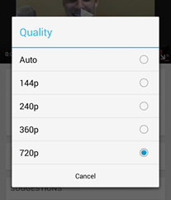
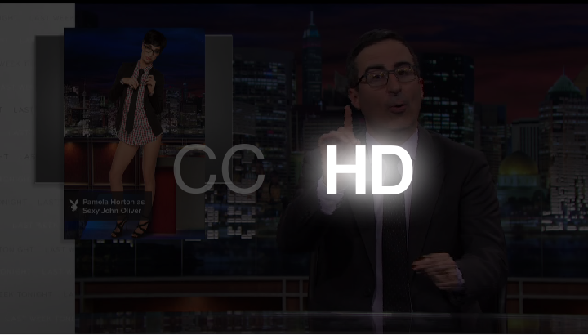
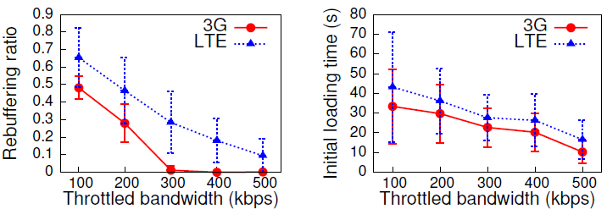
YouTube: carrier throttling impact
QoE-aware UI controller
Multi-layer QoE analyzer
Locally control bandwidth
  repeat the bandwidth limits of 100, 200, 300, 400, and 500 kbps
UI
controller
QoE-related UI logger
Application layer
analyzer
Application layer
analyzer
From cross-layer analyzer, in LTE around 96.6% (40 MB) more data is downloaded than in 3G for ~90 s videos!
Default video resolution is HQ for 3G and HD for LTE
Should not adapt video quality simply based on network type!
Cross-layer
analyzer
Cross-layer
analyzer
Transport/network layer analyzer
App-specific QoE-related
behavior
control
Network logger
Transport/network layer analyzer
Fixed!
Cross-layer
analyzer
RRC/RLC logger
RRC/RLC layer
analyzer

Slide 23
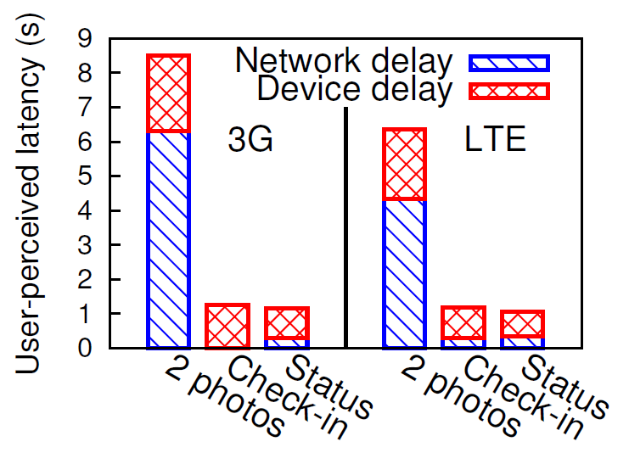
Facebook: post upload time breakdown
Measure device and network latency when posting a status, a check-in, and 2 photos
Sometimes no network latency, why?
[Finding]: network
delay not always
on the critical path!

Slide 24
Facebook: post upload time breakdown
QoE-aware UI controller
Multi-layer QoE analyzer
Measure device and network latency when posting a status, a check-in, and 2 photos
UI
controller
QoE-related UI logger
Application layer
analyzer
Big difference in network latency between 3G and LTE, why?
Cross-layer
analyzer
Transport/network layer analyzer
App-specific QoE-related
behavior
control
Network logger
Transport/network layer analyzer
Cross-layer
analyzer
Cross-layer
analyzer
Let’s further
breakdown !
RRC/RLC logger
RRC/RLC layer
analyzer
RRC/RLC layer
analyzer

Slide 25
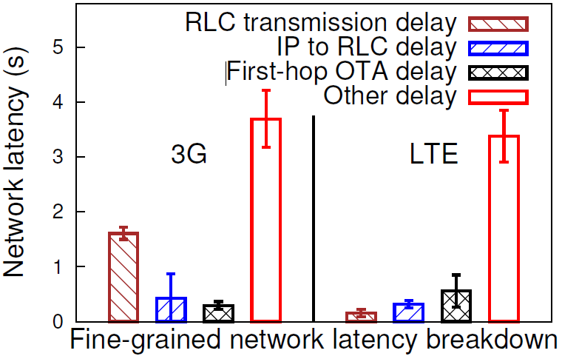
Facebook: post upload time breakdown
Measure device and network latency when posting a status, a check-in, and 2 photos
[Finding]: Much
longer transmission
delay in 3G,
likely caused by
smaller transmitting
segments in 3G.

Slide 26
Other results
App design & configuration impact
  Changing one Facebook default configuration can reduce ≥ 20% of data & energy consumption
  Compared to WebView, ListView version Facebook reduces ≥ 67% device latency, ≥ 30% network latency, ≥ 77% downlink data consumption
  YouTube ads reduce the initial loading time of the main video, but doubling the total loading on cellular networks.
Carrier side design
  Simplifying the 3G RRC state machine can reduce web page loading time by 22% for web browsing

Slide 27
Summary
QoE Doctor for systematic mobile app QoE measurement
  Automated replay of QoE-related user behavior
  Accurate measurement of QoE metric at UI layer
  Multi-layer diagnosis of QoE problems
  Applicable to popular apps
Systematically quantify various factors that impact QoE of popular apps

Slide 28
Questions?

