Slide 1


Exposing Congestion Attack on Emerging Connected Vehicle based Traffic Signal Control
Qi Alfred Chen, Yucheng Yin, Yiheng Feng, Z. Morley Mao, Henry X. Liu
University of Michigan

Slide 2


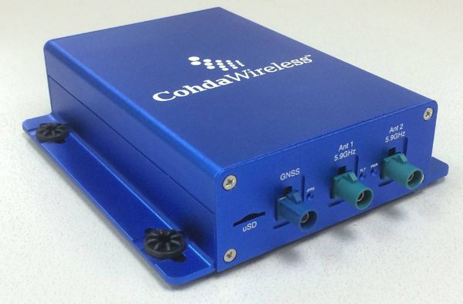



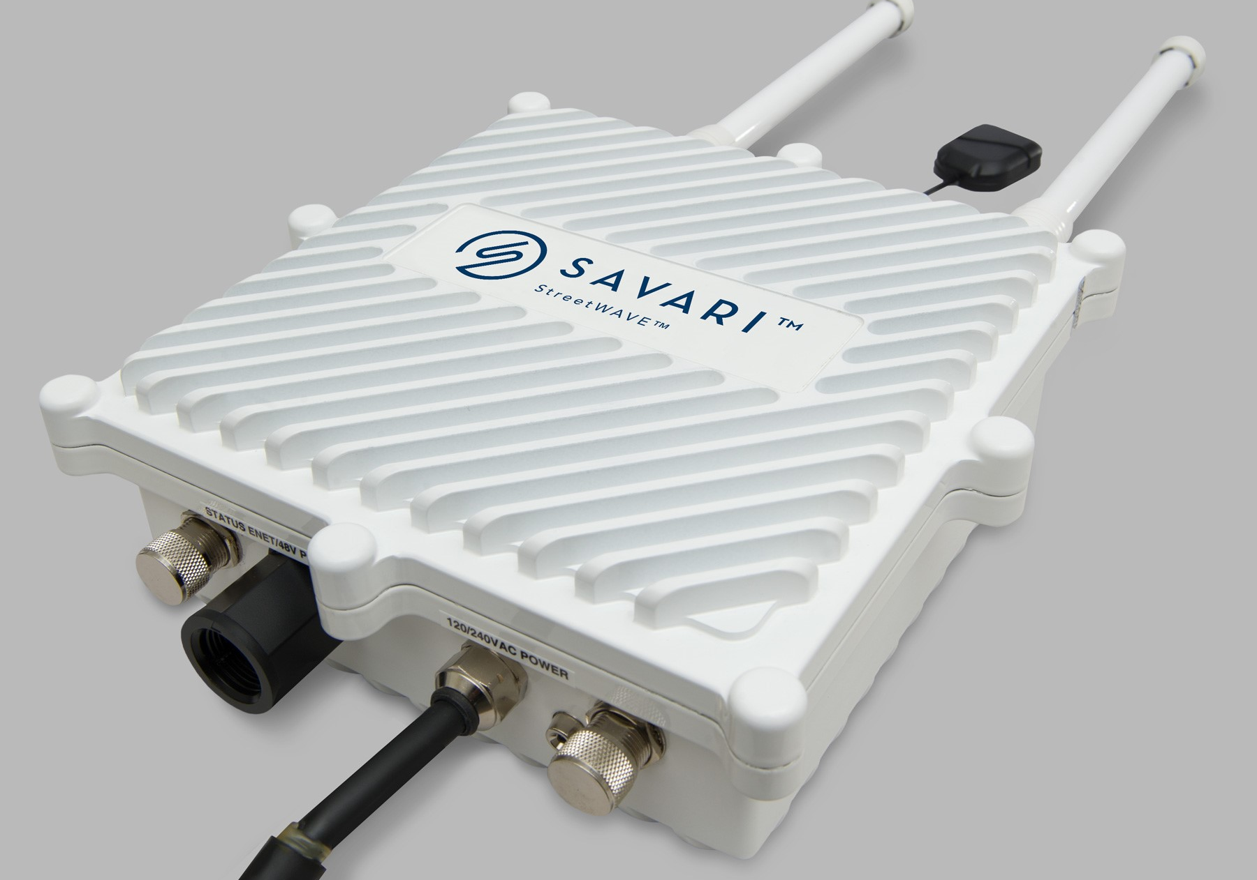

Background: Connected Vehicle technology
Wirelessly connect vehicles & infrastructure
Goal: Dramatically improve mobility, safety, environmental impact, & public agency operations
CV technology
Mobility
Safety
OBU
RSU
Environmental
impact
Public agency operations
CV = Connected Vehicle OBU = On-Board Unit RSU = Road-Side Unit

Slide 3



Background: Recent advances
Will soon transform transportation systems today
2016.9, USDOT launched CV Pilot Program
  National effort to deploy, test, & operationalize CV-based transportation systems
  Launched in 3 sites
CV = Connected Vehicle USDOT = United States Department of Transportation

Slide 4
Cybersecurity of CV-based transportation
However, such dramatically increased connectivity also opens a new door for cyber attacks
Highly important to understand potential security vulnerabilities & new security challenges
  Need to ensure security & safety for vehicles, transportation infrastructure, drivers & pedestrians
  Need to perform study now so that they can be proactively addressed before nationwide deployment

Slide 5

First security analysis of CV-based transp.
Target: Intelligent Traffic Signal System (I-SIG)
  Use real-time CV data for intelligent signal control
  USDOT sponsored design & impl.
  Fully implemented & tested in Anthem, AZ, & Palo Alto, CA
    26.6% reduction in total vehicle delay
  Under deployment in NYC and Tampa, FL
Real-time CV data
I-SIG
RSU
Control
CV = Connected Vehicle OBU = On-Board Unit RSU = Road-Side Unit

Slide 6

Threat model
Malicious vehicle owners deliberately control the OBU to send spoofed data
  OBU is compromised physically¹, wirelessly², or by malware³
Can only spoof data, e.g., location & speed
  Can’t spoof identity due to USDOT’s vehicle certificate system
Spoofed CV data
Real-time CV data
I-SIG
RSU
Malicious vehicle owner
Influence signal control
Control
¹ Koscher et al.@IEEE S&P’10
² Checkoway et al.@Usenix Security'11
³ Mazloom et al.@Usenix WOOT’16

Slide 7
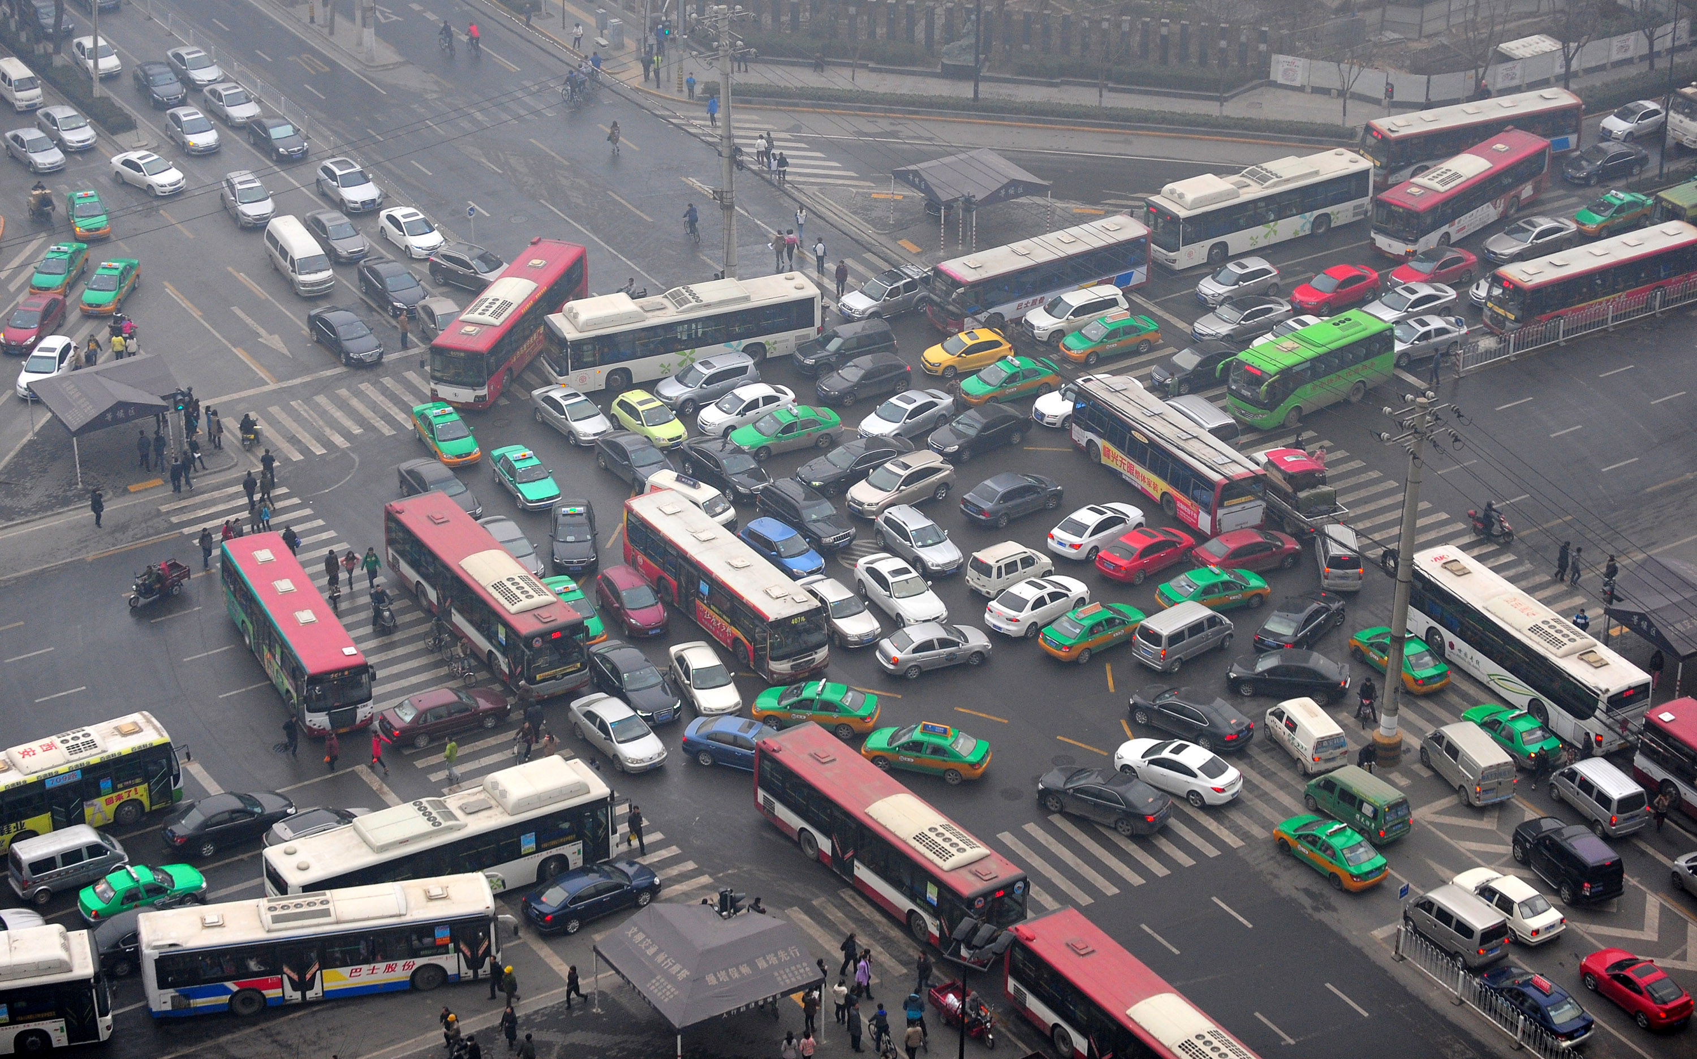
Attack goal
Create traffic congestion
  Increase total delay of vehicles in the intersection
    Directly subvert the design goal of I-SIG
  Damage: City functions & individual (wasted fuel, time)
  Incentive: Politically or financially

Slide 8



Analysis approach overview
Analysis of Attack input data flow
Data spoofing strategies
Source code
Dynamic analysis
Spoofing w/ top delay inc
Spoofing option enum
Increased delay calc
Congestion creation vuln.
Traffic snapshots from simulator
Exploit construction
Real-time attack requirement (e.g., decision time ≤ 4 sec)
Congestion creation exploit

Slide 9
Analysis result summary
Analysis of Attack input data flow
2 strategies
Data spoofing strategies
2 types of vuln.:
#1: Curse of transition period
#2: Last vehicle advantage
Source code
Dynamic analysis
Spoofing w/ top delay inc
Spoofing option enum
Increased delay calc
Congestion creation vuln.
Traffic snapshots from simulator
Exploit construction
Real-time attack requirement (e.g., decision time ≤ 4 sec)
Congestion creation exploit

Slide 10
Vuln #1: Curse of transition period
I-SIG has 2 operation modes based on PR:
  PR ≥ 95%, full deployment: Directly run an optimal signal planning algorithm
  PR < 95%, transition: The optimal algorithm becomes ineffective, use an unequipped vehicle estimation algorithm as pre-step
Yes (full deployment period)
PR ≥ 95%
Optimal signal planning algorithm
No (transition period)
Unequipped vehicle estimation
Vulnerable
PR = Penetration Rate

Slide 11


Vulnerable queue estimation
Find the queue estimation part highly vulnerable
  Data from one single attack vehicle can add a queue with tens of “ghost” vehicles
  Cause delay increased by 20-50%, sometimes even > 70%
Spoof the vehicle location!
Est. queue length = 3
Est. queue length = 7

Slide 12
An urgent & fundamental problem
An urgent problem for the current design
  Transition period is unavoidable, and long (25-30 yrs est. by USDOT)
  First thing needs to be resolved for its deployment in practice
Fundament cause: Lack a sufficiently robust signal control algorithm for the transition period
  Low PR is inherently more sensitive to data spoofing
    Fundamentally more challenging to ensure robustness
  Need joint research effort in both transportation & security communities
USDOT = United States Department of Transportation PR = Penetration Rate

Slide 13
Full deployment period is secure?
Yes (full deployment period)
Vulnerable
PR ≥ 95%
Optimal signal planning algorithm
No (transition period)
Unequipped vehicle estimation
Vulnerable
PR = Penetration Rate

Slide 14


Vuln #2: Last vehicle advantage
Vulnerability: Latest arriving vehicle determines signal plan
Attack: Spoof to arrive as late as possible to increase the delay of queuing vehicles in other directions
Fundamental cause: Security vs deployability trade-off
  Limited decision time forces choice of a sub-optimal config.
  Such sub-optimal config unexpectedly exposes such vuln.
Spoof to arrive as late as possible!
Delay++
Green light length
Green light length
Green light length
Green light length
More optimal

Slide 15
Attack video demo
Demo time!

Slide 16
Defense discussion
Robust algorithm design for the transition period
  Inherently challenging, need joint research efforts in both transportation & security communities
Speed-up control algorithm to avoid sub-optimal config.
  E.g., offload computation to a nearby workstation or cloud
Data spoofing detection using infrastructure-controlled sensors, e.g., camera
  Cross check validity of driving data from OBUs
CV = Connected Vehicle OBU = On-Board Unit RSU = Road-Side Unit

Slide 17
Conclusion
The first security analysis of a CV based transportation system, I-SIG
  Discover new vulnerability & analyze causes
    Current control algorithm design & config. are highly vulnerable
  Construct & evaluate exploits to show the severity in practice
  Propose defense directions based on the analysis insights
Hope to inspire follow-up studies
  E.g., other attack goals, other types of CV systems (60+ open sourced), defense solutions
Reported to USDOT CV Pilot Program office & sites (NYC and Tampa)
  https://tinyurl.com/congestion-attack
CV = Connected Vehicle USDOT = United States Department of Transportation

Slide 18
Questions?

