Slide 1


WCNC 2014
Efficient Route Guidance in Vehicular Wireless
Networks
Yu Stephanie Sun¹, Lei Xie¹, Qi Alfred Chen², Sanglu Lu¹, Daoxu Chen¹
¹State Key Laboratory for Novel Software Technology, Nanjing University, China
²University of Michigan, USA

Slide 2
Outline
1
Background and Motivation
2
Problem Formulation
3
Our Solutions
4
Performance Evaluation
5
Conclusion
1

Slide 3


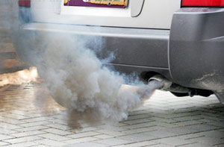
Background and Motivation
Traffic congestions can cause serious problems
Fuel consumption
Air pollution
Economic problems
(over $100 billion in 2012)
Effective route guidance system is needed
  However, traditional GPS routing only tries to find the shortest path instead of the fastest path we want
    Unaware of the real-time congestion situations
    All vehicles with the same destination are guided to the same route
Notes:
Economic problem details: From Urban mobility report [1], the cost from traffic congestion now is more than $100 billion, nearly $750 for every commuter in the U.S.

Slide 4
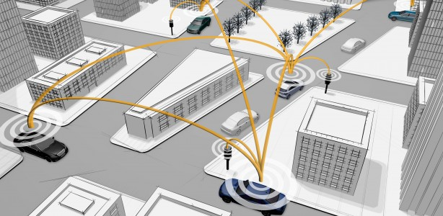
Background and Motivation
With vehicular wireless network, we have new opportunities
  Wide-deployed road-side access points (AP) can provide wireless access to users in moving vehicles and support data sharing
Our goal: leverage dynamic traffic information sharing among vehicles to design better route guidance algorithms for mitigating the congestion problems and reducing the travel time of drivers

Slide 5
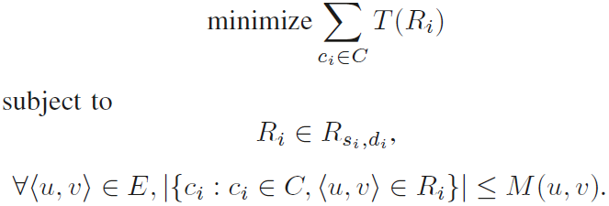
Problem Formulation
Area map G<V, E>, V is the intersections, E is the roads
C is the set of vehicles requesting route guidance
s, d are source and destinations of the routing request
M(u,v) is the maximum number of vehicles available on <u,v> ∈ E
R is the route, which is in the form of <v₀, v₁, …, v_{k}>
T (·) is the time duration of a route
Thus, we have the route guidance problem objective:
In the other word, the problem is to assign routes to all routing requests in the way that the overall travel time is minimal while the assigned routes are valid and the traffic volume on each road is not too much

Slide 6
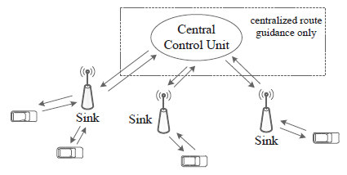
Our Solutions
System Architecture
  Components: sinks, vehicle-side sensors and a central control unit
  Two types of route guidance under this architecture:
    Centralized routing:
      Central control unit collects traffic information globally
      Needs abundant storage and computing resources
    Distributed routing:
      Local minimum solution due to limited information
      Much smaller overhead in storage and computing, and thus more deployable
Notes:
Sinks: Sinks are usually APs in vehicular network, and as discussed in [2],these sinks keep communicating with sensors in the vehicles such as GPS, cameras, mobile phones, etc.
Central control unit: The central control unit will exchange data with sinks, but it will only be used in centralized routing

Slide 7
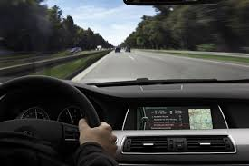
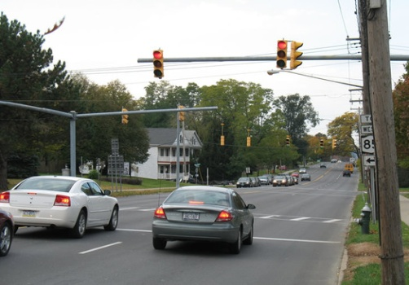
Our Solutions
Analysis
  Consider a vehicle travels on road <u, v> and will turn to road <v,w>:
The travel time
T(<u,v,w>)
=
+
driving time D(u, v)
waiting time W(u, v, w)
    Driving time: just the distance divides the max speed
    Waiting time: mainly the time for waiting red lights
      With the red light time, we need to estimate the number of red lights the vehicle is expected to wait
      Number of red lights to wait = (the traffic volume ahead) / (the traffic volume one green light can release)

Slide 8
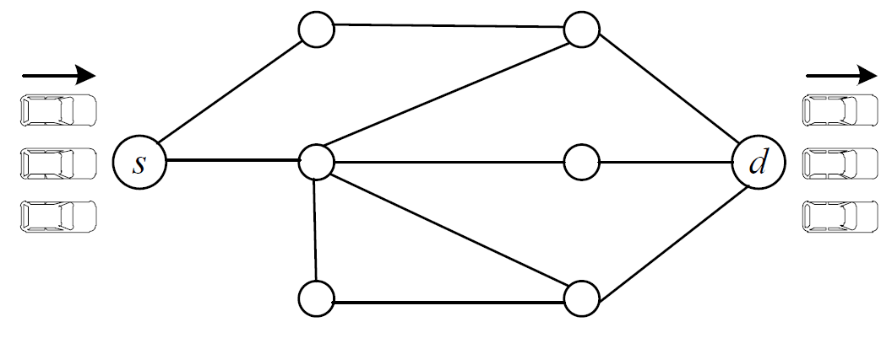
Our Solutions
Baseline Routing Algorithm
  For comparison, we need a baseline algorithm similar to routing without any route guidance
  A simple solution is to randomly selecting routes from s to d uniformly
    Not reasonable: should be closer to the shortest path
  Thus, we propose an improved random routing algorithm (IRR):
    1st path: choose the shortest path from s to d
    From the 2nd path, randomly delete an edge in the previous path, then find the shortest path again as a new path
      mimic the imperfection of human beings
  Combines the proximity to the shortest path and imperfection of human beings: random routing decisions made by some local taxi drivers
2
2
×
3
×
1
1
3
Notes:
To evaluate the route guidance systems, it is essential to construct a baseline routing algorithm whose ability is similar to the routing without any guidance.
Not reasonable: by using experiences or maps, the majority of drivers’ routing decisions without any guidance are more likely to be around the shortest path

Slide 9
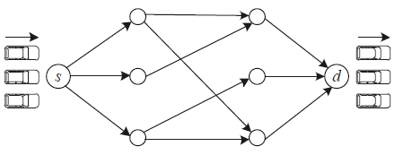
Our Solutions
Centralized Solution
  Target at extremely heavy traffic situation, e.g. rush hour
  Goal:
    Maximize: the number of vehicles that can reach the destination
    Minimize: the total time duration from source to destination
  The routing problems can be viewed as follows:
  Thus, centralized route guidance problem with single source and single destination can be solved as a minimum-cost maximum-flow problem
    Flow --- the traffic volume on the road
    Capacity --- maximum number of vehicles available on the road
    Cost ---the travel time T (·)
  We name this routing algorithm Minimum-Cost Maximum-Flow based Routing (MCMF-R)
Notes:
Motivation for centralized solution: When the traffic is not heavy, simply using classical guidance techniques such as GPS can handle all routing requests without any congestion. So the centralized route guidance in this paper focuses on the situation when the traffic is very heavy, where large number of vehicles needs to travel on the main roads and severe traffic jams are likely
to take place.

Slide 10
Our Solutions
Centralized Solution
  Routing results: from the minimum-cost maximum-flow problem solution , we extract travel paths one by one until there is no positive flow on any edges
  Multi-source multi-destination routing:
    First group routing request to groups with same source and destination pair
    Apply the above solution for single source and single destination group by group
    If groups are too small, merge sources and destinations near each other in location to be more efficient
  Analysis:
    Optimal solution
    Efficient routing: route a flow at a time
    Fairness consideration: the majority of vehicles have the priority
      First considering groups with bigger size in multi-source multi-destination routing

Slide 11
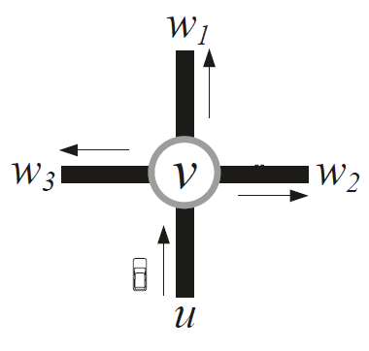
Our Solutions
Distributed Solution
  Target at situation when computation resources are too limited to support centralized solution
    Can only obtain the dynamic traffic information in adjacent roads collected in one AP
  Observation: the ineffectiveness of tradition routing is the lack of dynamic traffic information in shortest path calculation
    Our solution: take local dynamic traffic information into routing
  Traffic splitting: In each intersection, our task is to split the traffic to a road adjacent to the intersection
    Intersection v has p adjacent roads,
    <v, w_{j}>, j=1…p
    For vehicle on <u,v>, we need to assign a next stop in our routing, which is one of <v, w_{j}>, j=1…p, w_{j} ≠u

Slide 12
Our Solutions
Distributed Solution
  We can calculate T (u, v, w_{i}, . . . , d) using
    Drive time: D(u, v)
    Waiting time: T (u, v, w_{i} )
    Travel time after w_{i} : T (w_{i}, . . . , d)
      Use shortest path algorithm to estimate this term
  For the vehicle on <u,v>, we route it to w_{i} if T (u, v, w_{i}, . . . , d) = min{T (u, v, w_{j}, . . . , d)}, j=1…p, w_{j} ≠u
  Thus, our traffic splitting strategy is:
    Step 1: calculate T (u, v, w_{j}, . . . , d)}, j=1…p, w_{j} ≠u
    Step 2: choose the w_{j} which has the minimum T (u, v, w_{j}, . . . , d)}, route C vehicles to <v, w_{j} > as the next stop,
      C is the maximum vehicle number which can be added to <v, w_{j} > without increase T (u, v, w_{i} )
    Step 3: go to Step 1
  We name it Traffic Splitting Algorithm (TS)

Slide 13
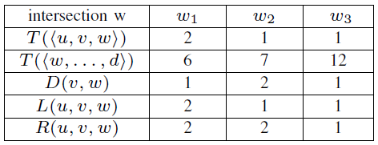
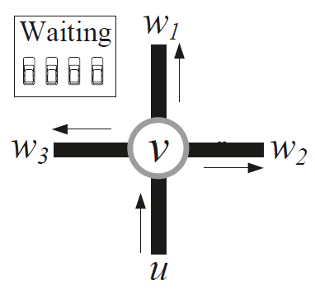
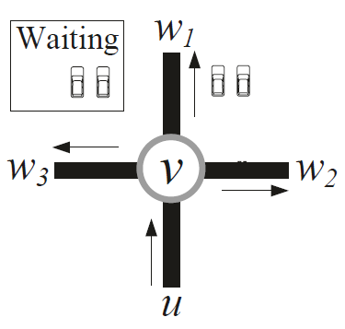
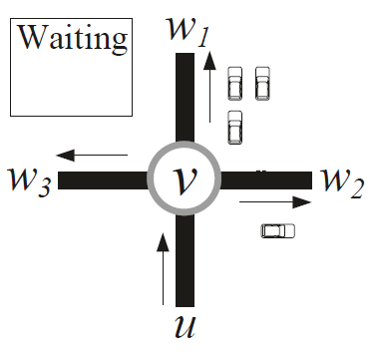
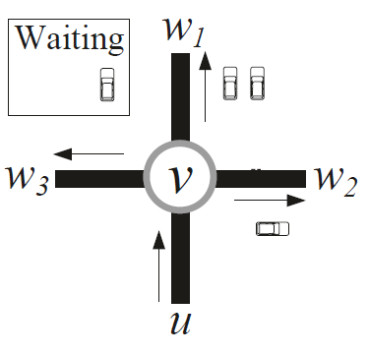
Our Solutions
Distributed Solution
  An example: 4 vehicles travelling on road <u, v> and requesting routing to common destination d,
Can allocate 1 vehicles
Can allocate 2 vehicles
Can allocate 2 vehicles, but we only have 1 left
T (u, v, w_{i}, . . . , d), j=1,2,3:
j=1: T (u, v, w₁, . . . , d)=9
j=2: T (u, v, w₂, . . . , d)=10
j=3: T (u, v, w₃, . . . , d)=14
+2=11
MIN
+2=12
MIN

Slide 14
Our Solutions
Distributed Solution
  Computation complexity: O(pn² + pn), p is the number of v’s adjacent roads, n is the number of intersections
  Communication overhead: only 2 message exchanges between vehicles and AP, thus a linear function of the vehicle number
  Analysis:
    Sub-optimal solution: may have wrong estimation in travel time after w_{i} , which is limited by the local information assumption
    Fairness consideration: in the algorithm choose vehicles in the order of some fairness metric such as distance to destination, urgent level of the request, etc.

Slide 15
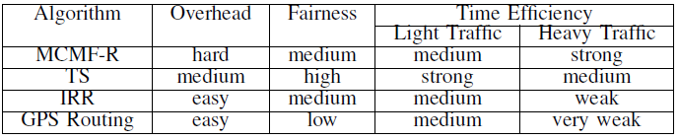
Our Solutions
Comparison between our centralized routing MCMF-R , distributed routing TS, random routing IRR and the traditional GPS routing
Hybrid Route Guidance Framework
  MCMF-R has high time efficiency for heavy traffic
  TS has low overhead and better fairness
  A hybrid framework combining them based on traffic pattern:
    In normal period, use TS
      Can serve most of the routing requests with high efficiency and low overhead
    When the system detects rush hour pattern, switched to MCMF-R
  Thus balances routing overhead and time efficiency, providing both better deployment and routing decisions than IRR and traditional GPS under different traffic intensity situations.
Notes:
Comparison: For the time efficiency of the two solutions proposed in this paper, MCMF-R is closer to the optimal solution, but imperfect measurement of travel time makes it underestimate or overestimate the current congestion situation to some extent. TS becomes much worse than MCMF-R when heavy traffic take place. But since it’s greedy, it is better than MCMF-R in light traffic condition, where the latter overestimates the congestion. In fairness, TS is better since MCMF-R considers more global optimization,
which needs some vehicles to sacrifice. MCMF-R needs global dynamic traffic information and central control, so it has bigger communication overhead compared to other algorithms.

Slide 16
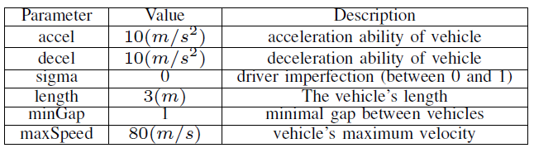
Evaluation
Implement MCMF-R and TS in C++
Evaluate with the realistic traffic generator Simulation of Urban MObility (SUMO)
Evaluation metrics:
  Time Efficiency: using the average travel time of the vehicles
  Fairness: using the standard deviation of the travel time of the vehicles
Simulation parameters:
  Construct the road network based on the map of Nanjing city, China
  Routing request: randomly generate 200 source and destination pairs, and then assign random vehicle volumes to them.
  Background traffic: we use repeated vehicles in SUMO with repeat period 2

Slide 17
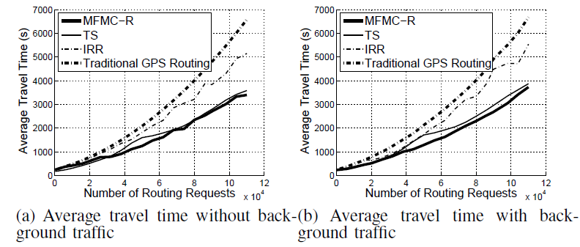
Evaluation
Simulation result -- Time efficiency:
  MCMF-R and TS are at least 20% better than IRR and traditional GPS routing, especially when the traffic is heavy.
    For traditional GPS routing, improvement ≥ 40% on average
Close to each other when there is no background traffic
With background traffic MCMF-R is better --- more time efficient under heavy traffic conditions
Notes:
shows the average travel time for different routing request volumes with no background traffic flows on roads. In (b), heavy background traffic is added on some most commonly chosen roads when no background traffic exists

Slide 18
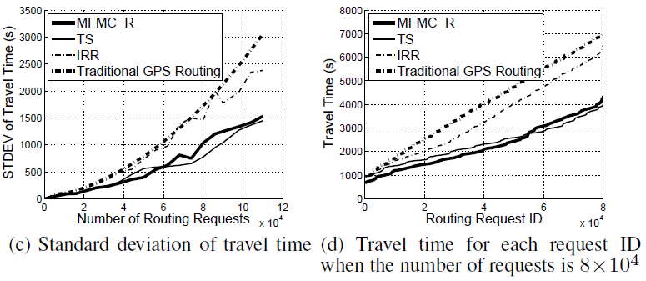
Evaluation
Simulation result -- Fairness:
  MCMF-R and TS are at least 50% better than IRR and traditional GPS routing when the vehicle volume approaches 8×10⁴ to 10×10⁴
Comparable to each other when the traffic volume ≤ 4×10⁴
When the traffic volume ≥ 6×10⁴, TS surpasses MCMF-R and strictly dominates it --- in MCMF-R more vehicles sacrifice for global optimization
Notes:
(c) shows the standard deviation of the travel time for different routing request volumes, and (a) shows the sorted travel time for each route request when the routing request volume is 8 × 10^4

Slide 19
Conclusion
We propose two efficient algorithms for route guidance problem in vehicular network:
  MCMF-R for centralized routing
  TS for distributed routing
Evaluation results show that both algorithms have better time efficiency and fairness than traditional methods.
Between MCMF-R and TS, TS is more deployable, and more suitable in low traffic volume routing than MCMF-R, and when the traffic is heavy, MCMFR is better in time efficiency but worse in fairness.
A hybrid framework is then proposed to provide better deployment and routing decisions under different traffic intensity situations

Slide 20
WCNC 2014
Questions ?
Thank you !

